Slide 1
Better defining exhausted TIGIT⁺KLRG1⁺ subsets in teplizumab-treated T1D subjects using ATAC-seq: epigenetics & mitochondrial variants
10-17-24 SI meeting
Ty Bottorff – Bioinformatics postdoc
Linsley lab

Slide 2

Acknowledgements
Peter Linsley
Long lab
Josh Centore
Alice Wiedeman
Alice Long
Genomics core
Software team
Bioinformatics group
Stephan Pribitzer
Basilin Benson
ITN
John Ray
Patient donors

Slide 3
Outline

Slide 4
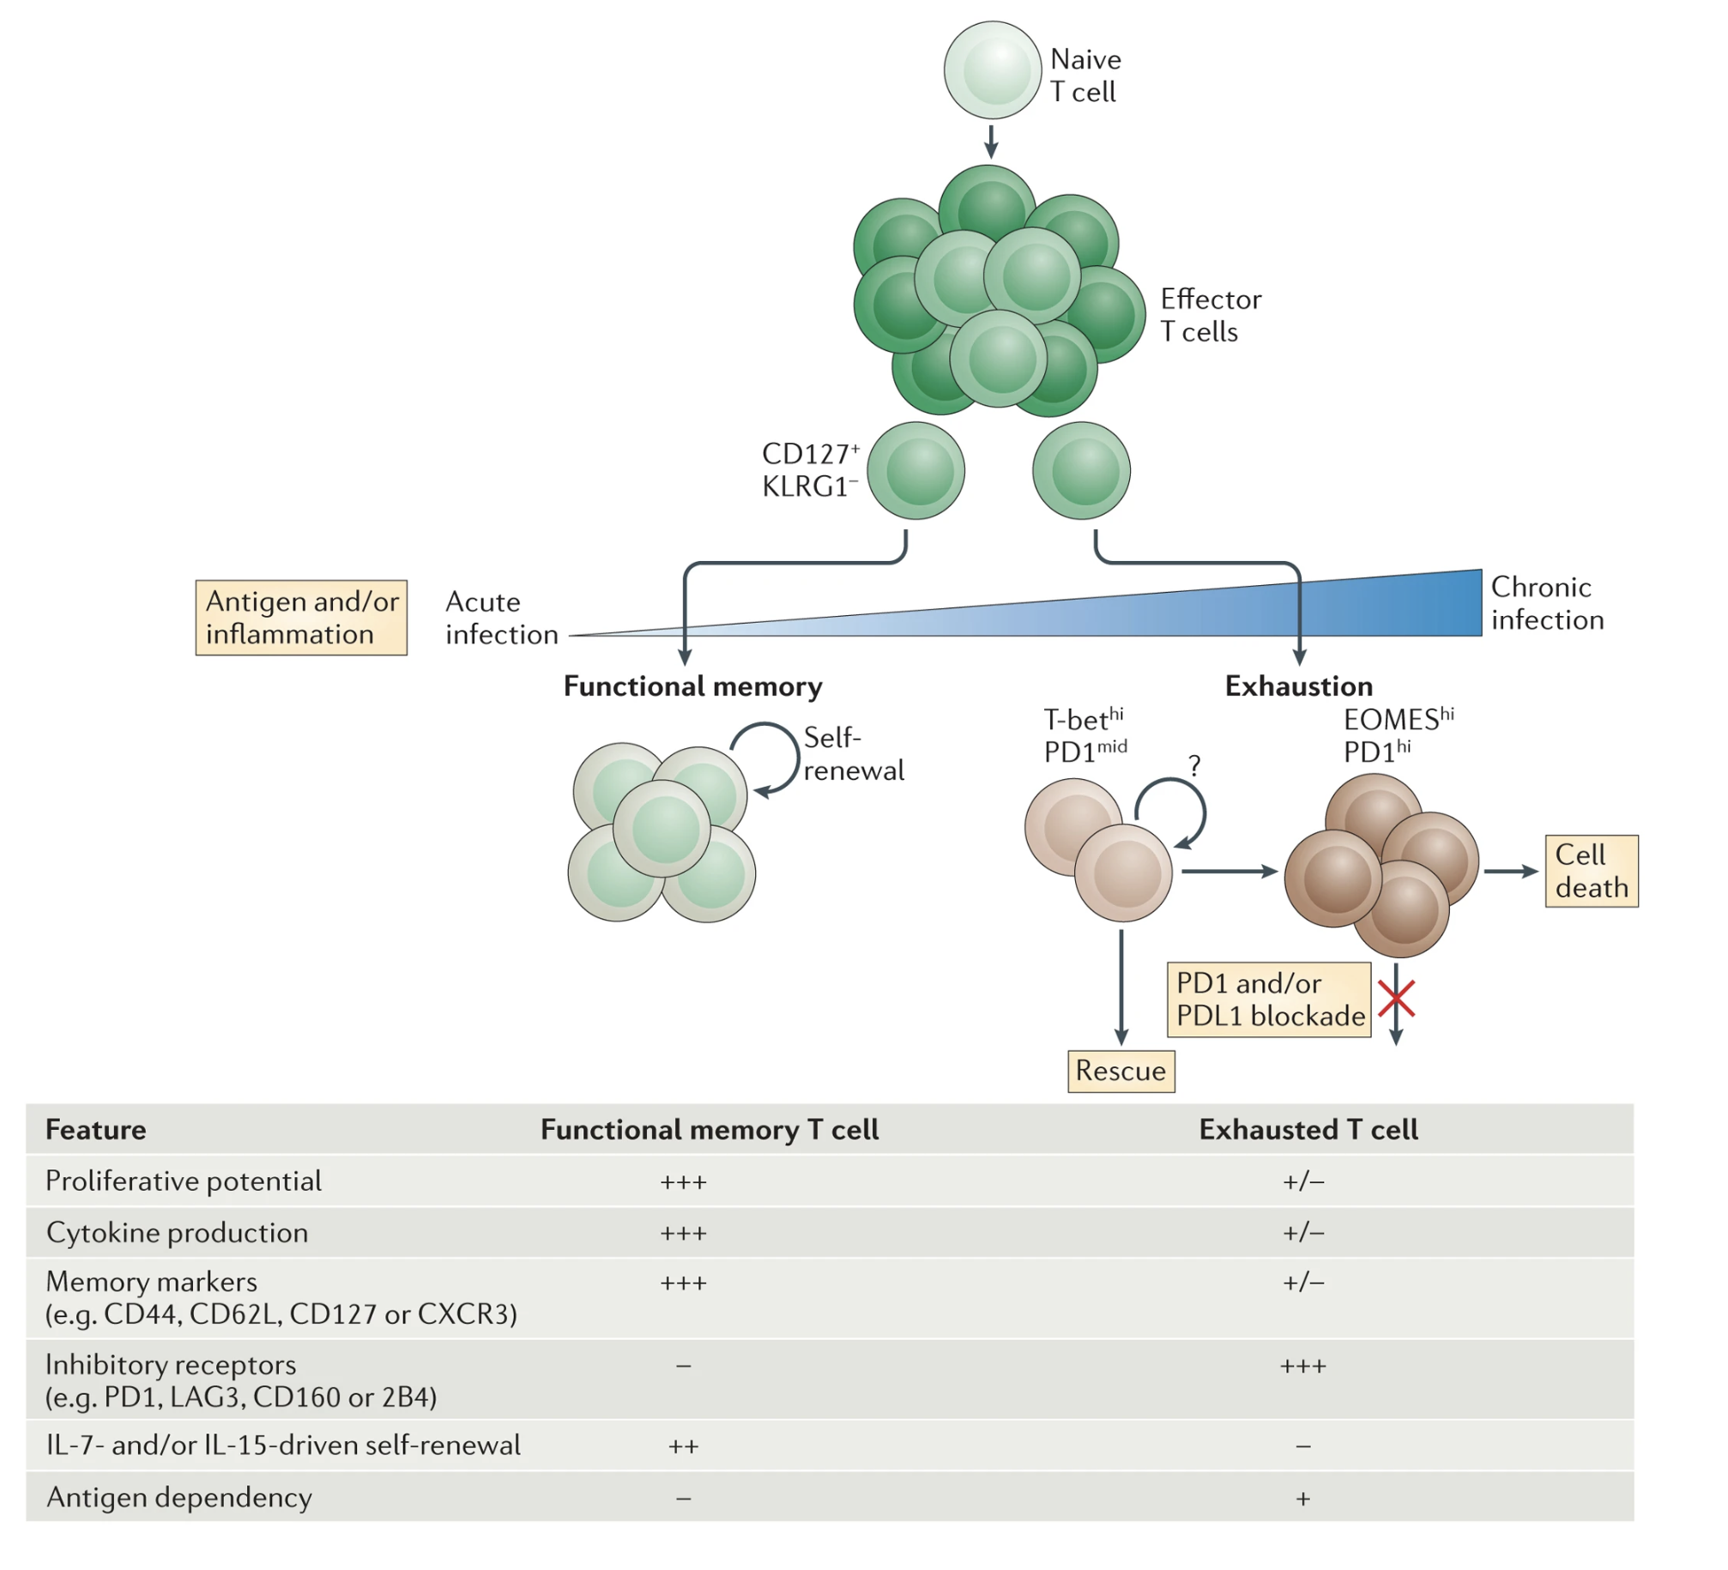
T cell exhaustion results from chronic antigen stimulation, inability to fully clear antigen
Specific TFs (EOMES, TOX) expressed as well
Epigenetic changes
Reformat intro here using poster abstract +
Printed notes in notebook in lab (i.e. show data
supporting claims I was just stating)
Wherry & Kurachi. Nat Reviews Immunol. 2015

Slide 5
Levels of T_{ex} are a biomarker in T1D
Higher levels of (partial) T_{ex} (TIGIT⁺ KLRG1⁺) CD8s associated with
slower progression to T1D
beneficial response to therapy (teplizumab/alefacept) and in at risk for and new onset T1D
Higher levels of TIGIT⁻KLRG1⁺CD127⁺ CD8s associated with worse outcome
Include new Josh figs:
- DP good
- Non-exh CD127+ bad
Notes:
Phenotype of islet-reactive CD8s is more so T_{eff}, less so T_{ex}

Slide 6
Central questions
How do the different cell populations’ epigenetic profiles differ?
What insights can we gain into CD8 TEM differentiation paths?
Notes:
are PD-1⁺ and CD57⁺ T_{ex} epigenetically exhausted yet distinct here in teplizumab-treated subjects as observed with alefacept in TIDAL (Witkop, Commun Biol)?

Slide 7
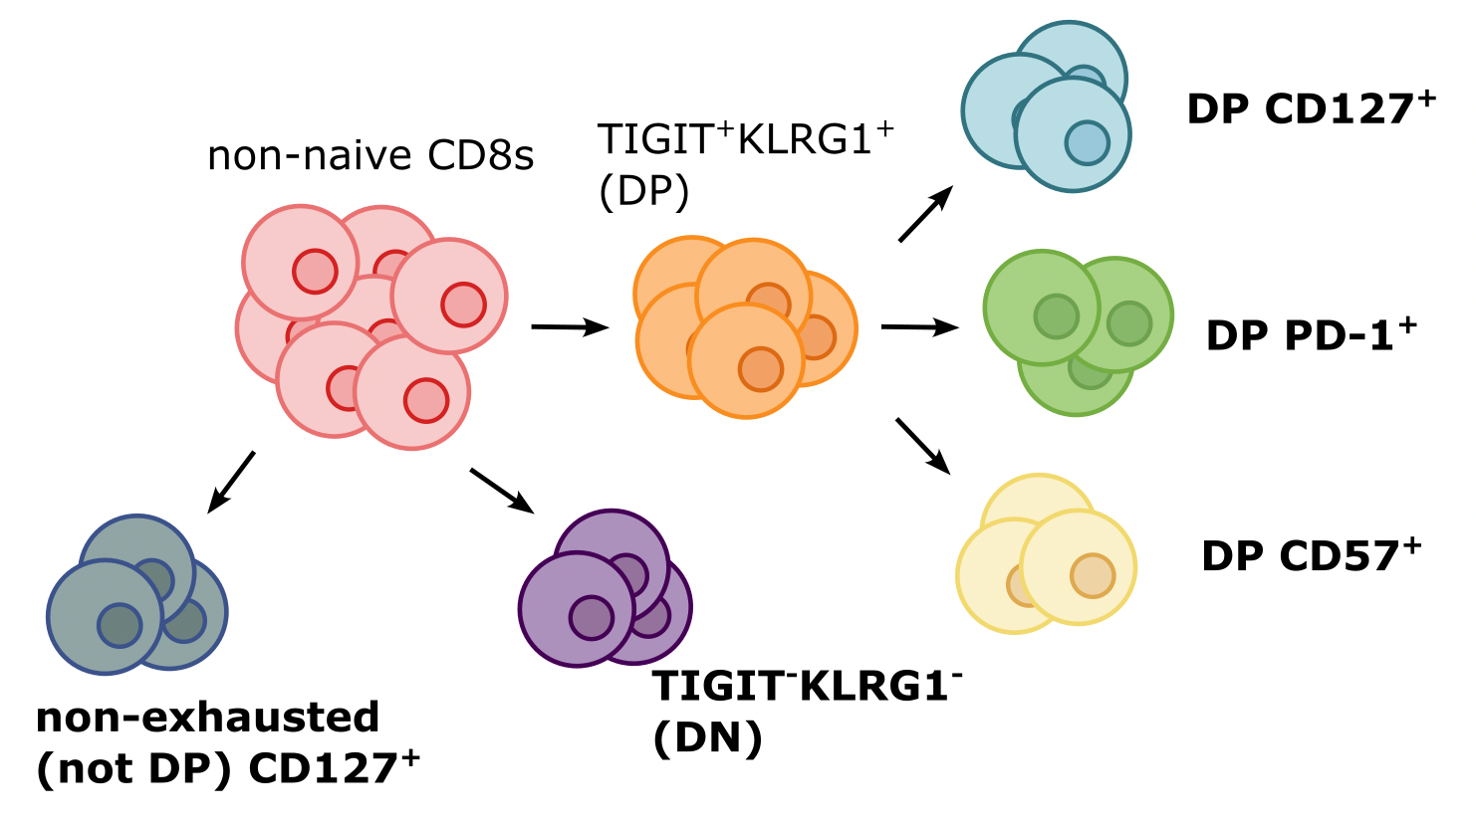
Bulk ATACseq of non-naive CD8 populations from PBMCs in recent onset T1D patients
Notes:
PBMCs from recent onset T1D patients, 6 responders (R) and 4 non-responders (NR) to teplizumab, 6 months post-treatment were sorted for bulk ATACseq of the bolded sorts. Rs were chosen for high TIGIT+KLRG1+ fraction of CD8 TEMs, and NRs were chosen for low TIGIT+KLRG1+ fraction of CD8 TEMs.
~equal sex distribution among donors
Ages 10-29, all but 1 in teens

Slide 8
Obtaining consensus peaks to serve as features in counts matrix
Pile up reads from all alignment .bam files by study group (cell sort + responder status)
Find genomic regions (~1 kb) enriched in merged alignment files (call peaks)
Take union of these peaks

Slide 9
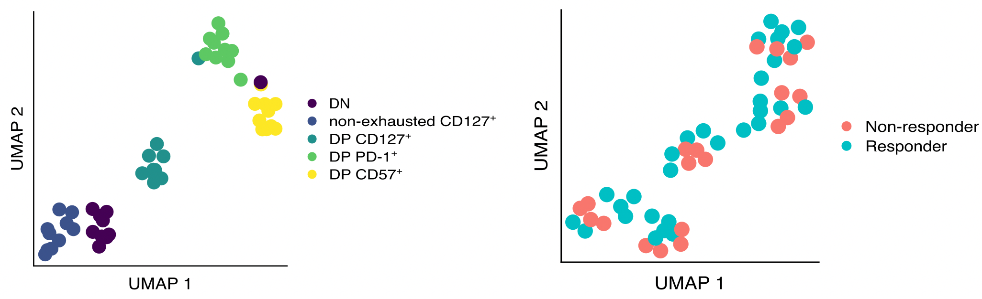
Epigenetic profiles of different non-naive CD8 populations are distinct
Notes:
UMAP visualizations of bulk ATAC-seq data from sorted PBMCs from 10 recent onset T1D teplizumab-treated donors (6 responders, 4 non-responders). (left) UMAP with patient profiles colored by cell sort with donor and responder status regressed out. (right) UMAP with patient profiles colored by responder status with donor and cell sort regressed out.

Slide 10
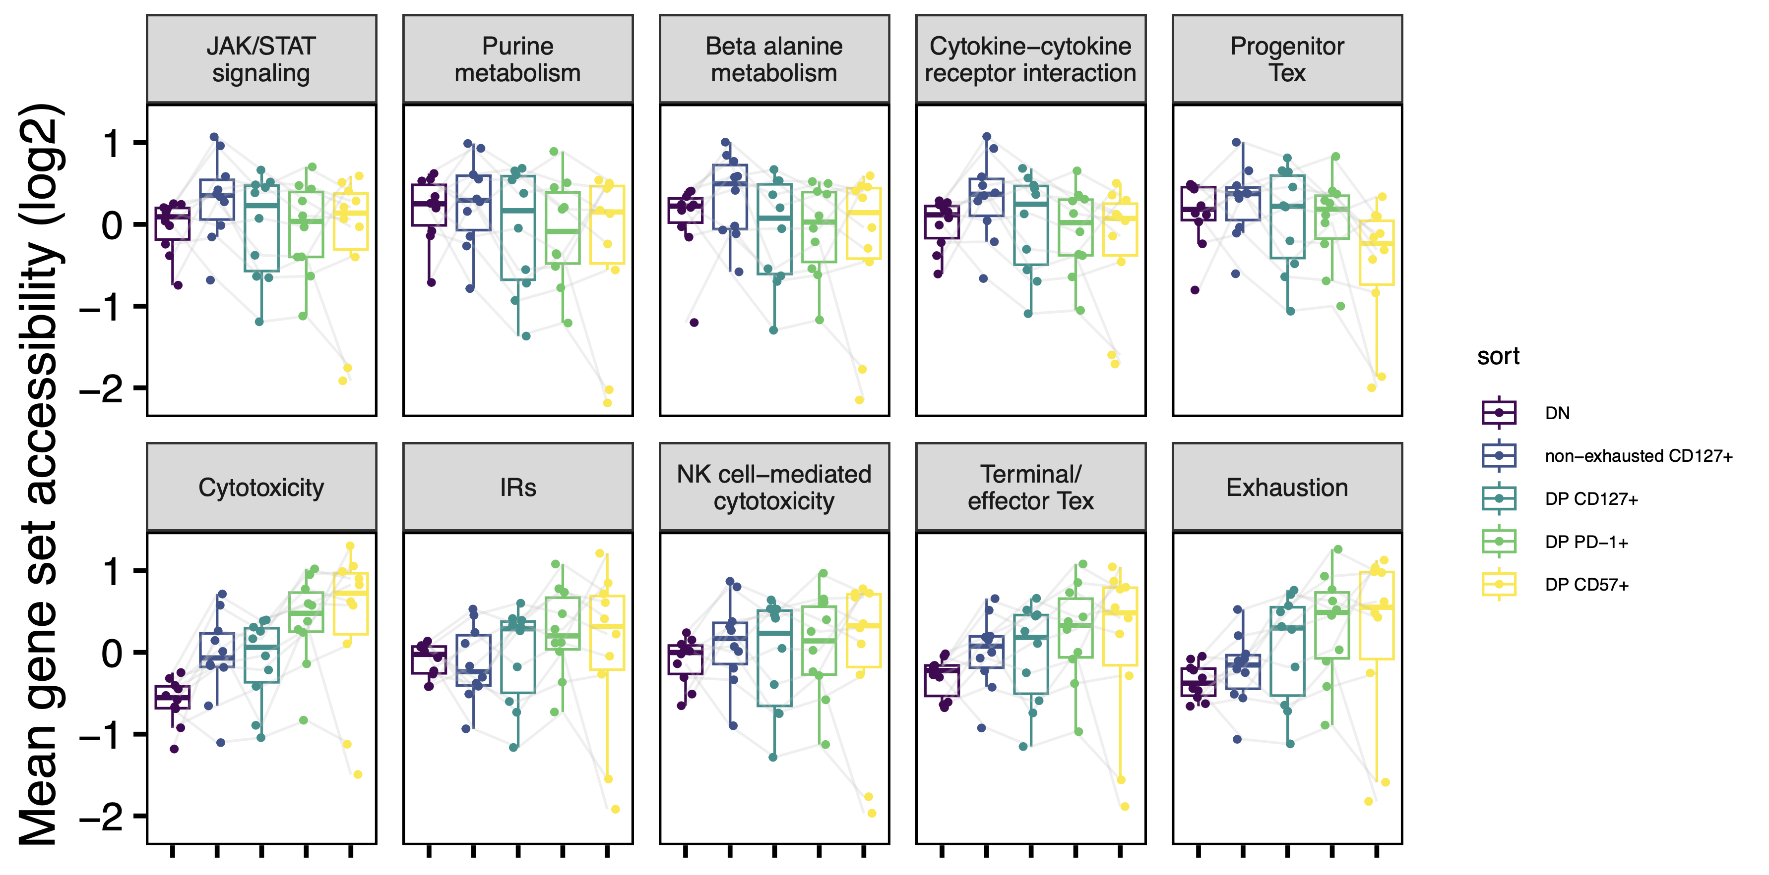
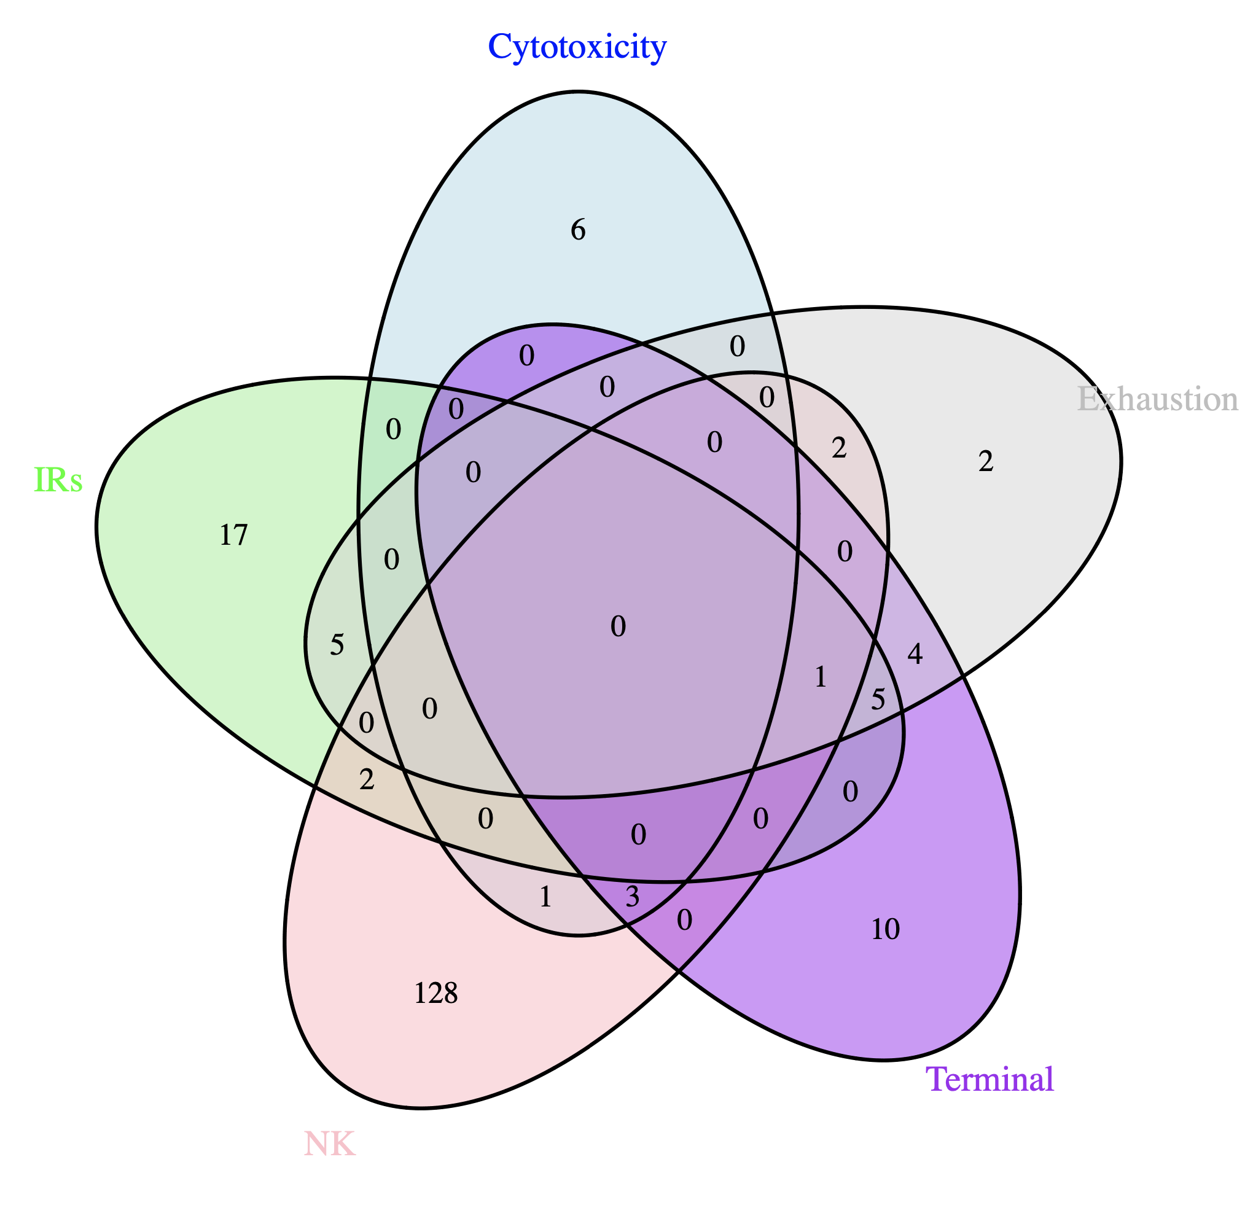
Summary of accessibility differences between different sorts
Notes:
cytotoxicity_genes [1] "GZMA" "GZMB" "GZMH" "GZMM" "GZMK" "PRF1" "NCR1" "KLRF1" "NKG7" "IFNG”
ir_genes [1] "PDCD1" "HAVCR2" "PD1" "CTLA4" "LAG3" "TIM3" "TIGIT" "2B4" "CD160" "BTLA" "CD233" "CD244" [13] "FCGR2B" "PILRA" "FDF03" "CD72" "CD5" "PECAM1" "CD31" "CD22" "CEACAM1" "CD66A" "CD33" "Siglec3" [25] "LAIR1" "KLRC1" "NKG2A" "KIR2DL1" "HAVCR1" "KIR2DL5”
exhaustion_genes [1] "CD244" "SLAMF6" "TBX21" "PDCD1" "HAVCR2" "KLRG1" "TOX" "TCF1" "PD1" "CTLA4" "LAG3" "TIM3" [13] "TIGIT" "KIR3DL2" "KIR2DL3" "NKG2A" "EOMES" "HAVCR1" "CD160”
terminal_genes [1] "CD38" "ID2" "PRF1" "IFNG" "PRDM1" "CX3CR1" "CD101" "TOX" "CD39" "HAVCR2" "CD244" "GZMB" "RUNX1" [14] "TIGIT" "PDCD1" "LAG3" "CD244" "ITGAE" "CTLA4" "EOMES" "TBX21" "ZEB2" "KLRG1" "CD69"

Slide 11
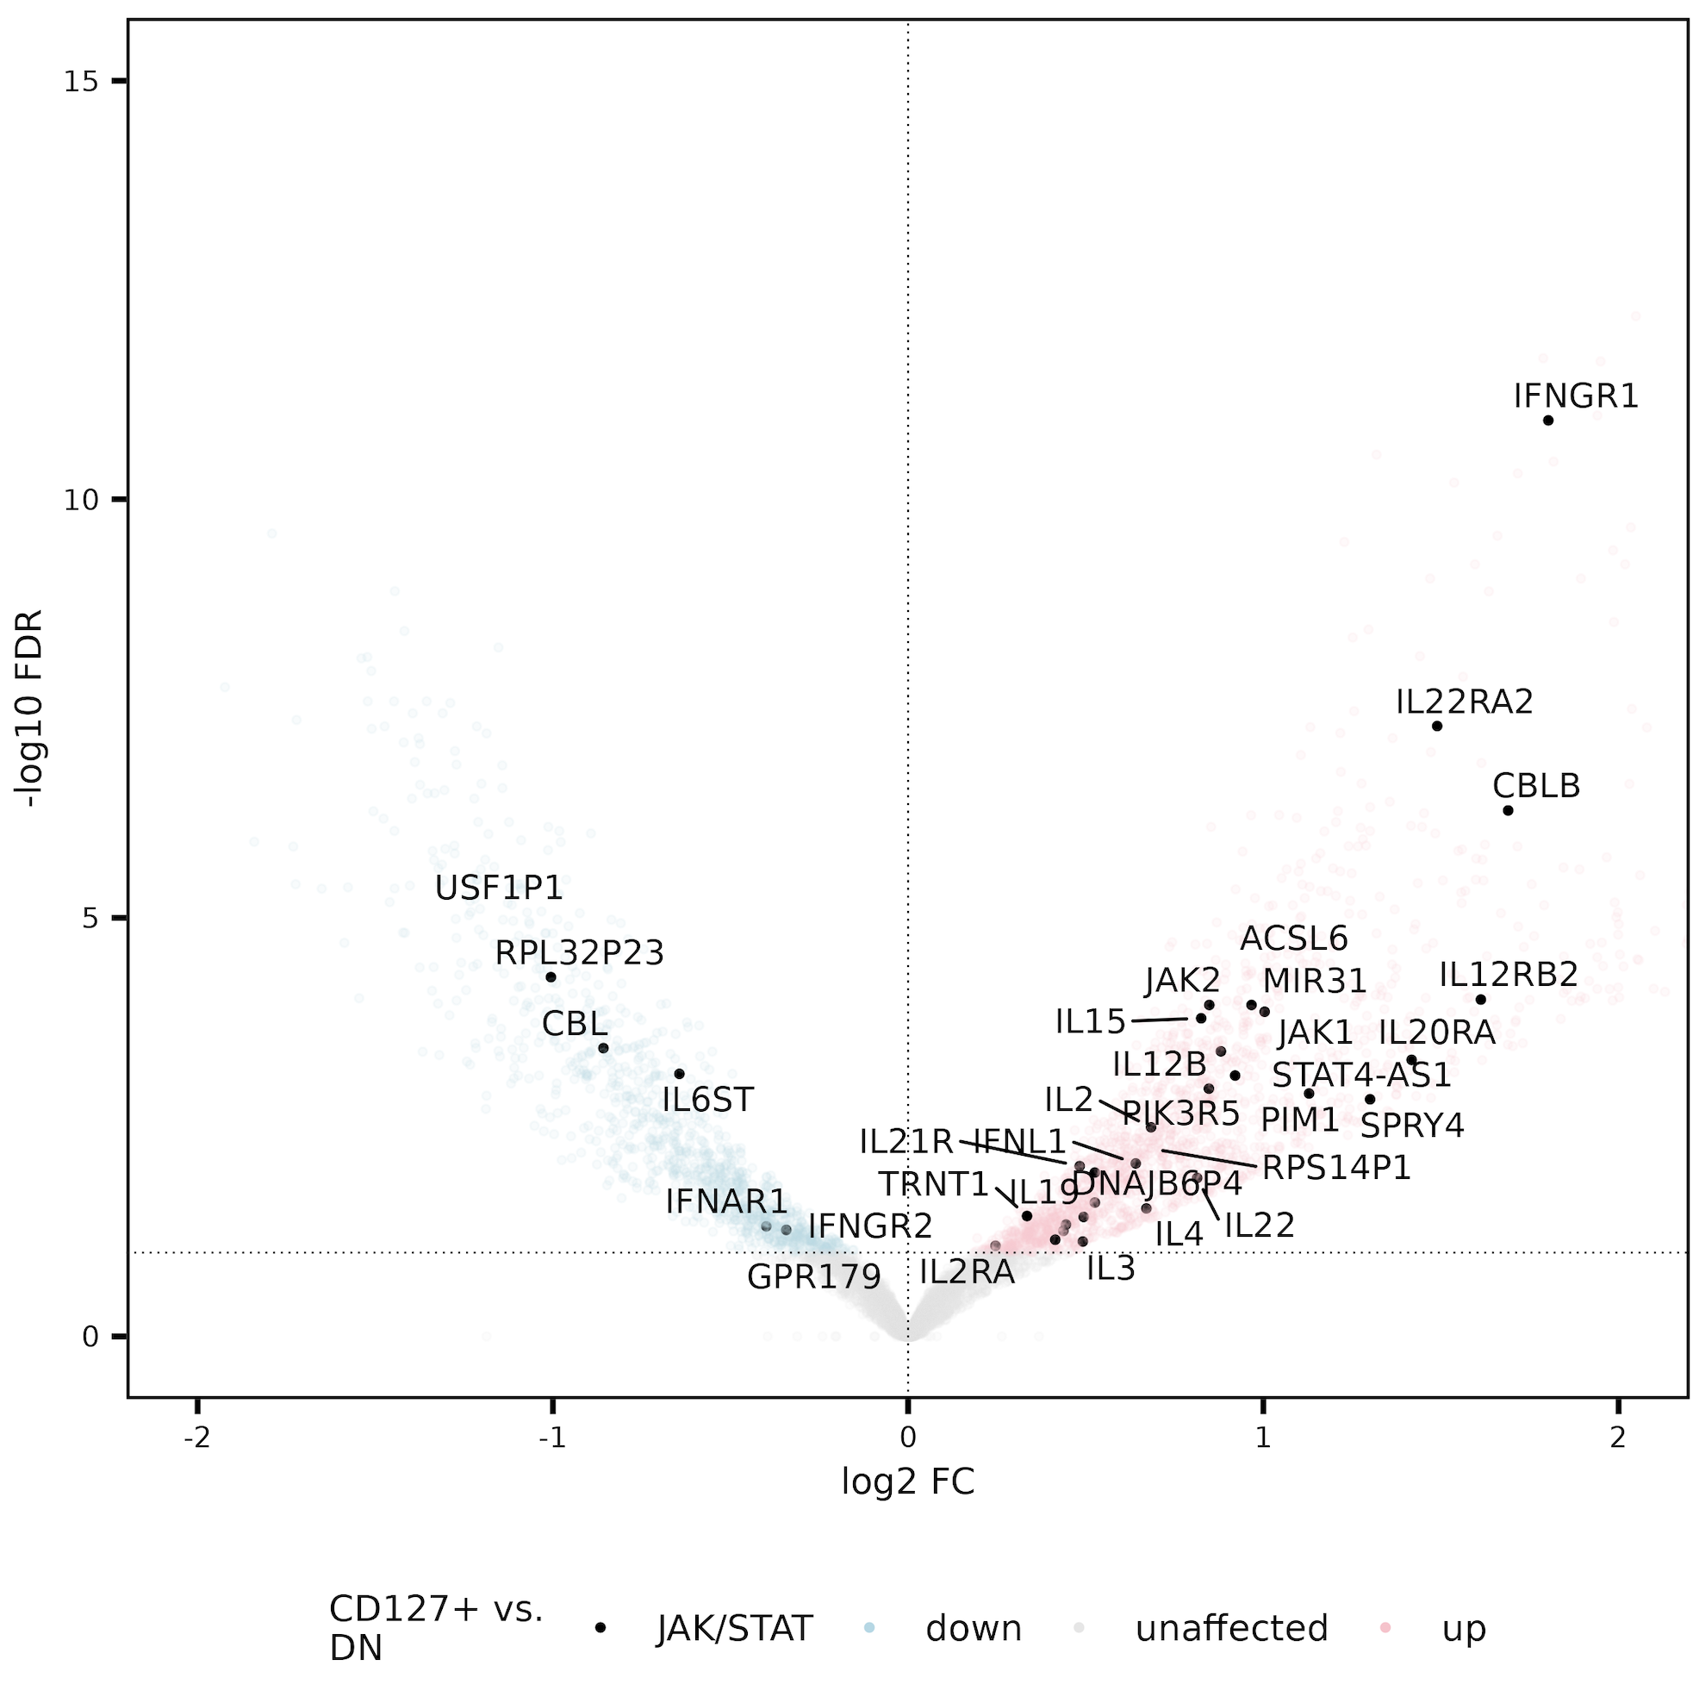
JAK/STAT gene set more accessible in CD127⁺ sorts vs. DN
Notes:
JAK/STAT enriched (stringdb) in peaks’ genes/promoters up in both CD127⁺ sorts vs. DN
IL-10 also enriched (stringdb) but wasn’t convincing on VP

Slide 12
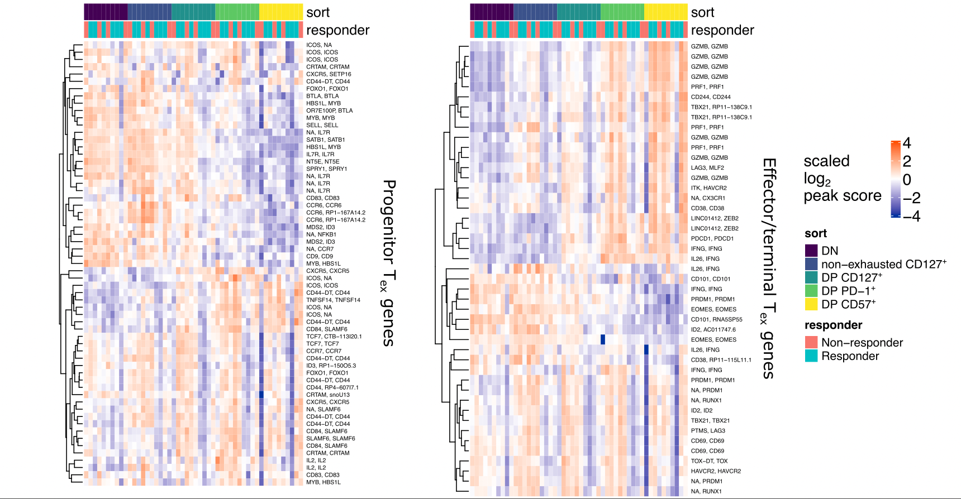
DP CD57⁺ have less of a T_{ex}^{progenitor} profile, more of a T_{ex}^{effector} one

Slide 13
Intro slide for pseudotime/P348 project (UMAP colored by pseudotime, and how we know where CD57s and CD127s are and stuff?

Slide 14
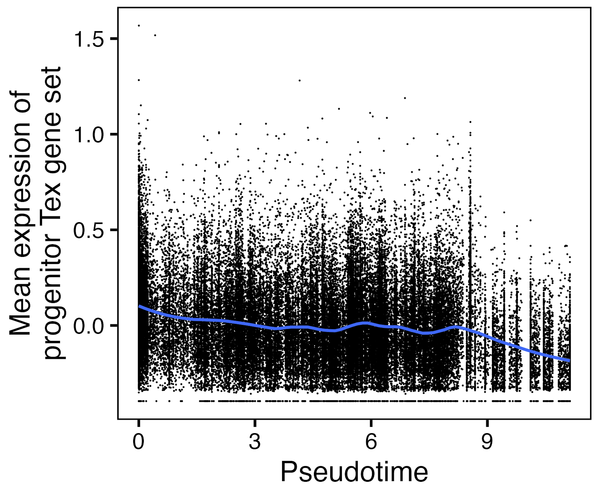
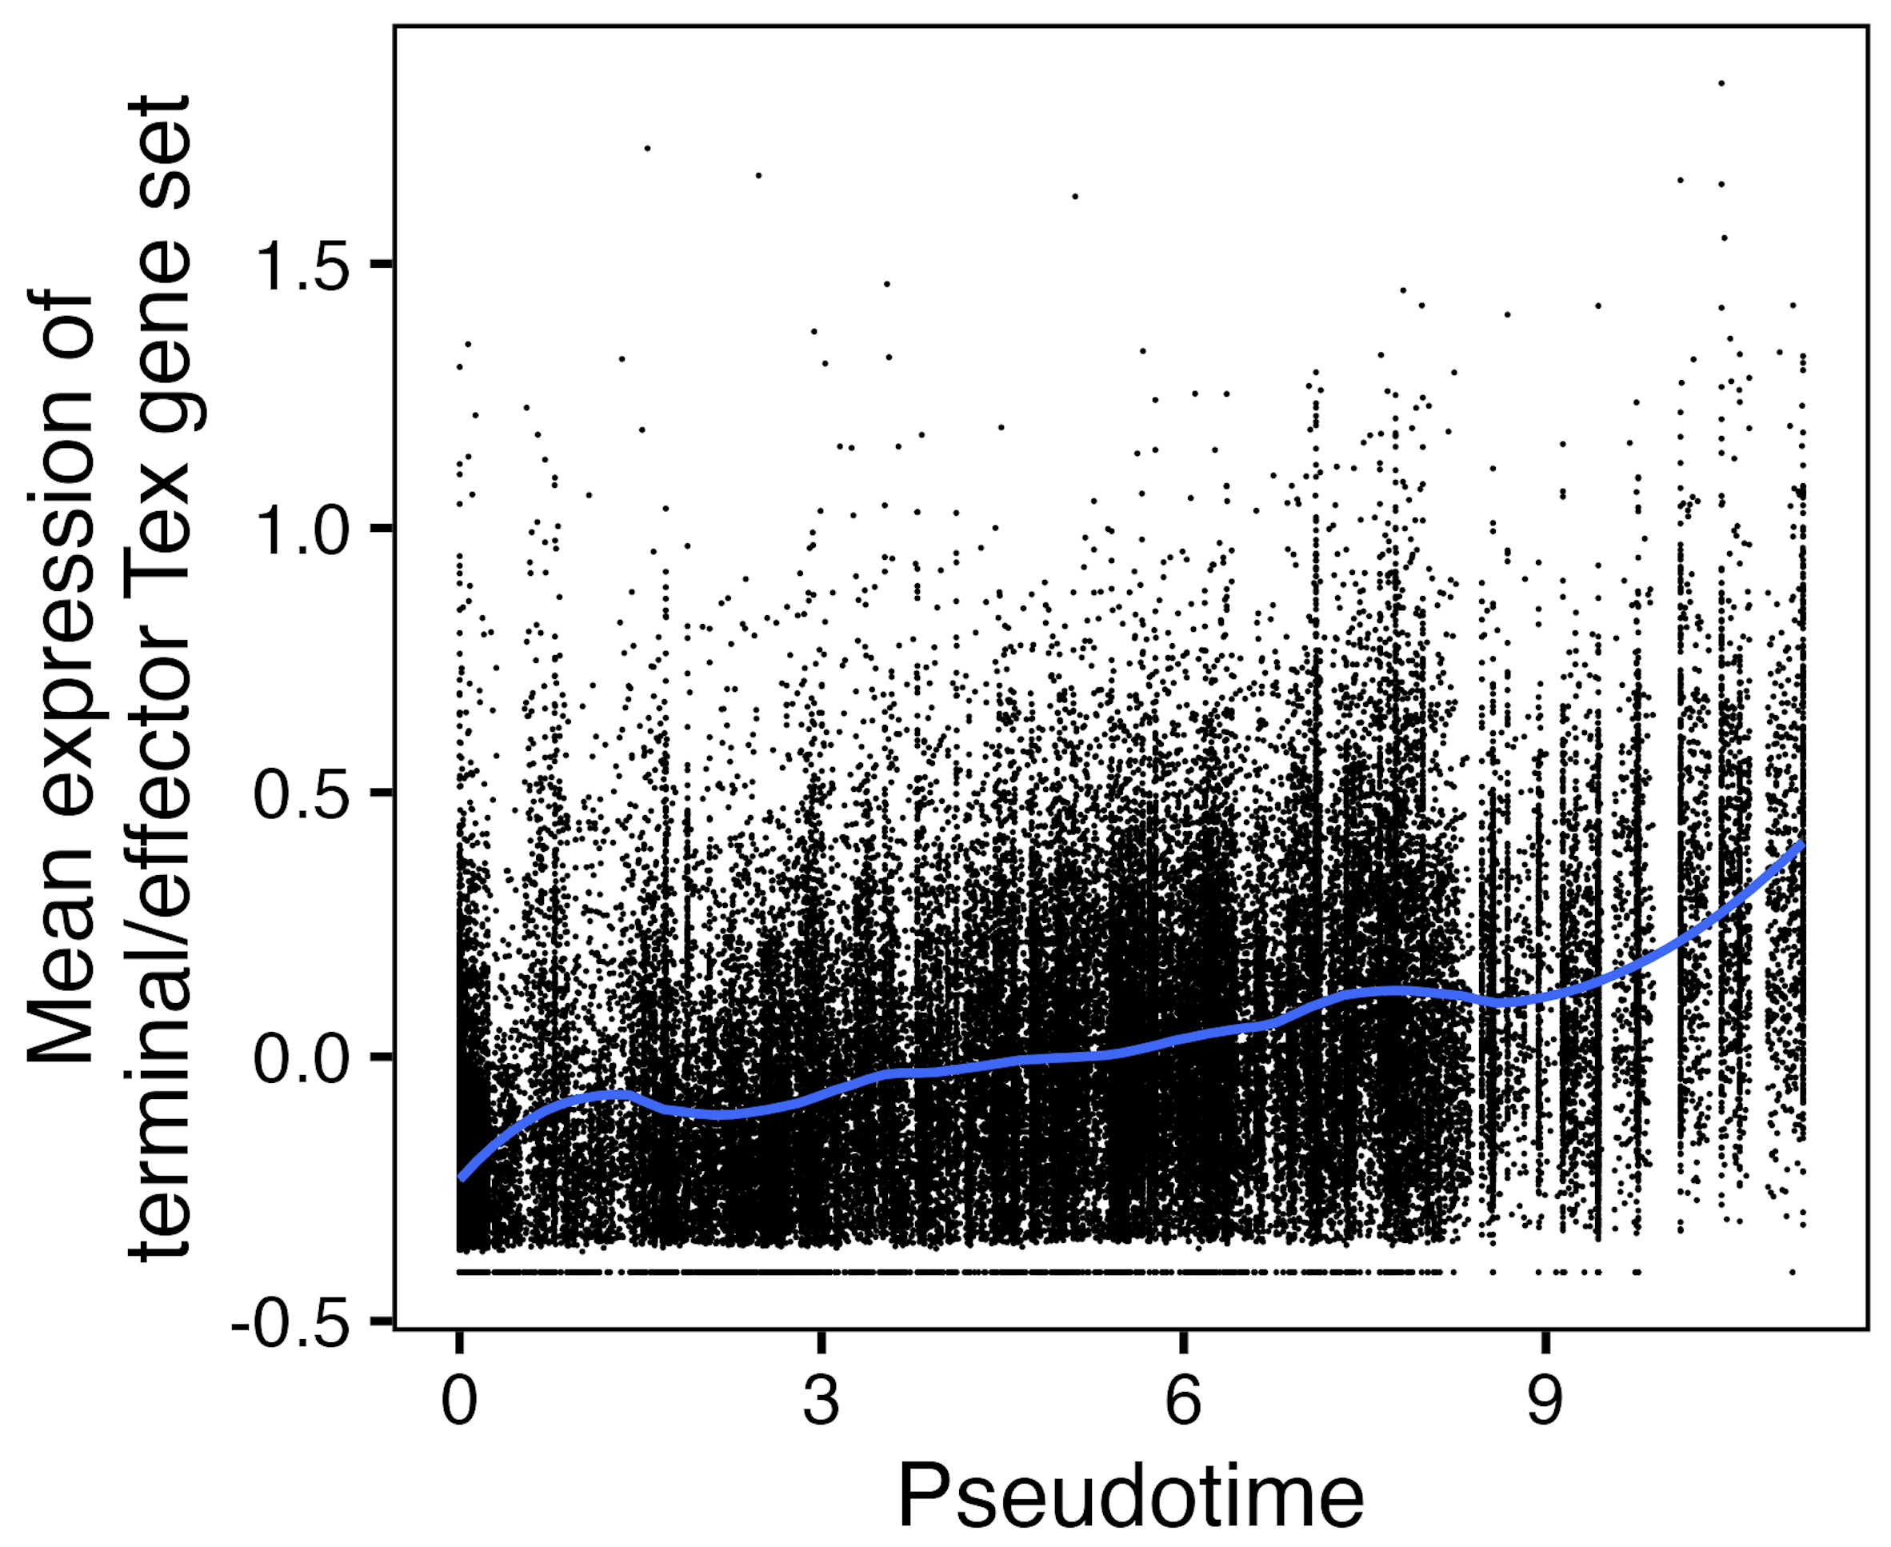
TN10 (all non-naive CD8s): over pseudotime, progenitor T_{ex} gene set expression decreases & terminal/effector T_{ex} gene set expression increases
Notes:
RNA expression
Z-score transformation (mean = 0, SD = 1) is applied to each gene's expression across all cells to get this scaled.data that I used for yvals here
Better ylab is Mean z score of genes in …?

Slide 15
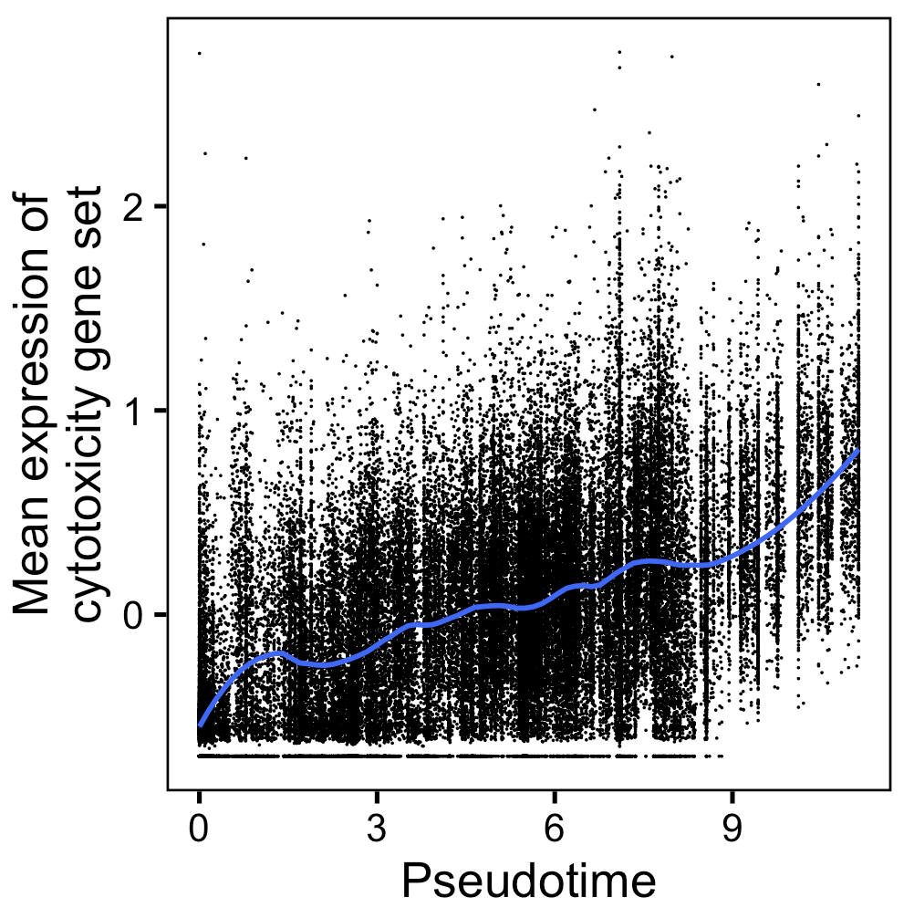
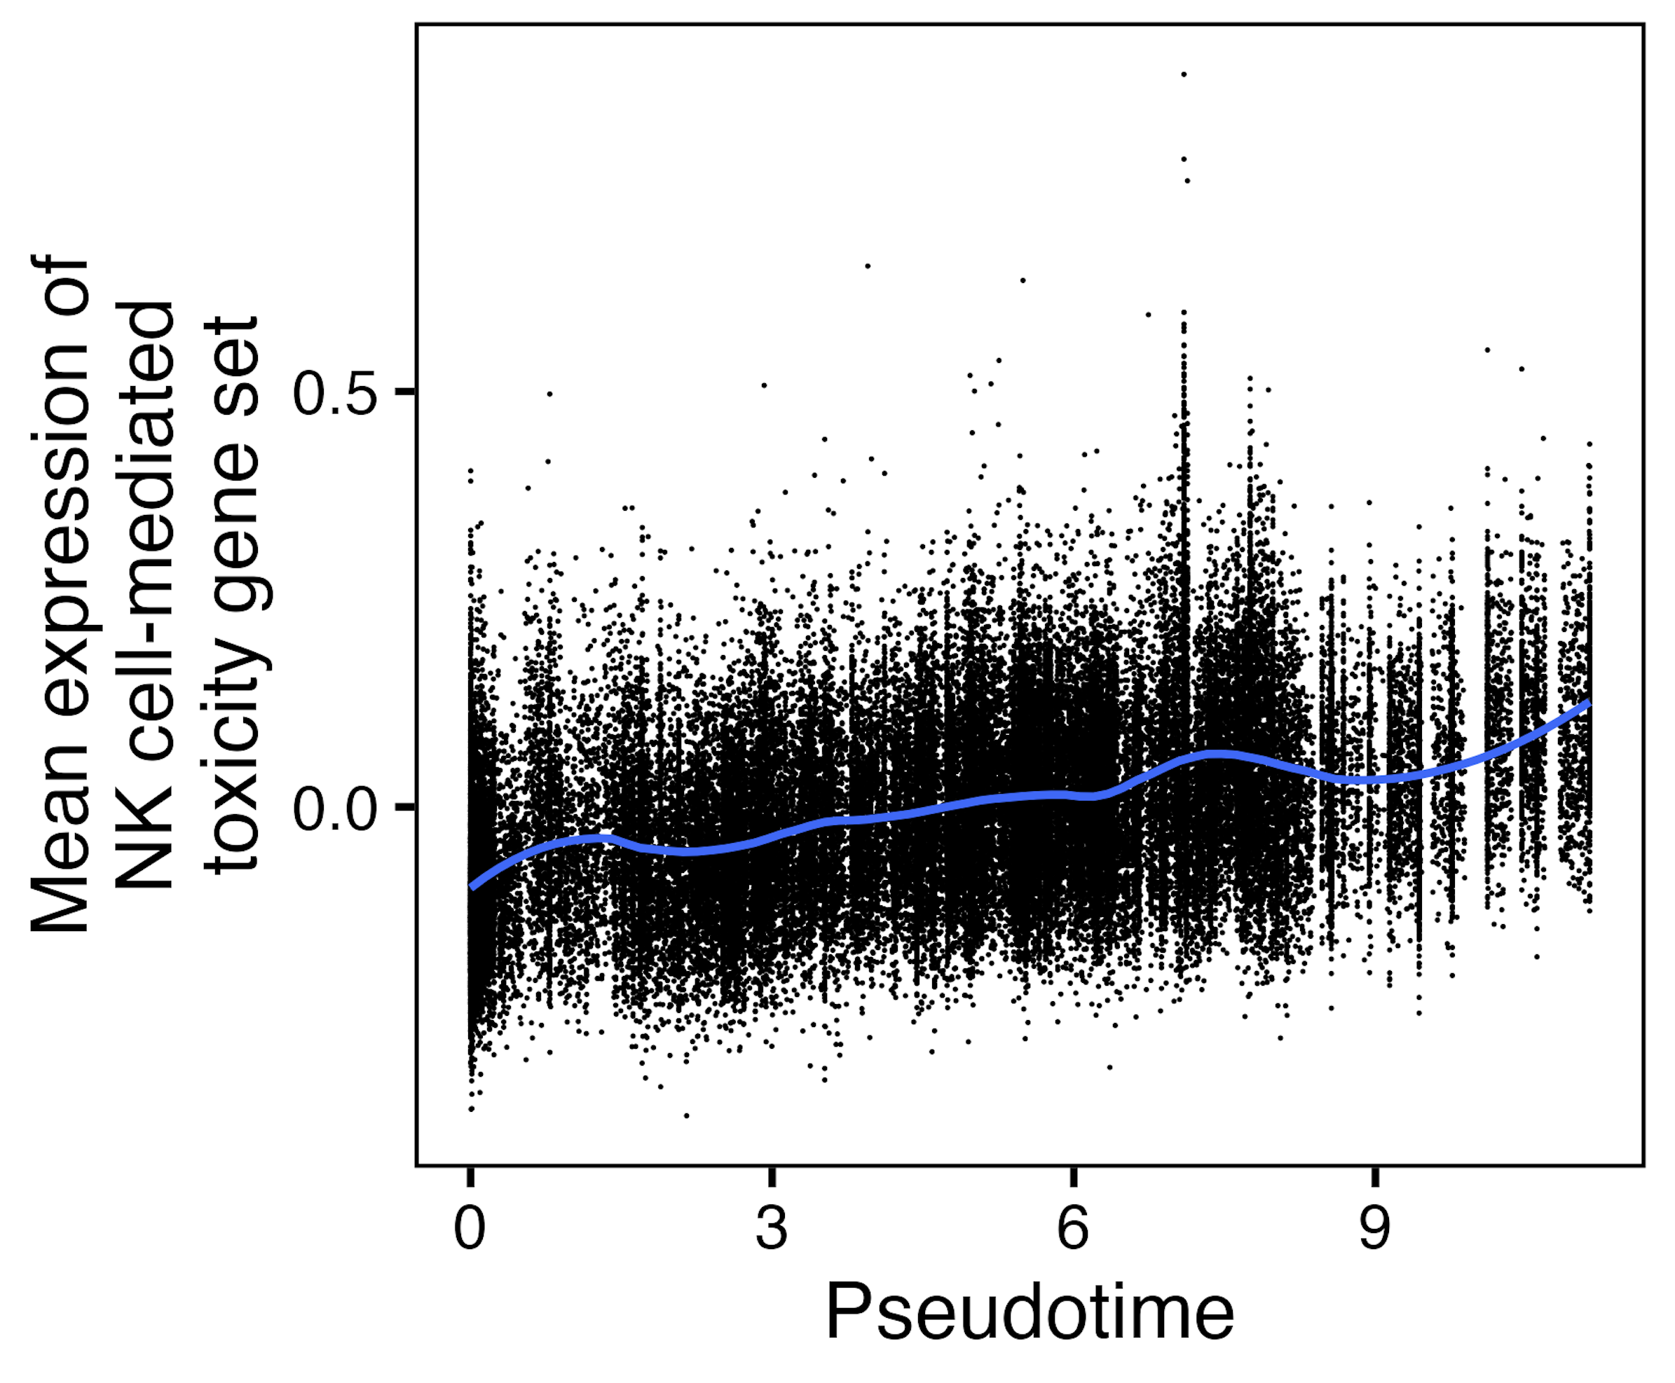
TN10 (all non-naive CD8s): cytotoxicity/NK gene sets’ expressions also increase over pseudotime
Notes:
RNA expression
Z-score transformation (mean = 0, SD = 1) is applied to each gene's expression across all cells to get this scaled.data that I used for yvals here
Better ylab is Mean z score of genes in …?

Slide 16
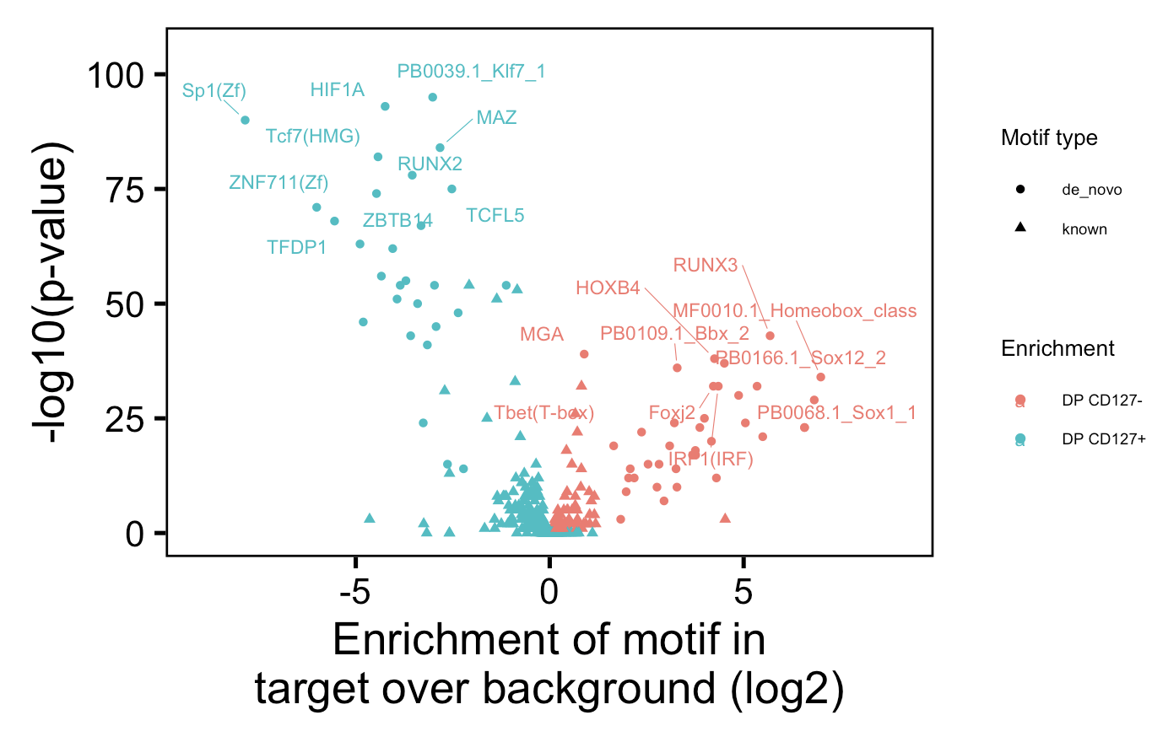
Homer slide in main if I can fit it into story for DPs and/or CD127s/DN…
More progenitor
TCF7
TFDP1?
HOXB4?
More terminal
Tbet
IRF?
MGA?
HIF1A?
Notes:
For each unique TF (often appeared on both sides of contrast), just took one with lower pval
Mitochondrial dysfunction promotes the transition of precursor to terminally exhausted T cells through HIF-1α-mediated glycolytic reprogramming
Not exactly consistent with Erin’s: “T-bet and Tcf-1 as regulators of the CD57⁺ and PD-1⁺ Tex populations, respectively.”, but that is kind of consistent with PD1 being closer to progenitor and CD57 being more terminal (given trends of MT SNV counts)
Consistent with PMCID: PMC6156005: loss of Runx2 in T cells leads to reduction in KLRG1<sup>low</sup>CD127<sup>high</sup> memory precursor cell numbers with no effect on terminal populations (KLRG1<sup>high</sup>CD127<sup>high</sup>)
Consistent with PMCID: PMC5564218: “Runx3 deficiency limits clonal expansion and impairs upregulation of cytotoxic molecules in T<sub>EFF</sub> cells” in the sense that part of DP CD127- (CD57+) seems more cytotoxic (KIRs)
Bolding meaning consistent with progenitor vs. eff/terminal Tex split
Known meaning from a library of motifs-TFs, de novo meaning looking for new motifs and then looking for motifs-TF to find similar motifs and label it with that TF, presumably

Slide 17
Erin’s P452 data on PD-1/CD57 fluidity/TCR sharing (close in lineage w/out directionality), motivation for MT SNVs here to provide directionality

Slide 18
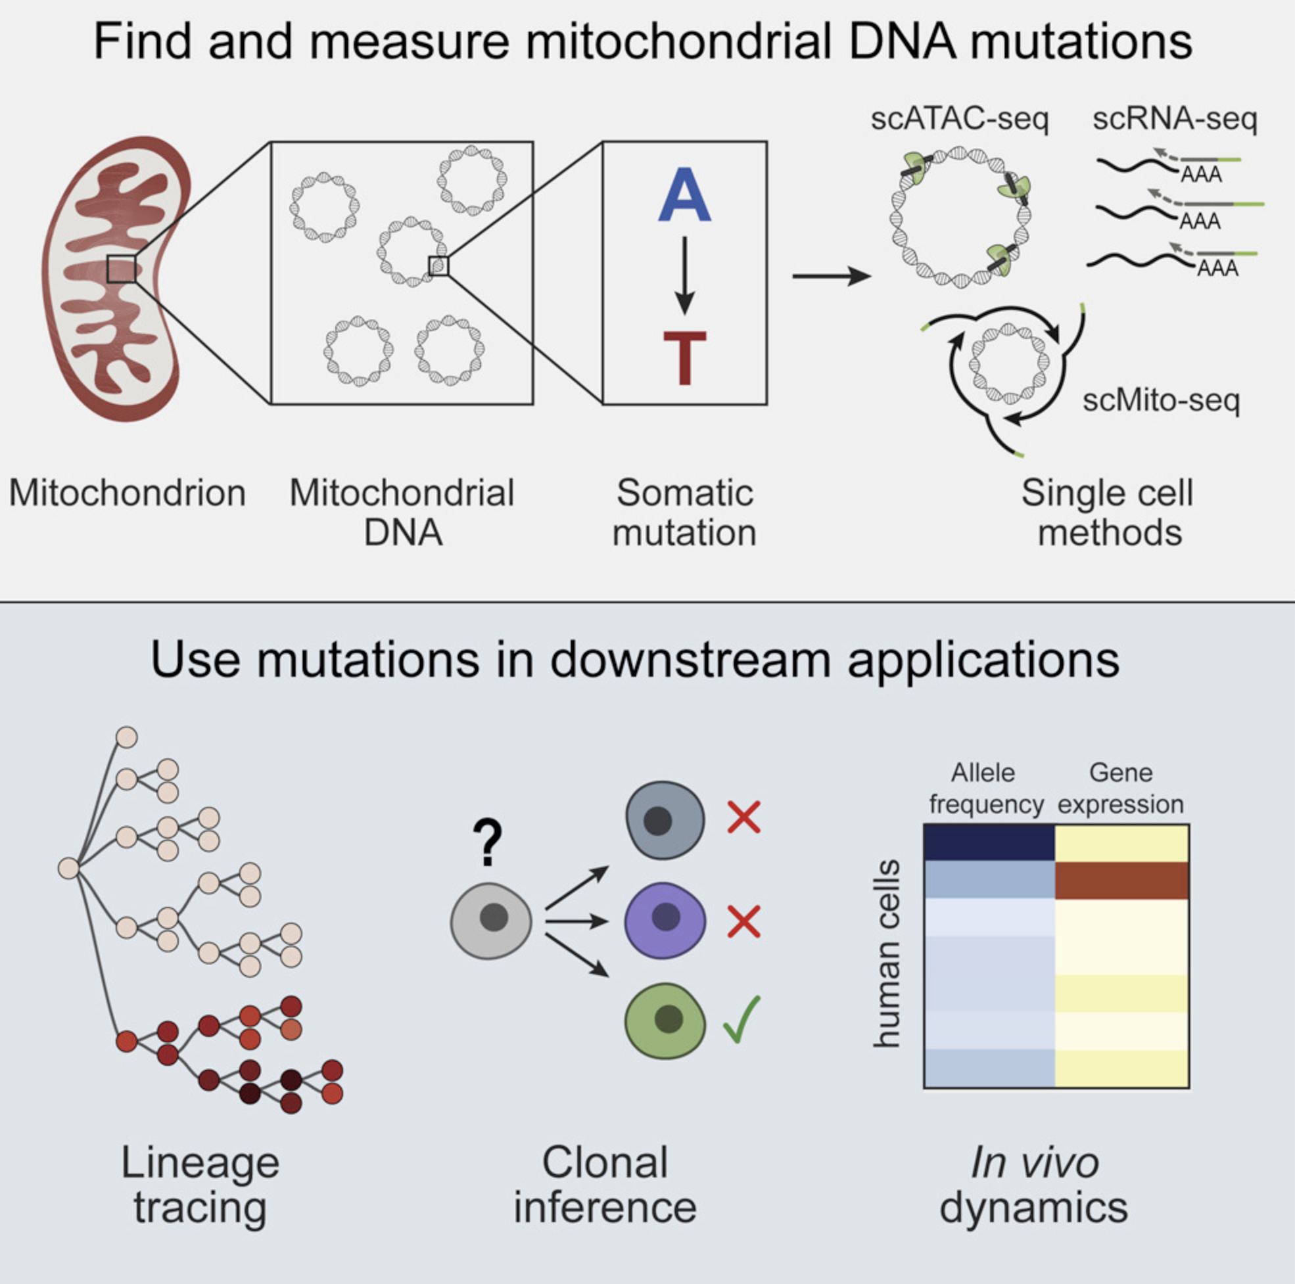
Mitochondrial DNA mutations have been used to trace lineages in hematopoietic cells
MT DNA…
has much higher mutation rate than nuclear DNA
is very accessible to transposase (no histones)
Ludwig et al. (2020) Cell
Notes:
MT notes:
Mitochondrial genomes have high copy number (100–1,000s)
homoplasmy is when all copies of the mitochondrial genome in a cell are identical; heteroplasmy is when there is a mixture of two or more mitochondrial genotypes
mutations in mtDNA often reach high levels of heteroplasmy (proportion of mitochondrial genomes containing a specific mutation) due to a combination of vegetative segregation, random genetic drift, and relaxed replication
Exclusively maternal inheritance
mtDNA mutation rates are estimated to be 10- to 100-fold higher than for nuclear DNA
Although there are no histones in mitochondria, mtDNA does not exist in a ‘naked' form. It is packaged into nucleoids, which are DNA–protein assemblies composed of mtDNA surrounded by core and peripheral nucleoid factors

Slide 19
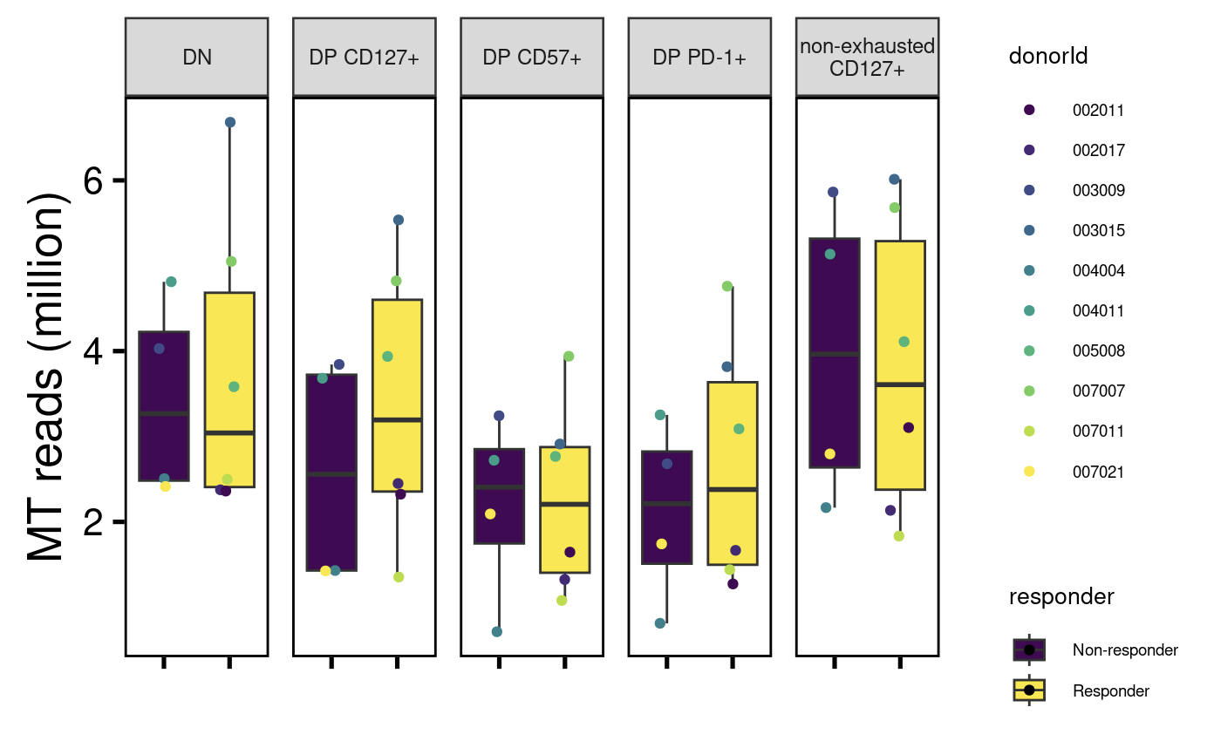
~5-15% of reads map to mitochondrial genome, ~similar levels across cell sorts
Pre-reseq
Remake plot (higher counts)

Slide 20
Using VarScan to identify mitochondrial single-nucleotide variants
What’s a pileup file?
Extract MT mapping reads from alignment bam files
Create pileup files (necessary input for Varscan) using samtools
Run Varscan variant caller on each library
Parses pileup input 1 base at a time, computing number of bases supporting each observed allele
Only bases meeting minimum base quality (default: 20) from reads meeting minimum mapping quality (default: 1) are considered
Coverage (number of qualifying bases) is calculated
If coverage meets minimum threshold, then VarScan examines each observed allele to test if it was…
supported by minimum number of supporting reads
Meets minimum allele frequency threshold (min_var_freq)
Passes basic strand-bias filter
Has Fisher’s exact test pval < threshold
Filter out possible seq/mapping errors
Filter out variants present in all cell sorts within a donor
Xu et al. (2019), eLife
Notes:
VarScan employs a robust heuristic/statistic approach to call variants that meet desired thresholds for read depth, base quality, variant allele frequency, and statistical significance.
Min_coverage param does seem to matter somewhat… with higher value (20 vs. 8), trends seem more extreme, I think this is fine even if 8 is default value as 20 is more stringent…
VarAllele Most frequent non-reference allele observed, this is what I use for sharing analyses

Slide 21
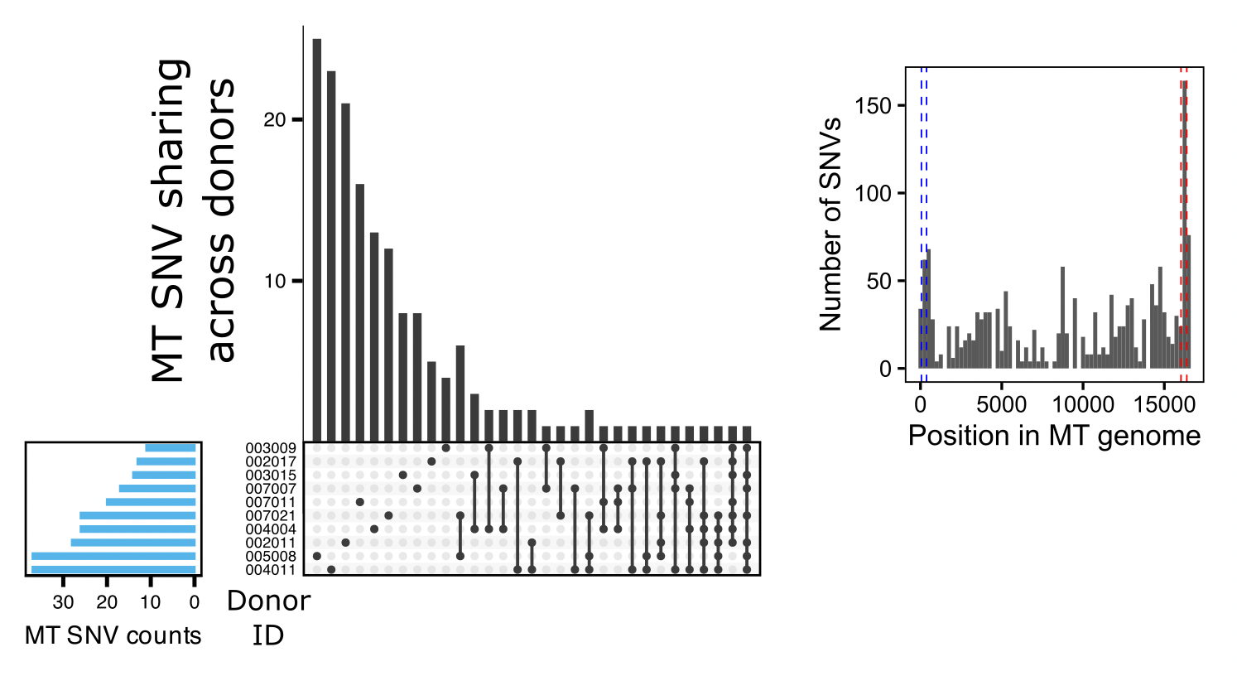
Identifying mitochondrial single-nucleotide variants from mitocondrial-mapping bulk ATACseq reads
Replace donorId with ITN-approved one
Notes:
MT SNVs called using VarScan. (left) Upset plot showing sharing of MT SNVs across donors. (right) Distribution of MT SNVs across MT genome with hypervariable regions highlighted (HV1 in red, HV2 in blue)

Slide 22
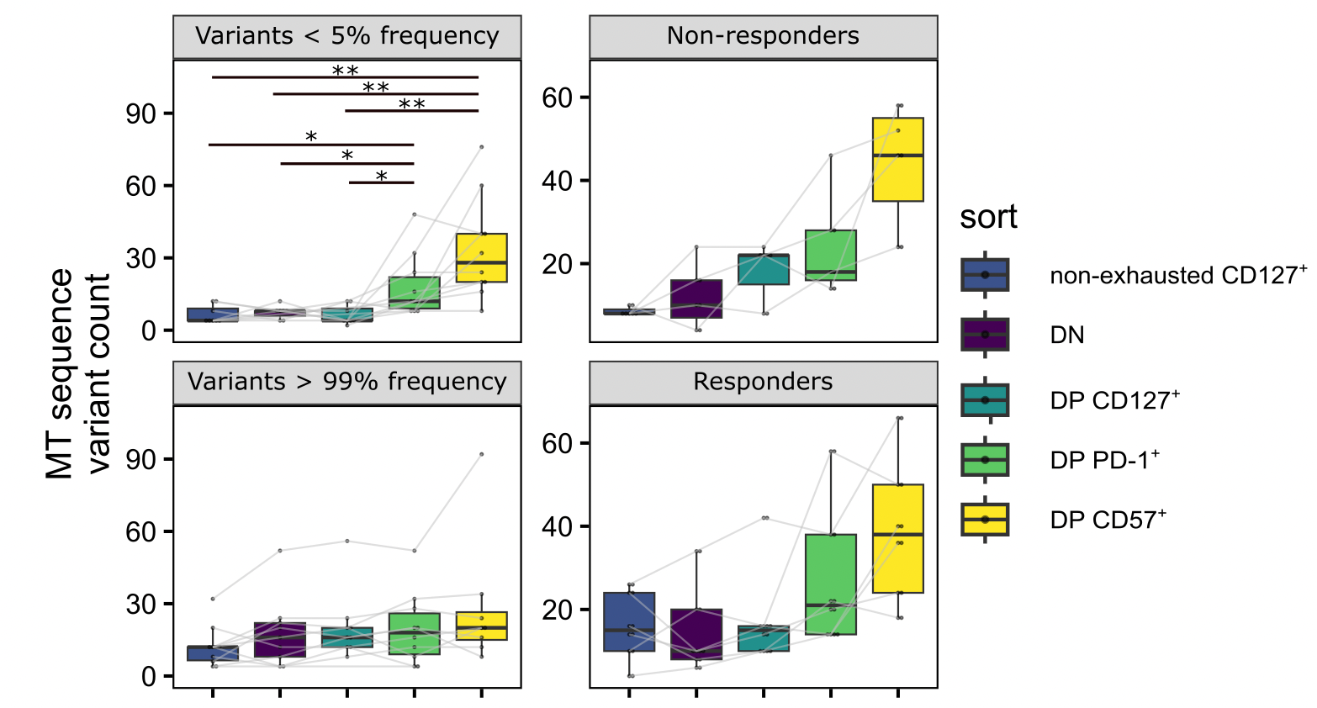
Accumulated over cell divisions, MT SNVs can provide directionality in a differentiation pathway
Rephrase stats * descriptor
* and ** refer to padj < 0.01 and padj < 0.05, respectively, from Wilcoxon rank sum tests.
Notes:
Mitochondrial single nucleotide variant (MT SNV) counts faceted by variant frequency or responder status

Slide 23
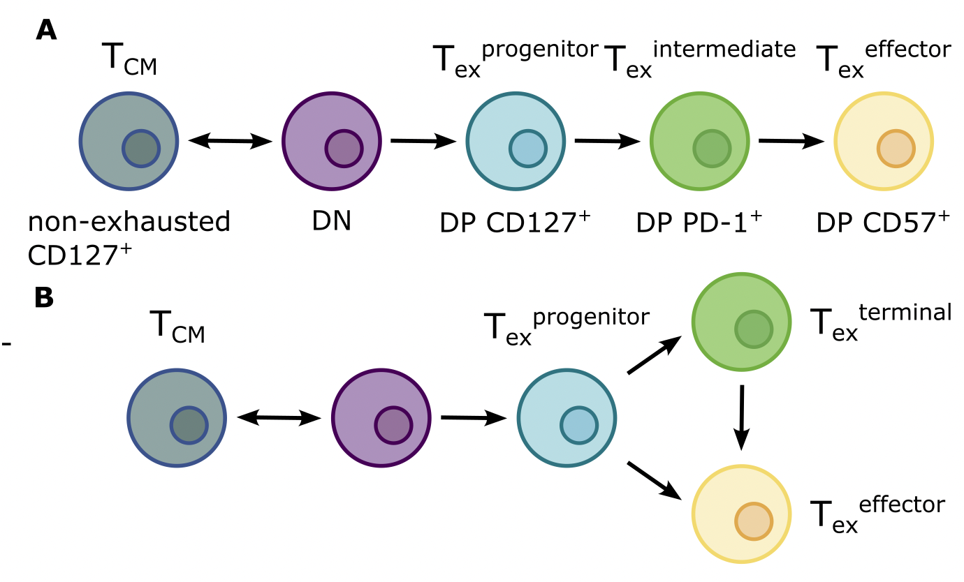
Conclusions: make sure all slides represented here (otherwise move slides to backup?)
DP CD57⁺ non-naive CD8s have a epigenetic profile consistent with a T_{ex}^{effector} phenotype rather than a T_{ex}^{progenitor} phenotype
DP PD-1⁺ and DP CD57⁺ non-naive CD8s have more low-frequency MT SNVs than other non-naive CD8s here, placing them later in a differentiation pathway
Notes:
Leaning towards model A?

Slide 24
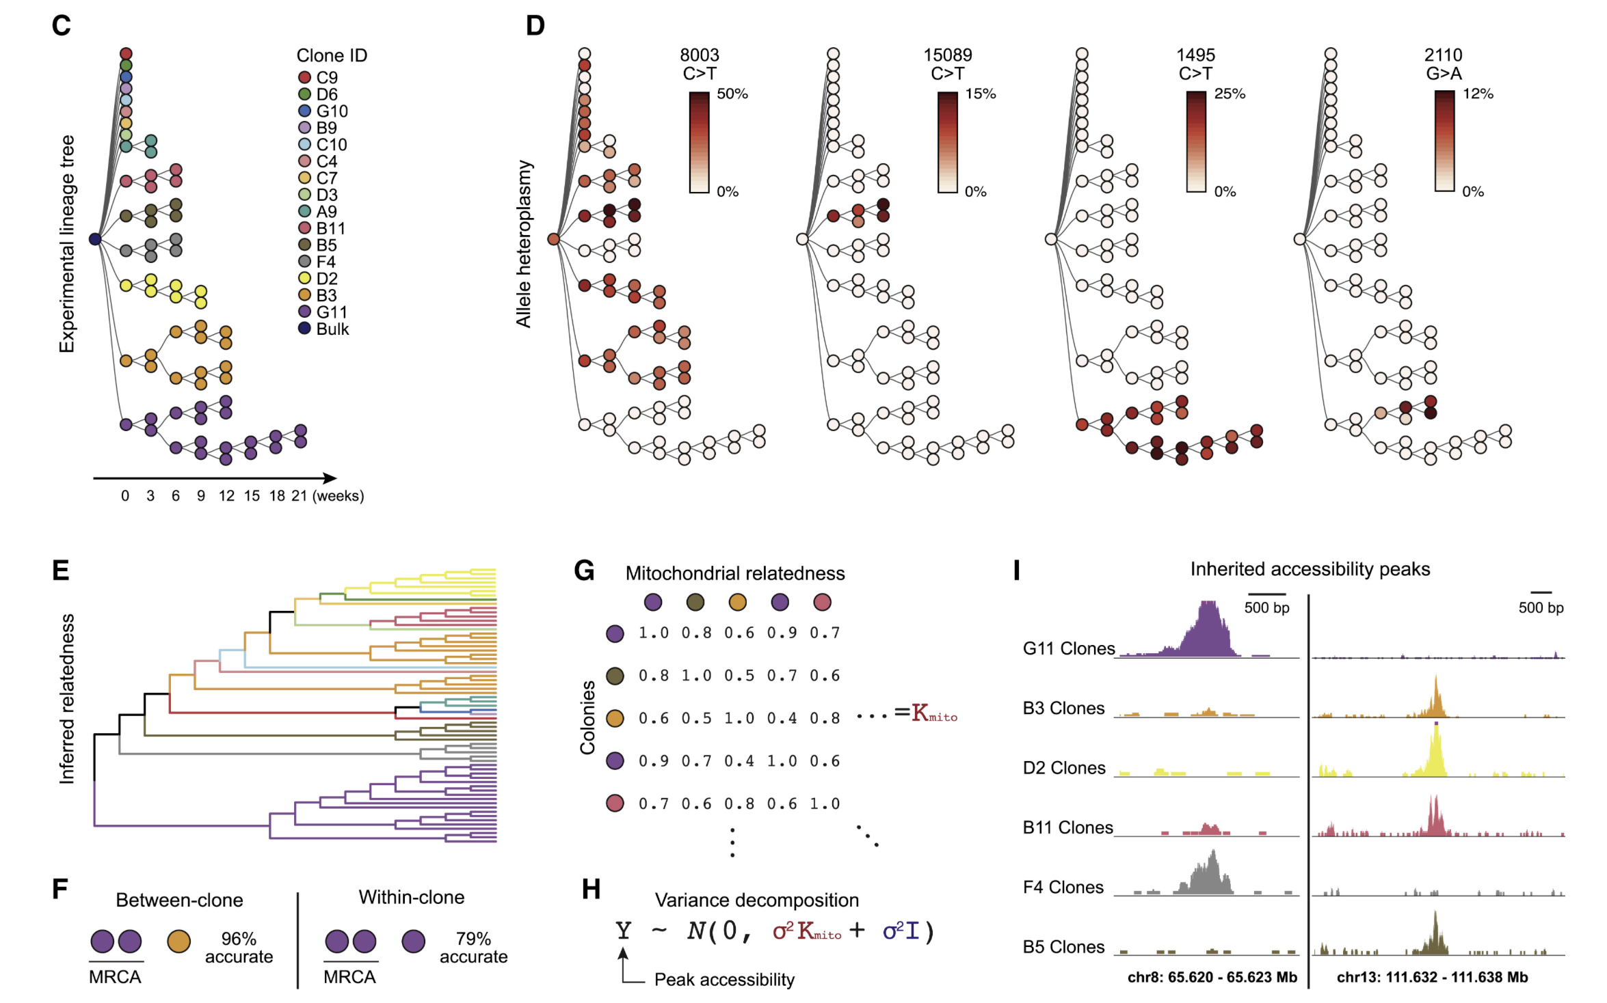
Next steps
Unique benefit of scATAC over bulk
Confirm that MT SNV counts are proportional to accumulated cell division count (pulse chase mass spectrometry of immune cells in T1D)
scATACseq: trace lineages using MT SNVs (proof of concept using Allen Institute TEAseq data) to differentiate between models
Assess DP CD57⁺ non-naïve CD8s’ specificities/function
Ludwig et al. (2020) Cell
Notes:
For sc lineage tracing, I think sorts should include some stuff from along each “step” of lineage
Plan: create fig E diagram and color by cell sort
Perhaps would want to change sorting strategy to include parent DP. PD-1⁺ and CD57⁺, or CD127⁺ ever co-expressed?
Other idea: scRNAseq
allows RNA velocity
would get even fewer MT reads (not all MT genome transcribed)

Slide 25
Extra slides

Slide 26
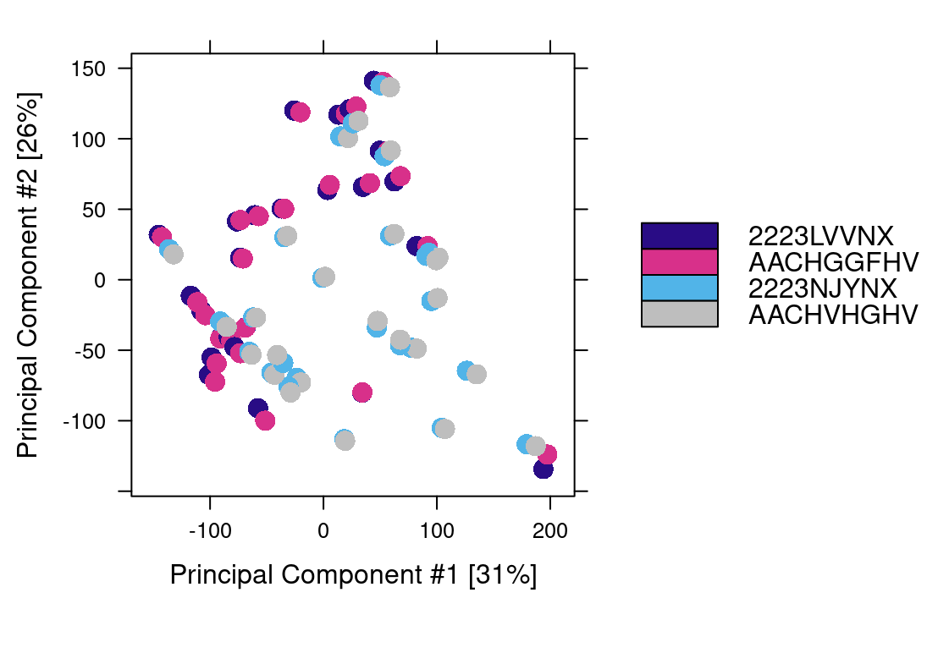
Epigenetics look very similar across seq batches
Flow cell ID: AA_ (orig) and 22_ (reseq)
Notes:
(AA_ fcids vs. 22_ flow cell IDs)
- so I merged alignment files by libid and then called peaks on those merged alignment files

Slide 27
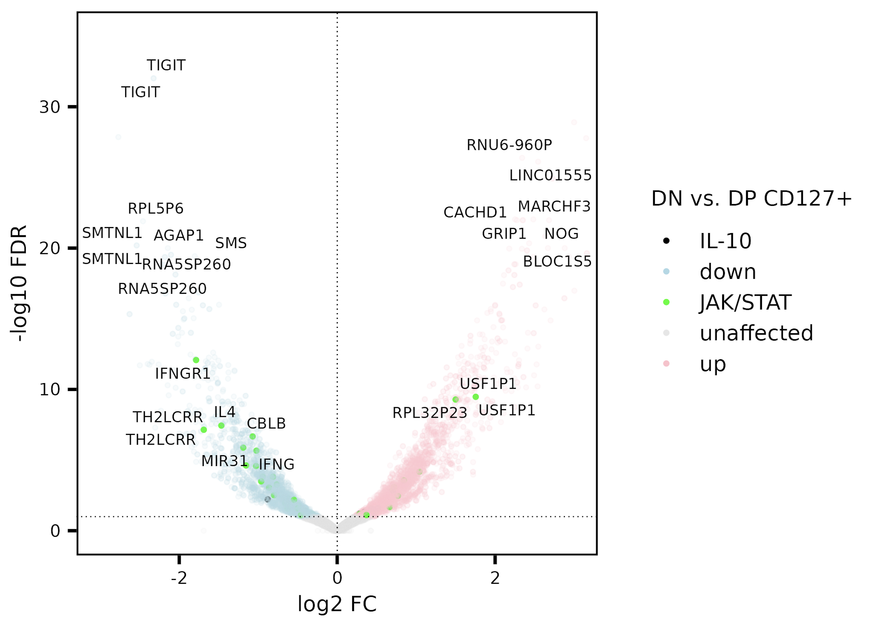
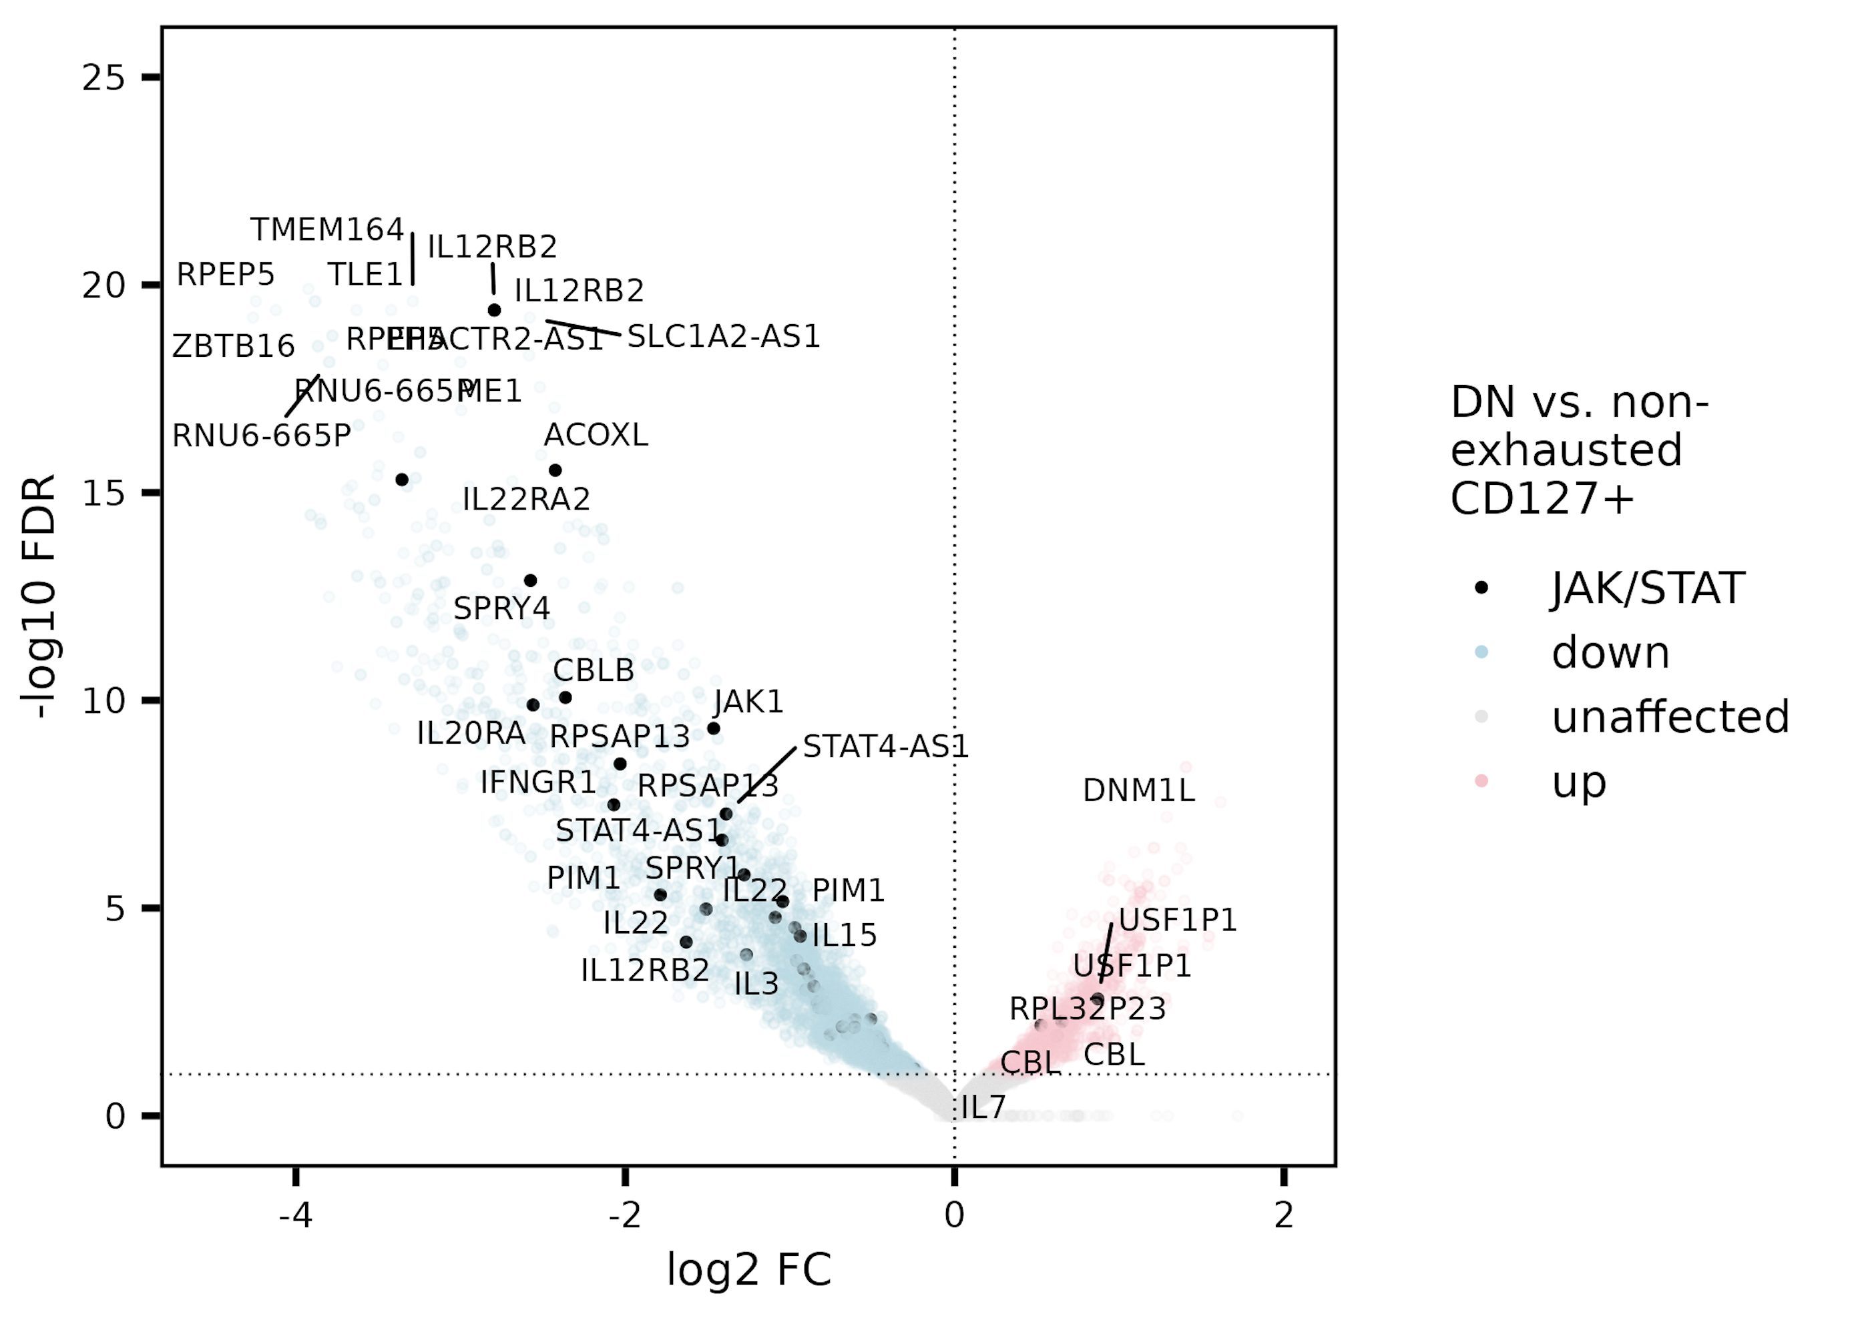
JAK/STAT gene set perhaps more accessible in both CD127⁺ sorts (separate) vs. DN
JAK/STAT & IL-10 enriched (stringdb) in peaks’ genes/promoters up in both CD127⁺ sorts vs. DN

Slide 28
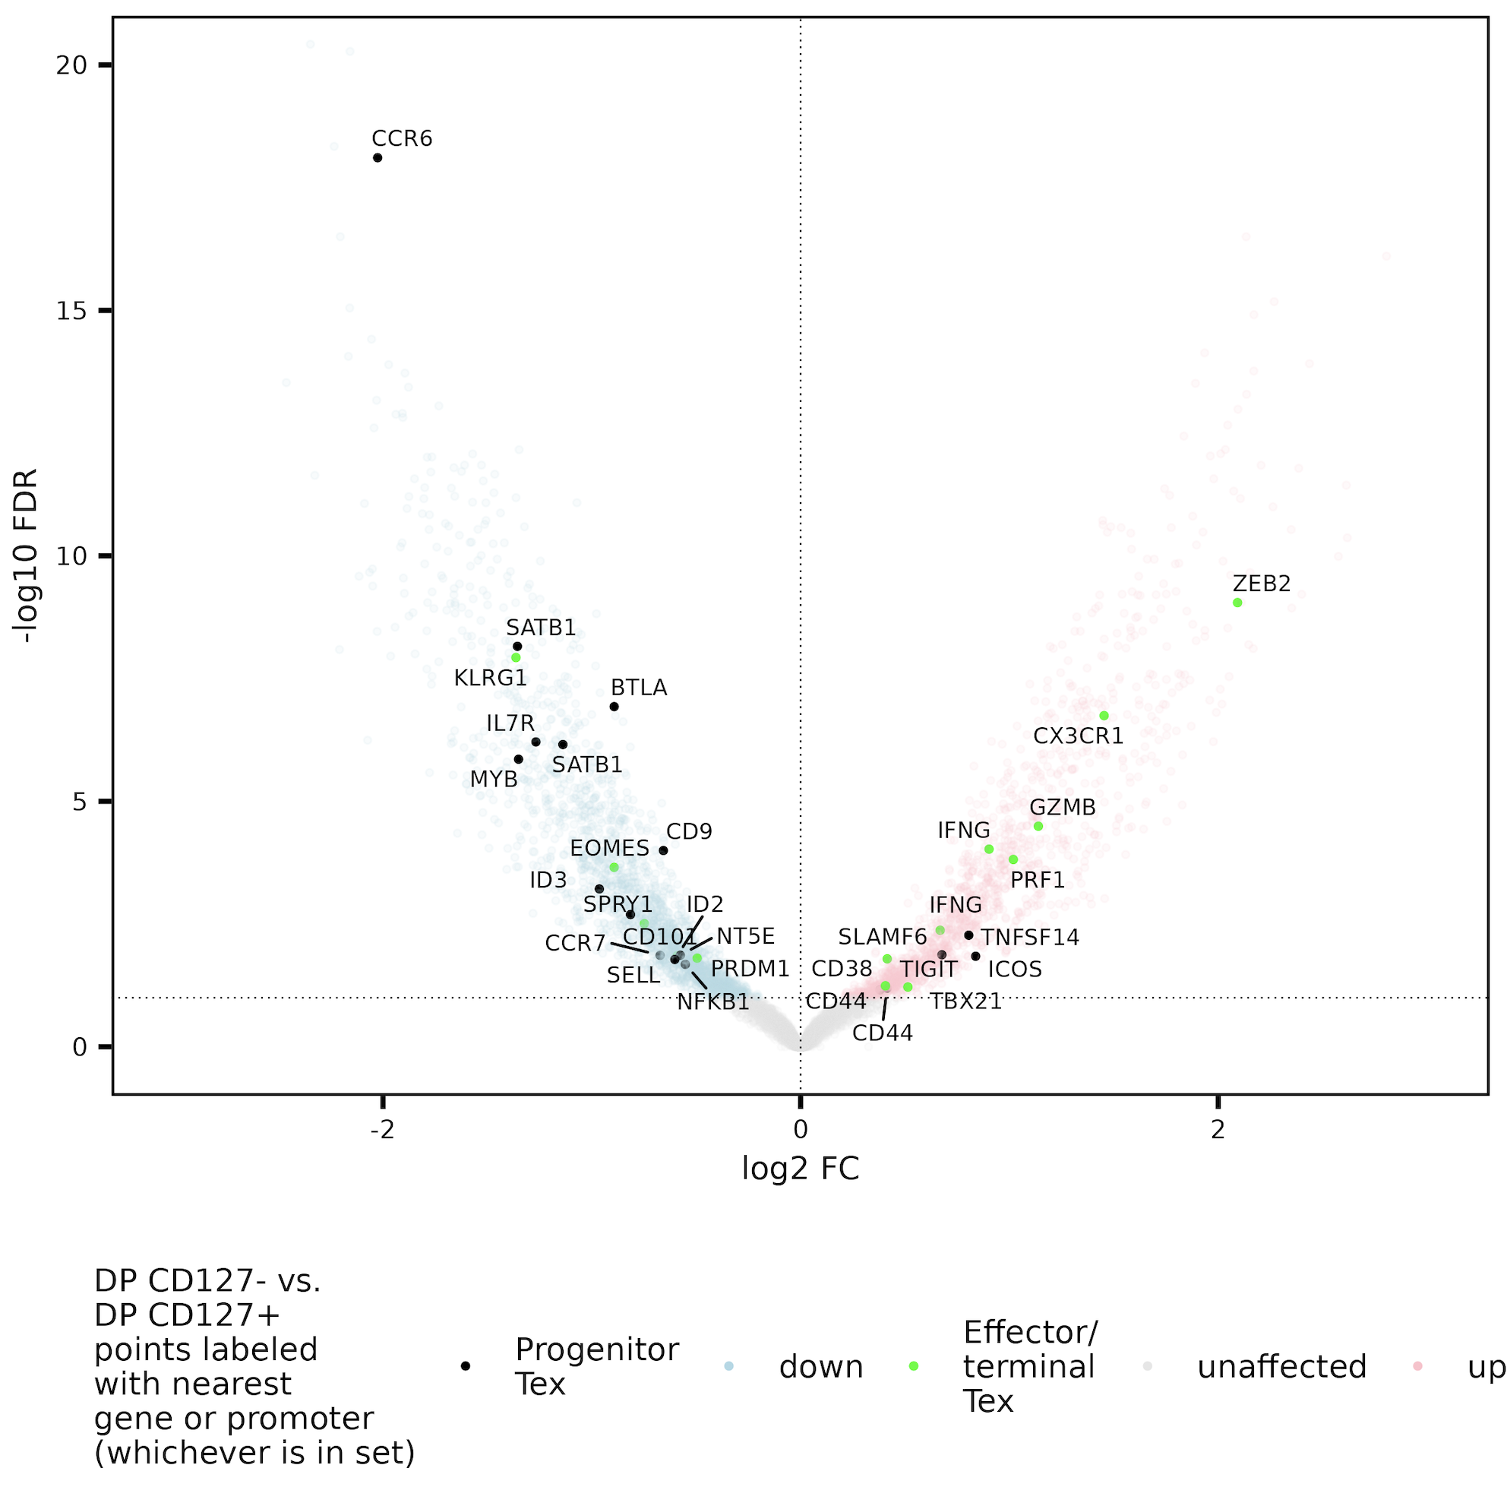
DP CD127⁺ lean to having more accessible peaks near progenitor T_{ex} genes, DP CD127⁻ lean more effector/terminal T_{ex}
Up in DP CD127⁺
Up in DP CD127⁻
Progenitor T_{ex} genes: TNF, IL7R, SPRY1, CXCR5, CD73 (NT5E), CCR7, SELL, CD9, ICOS, TNFSF14, SATB1, CD44, SLAMF6, IL2, MYB, CD83, REL, NFKB1, FOXO1, BTLA, CCR6, CD81, CRTAM, TCF7, ID3
Effector/terminal T_{ex} genes: CX3CR1, ZEB2, CD38, PRF1, PRDM1, GZMB, ID2, IFNG, CD101, ENTPD1 (CD39), HAVCR2 (TIM-3), CD244, RUNX1, TIGIT, PDCD1, LAG3, CD244, CD103, CTLA4, EOMES, TBX21, CD69, KLRG1, TOX
Bold meaning consistent evidence in mean gene coverage plots (CD38, PRF1, PRDM1, GZMB higher only in DP CD57⁺)
Notes:
Some of the terminal consistent evidence mean coverage plots are really just higher in DP CD57+ and similar in DP CD127+/PD-1+ (but this is consistent with DP CD57 being most terminal given the MT SNV counts), haven’t yet looked at this VP coloring in each DP CD127+ vs. PD-1/CD57 separately as I have done for the purine metabolism/TGFB gene sets
Likely that not all of these chosen genes are equally selective for progenitor vs. terminal… list could definitely use revision/immunologist perspective
NT5E = CD73, SELL = CD62L
Texeff: TBX21/Tbet, Zeb2, KLRG1
ITGAE = CD103, TBX21 = TBET

Slide 29
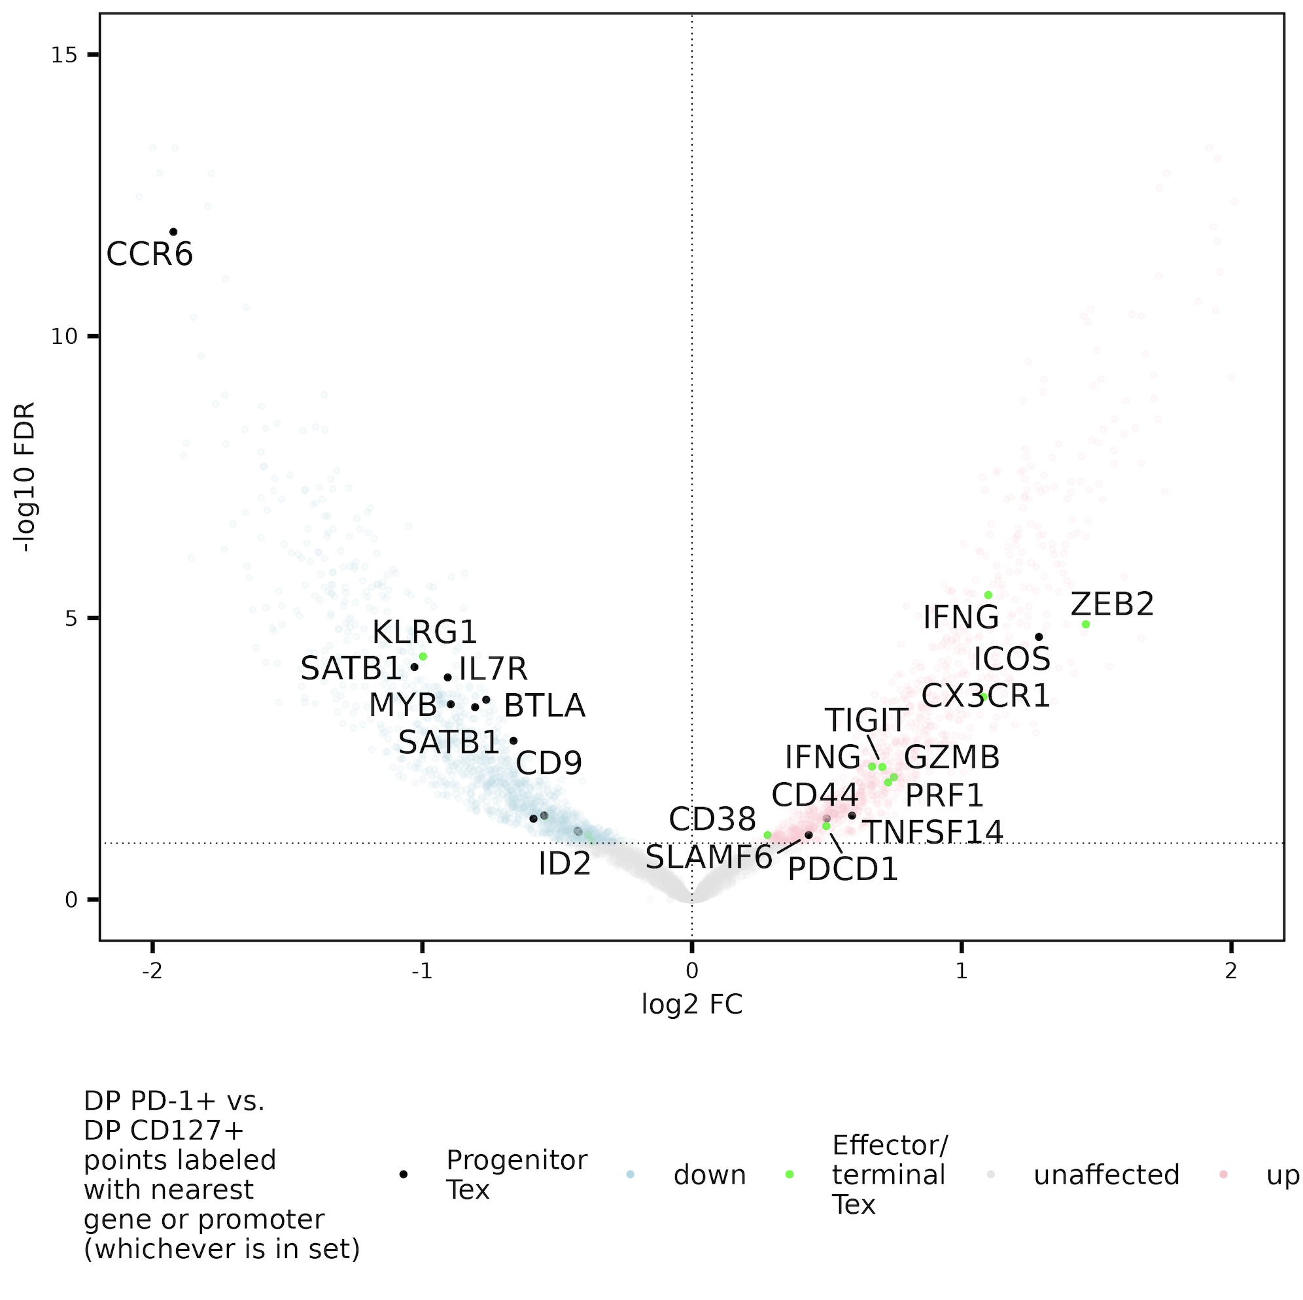
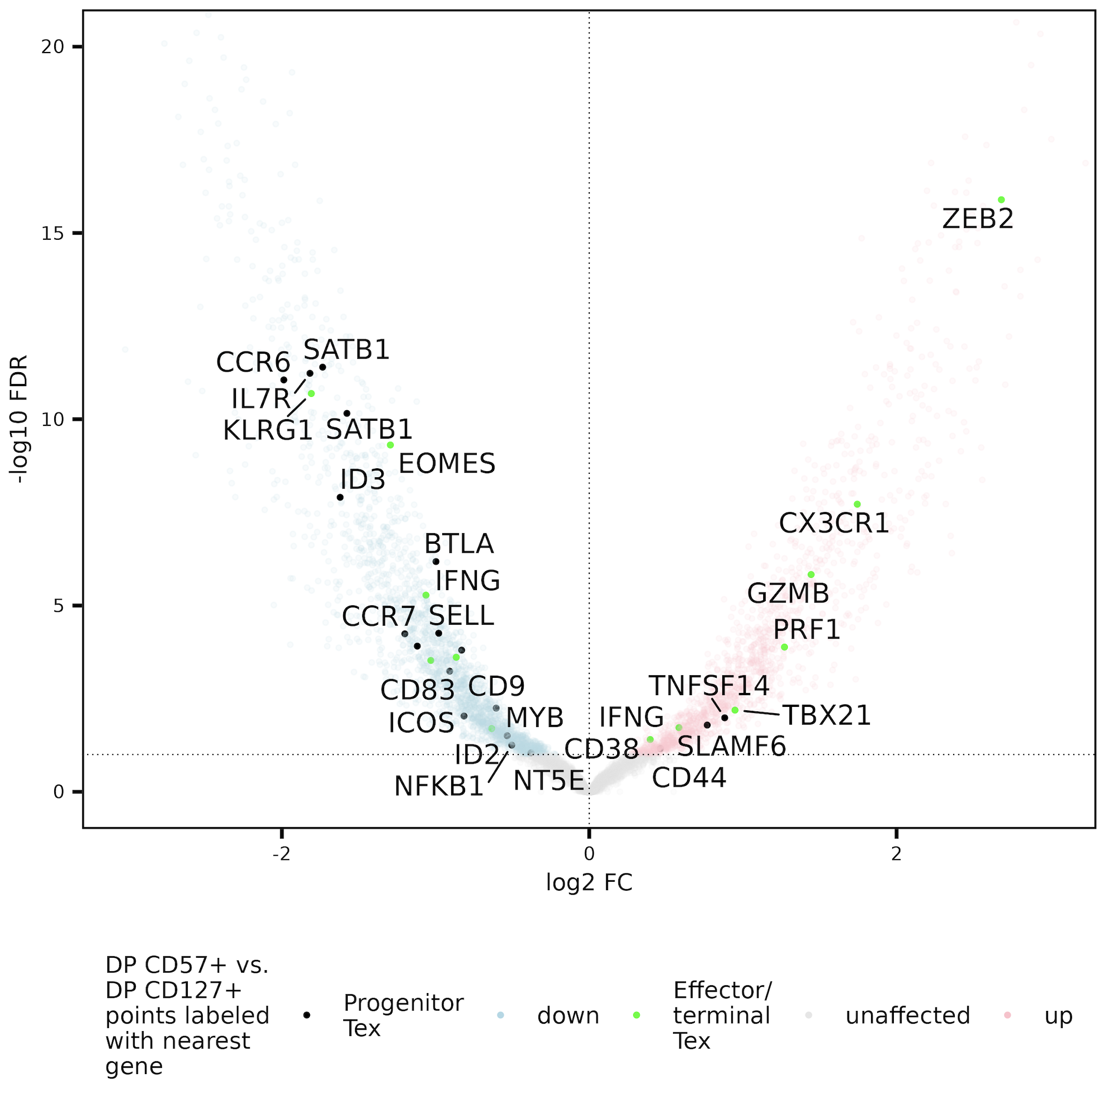
DP CD127⁺ lean to having more accessible peaks near progenitor T_{ex} genes, both DP CD127⁻ sorts lean more effector/terminal T_{ex}

Slide 30
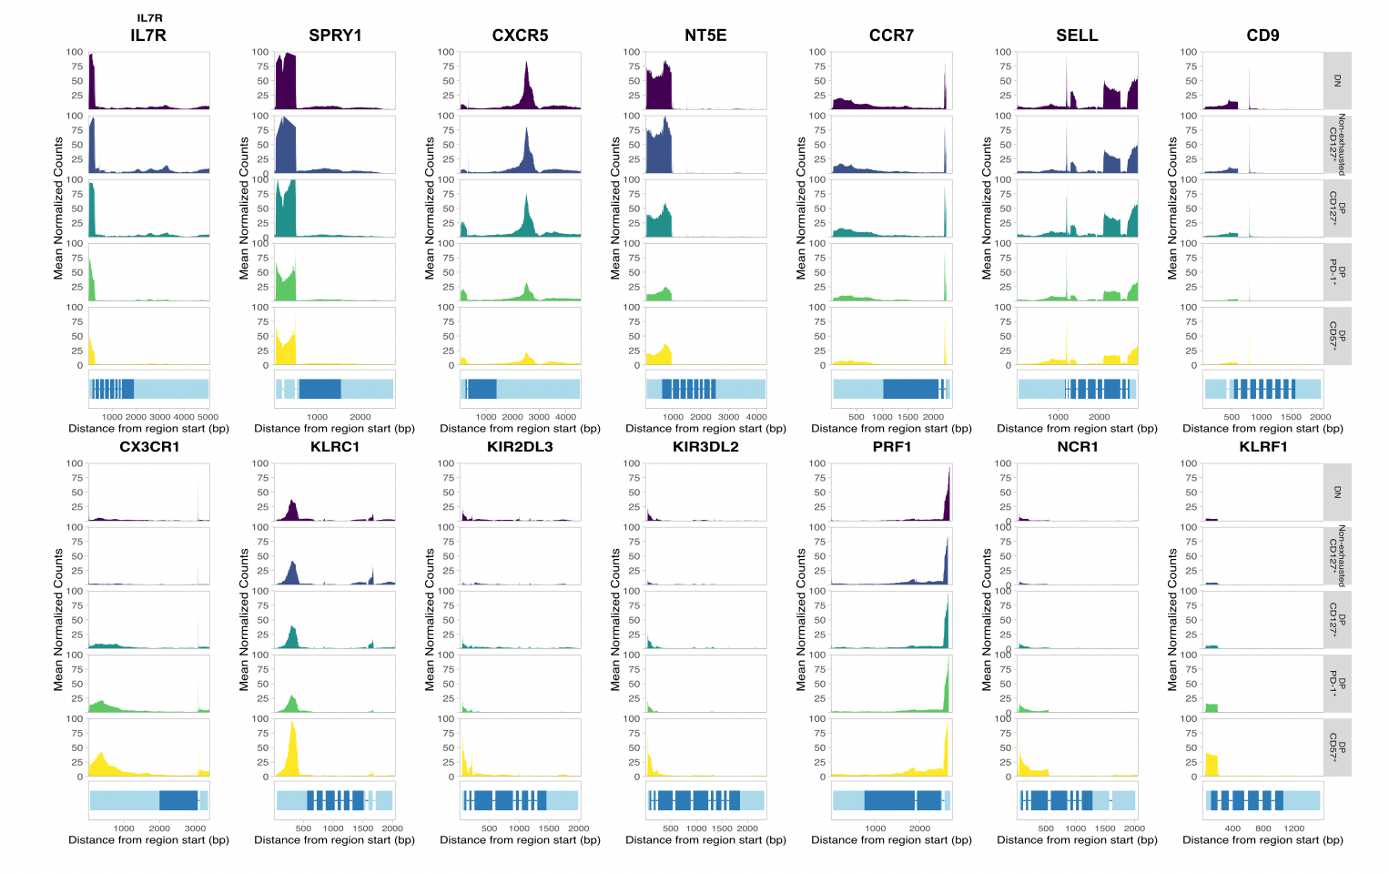
DP T_{ex} heterogeneity also observed in gene bodies

Slide 31
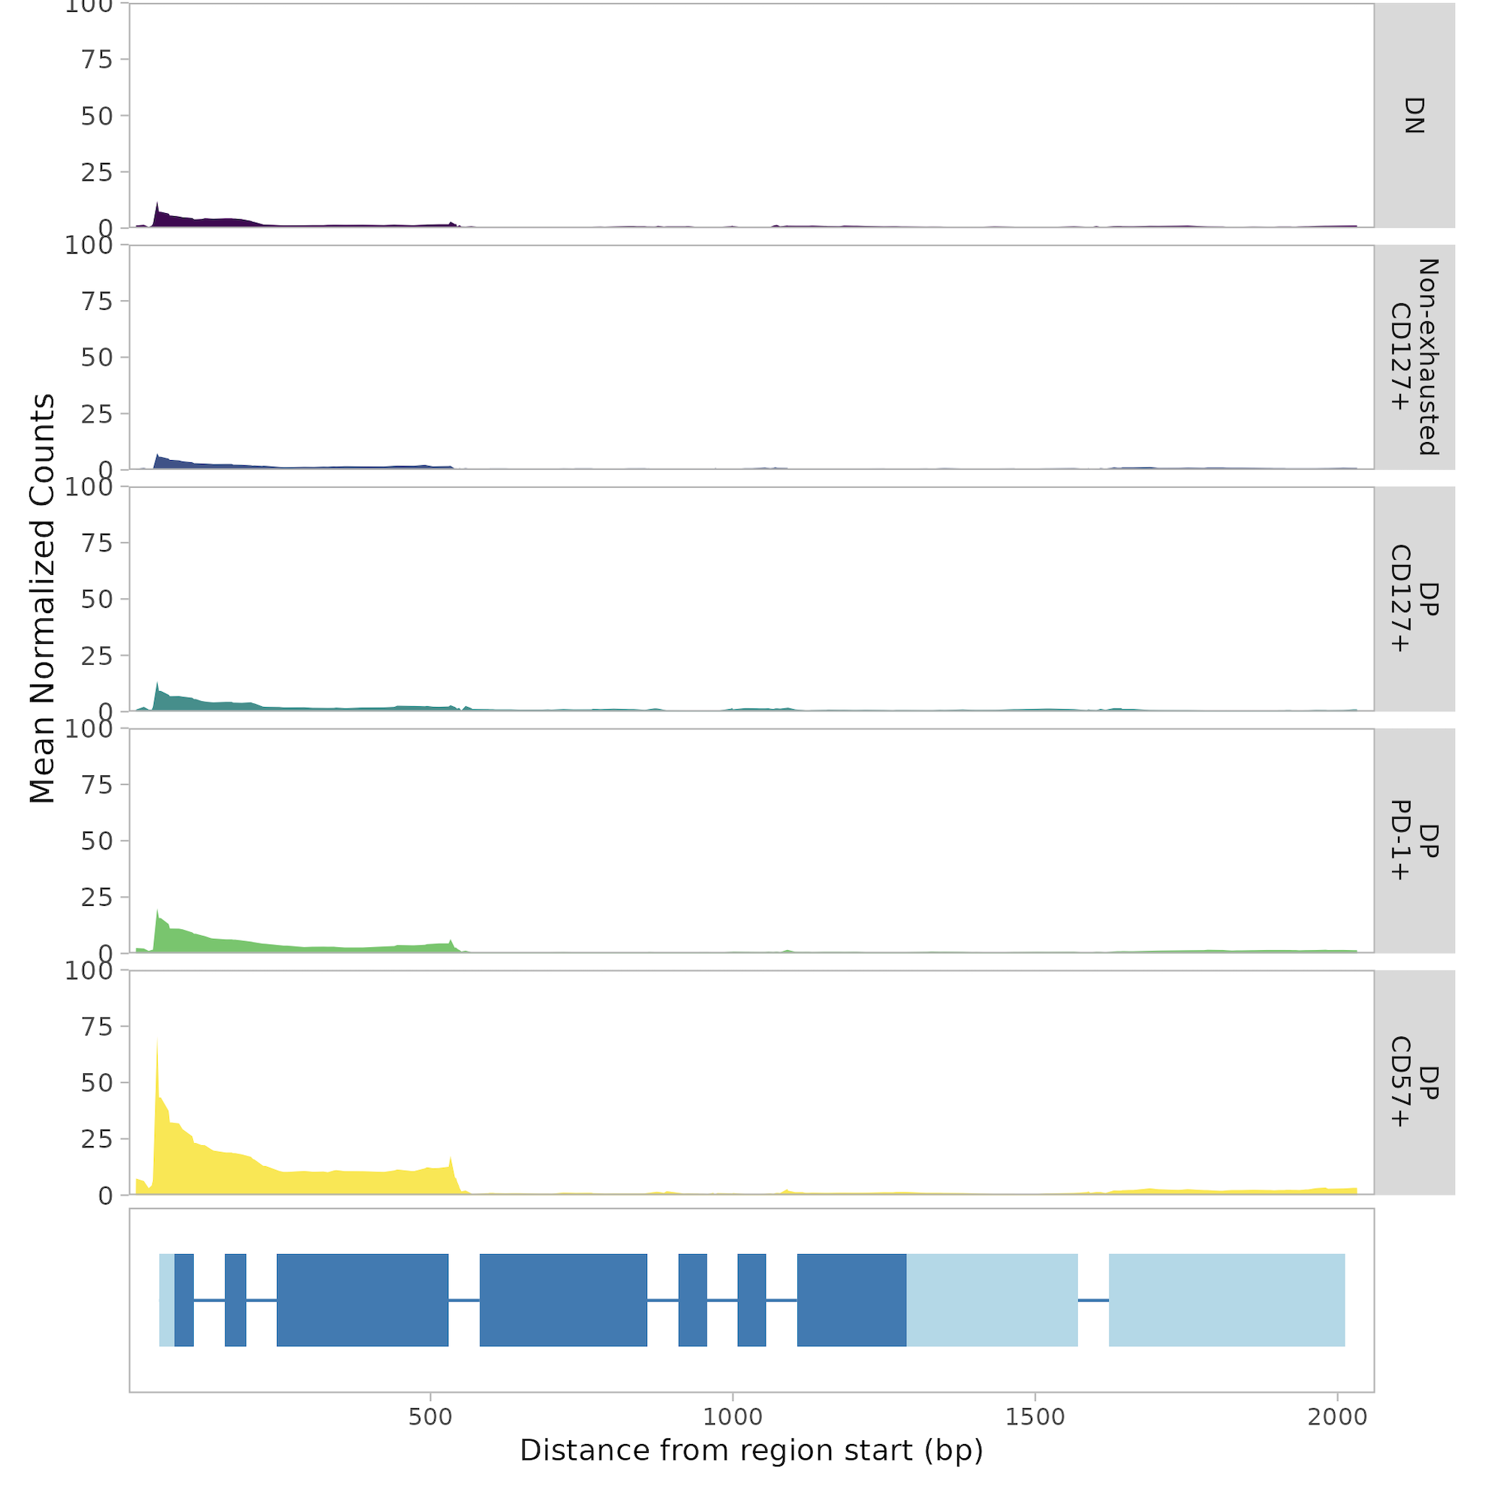
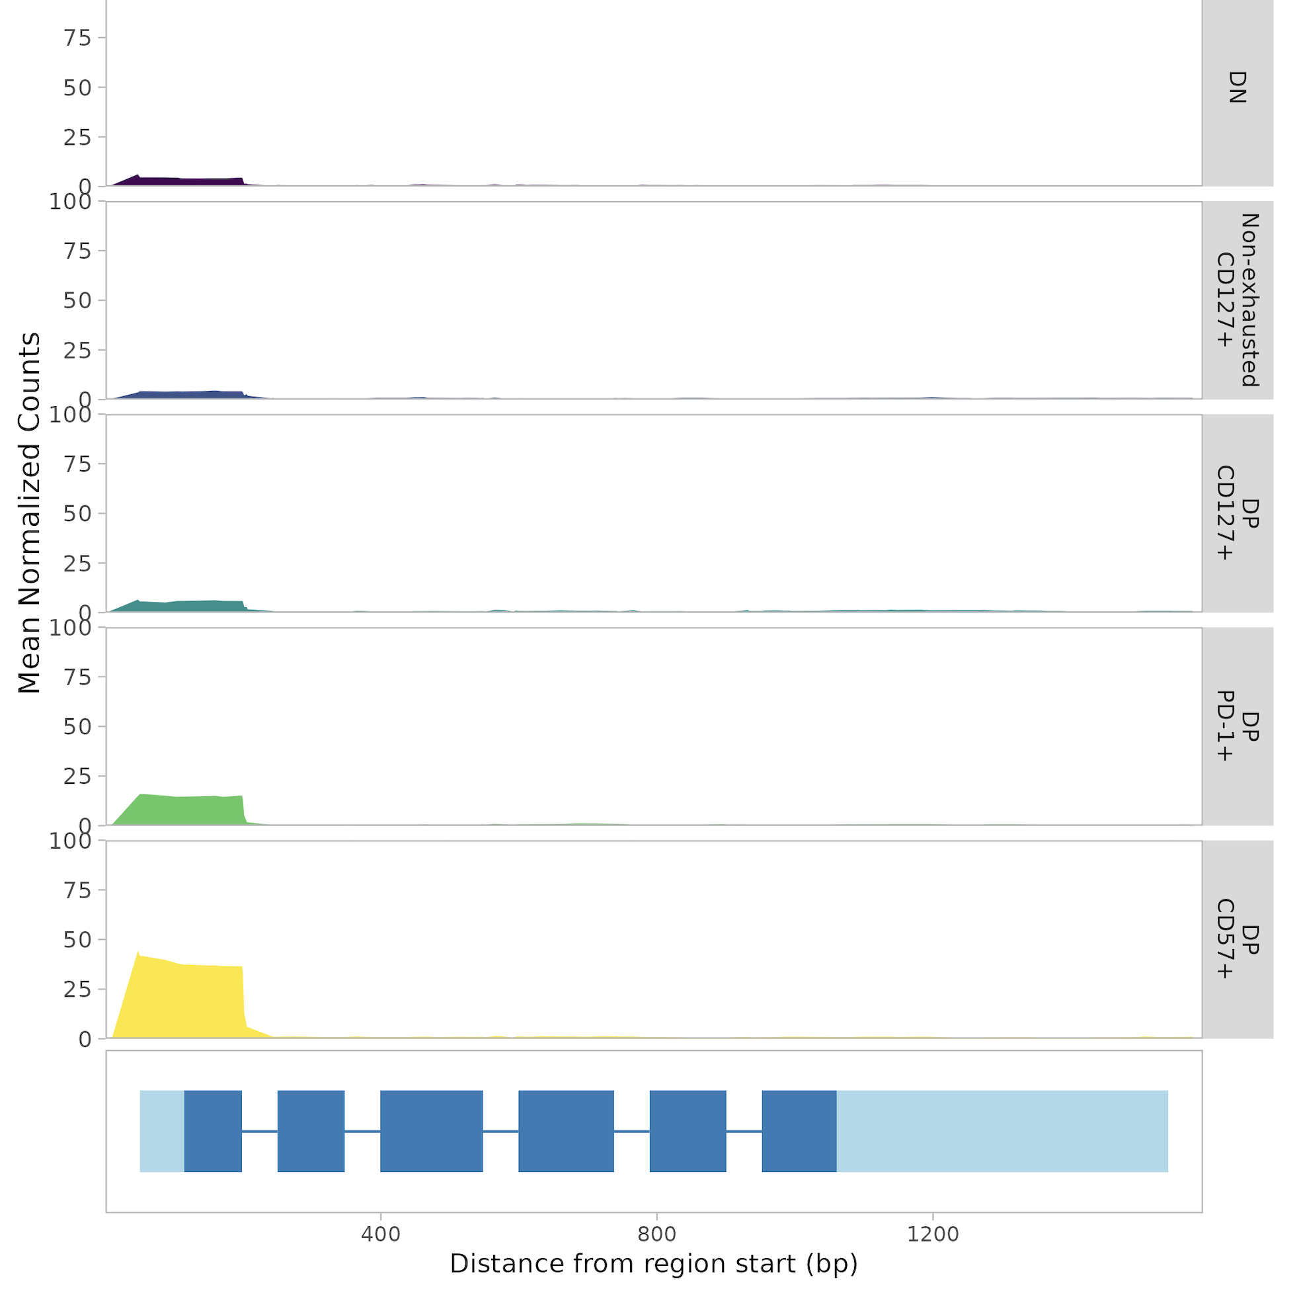
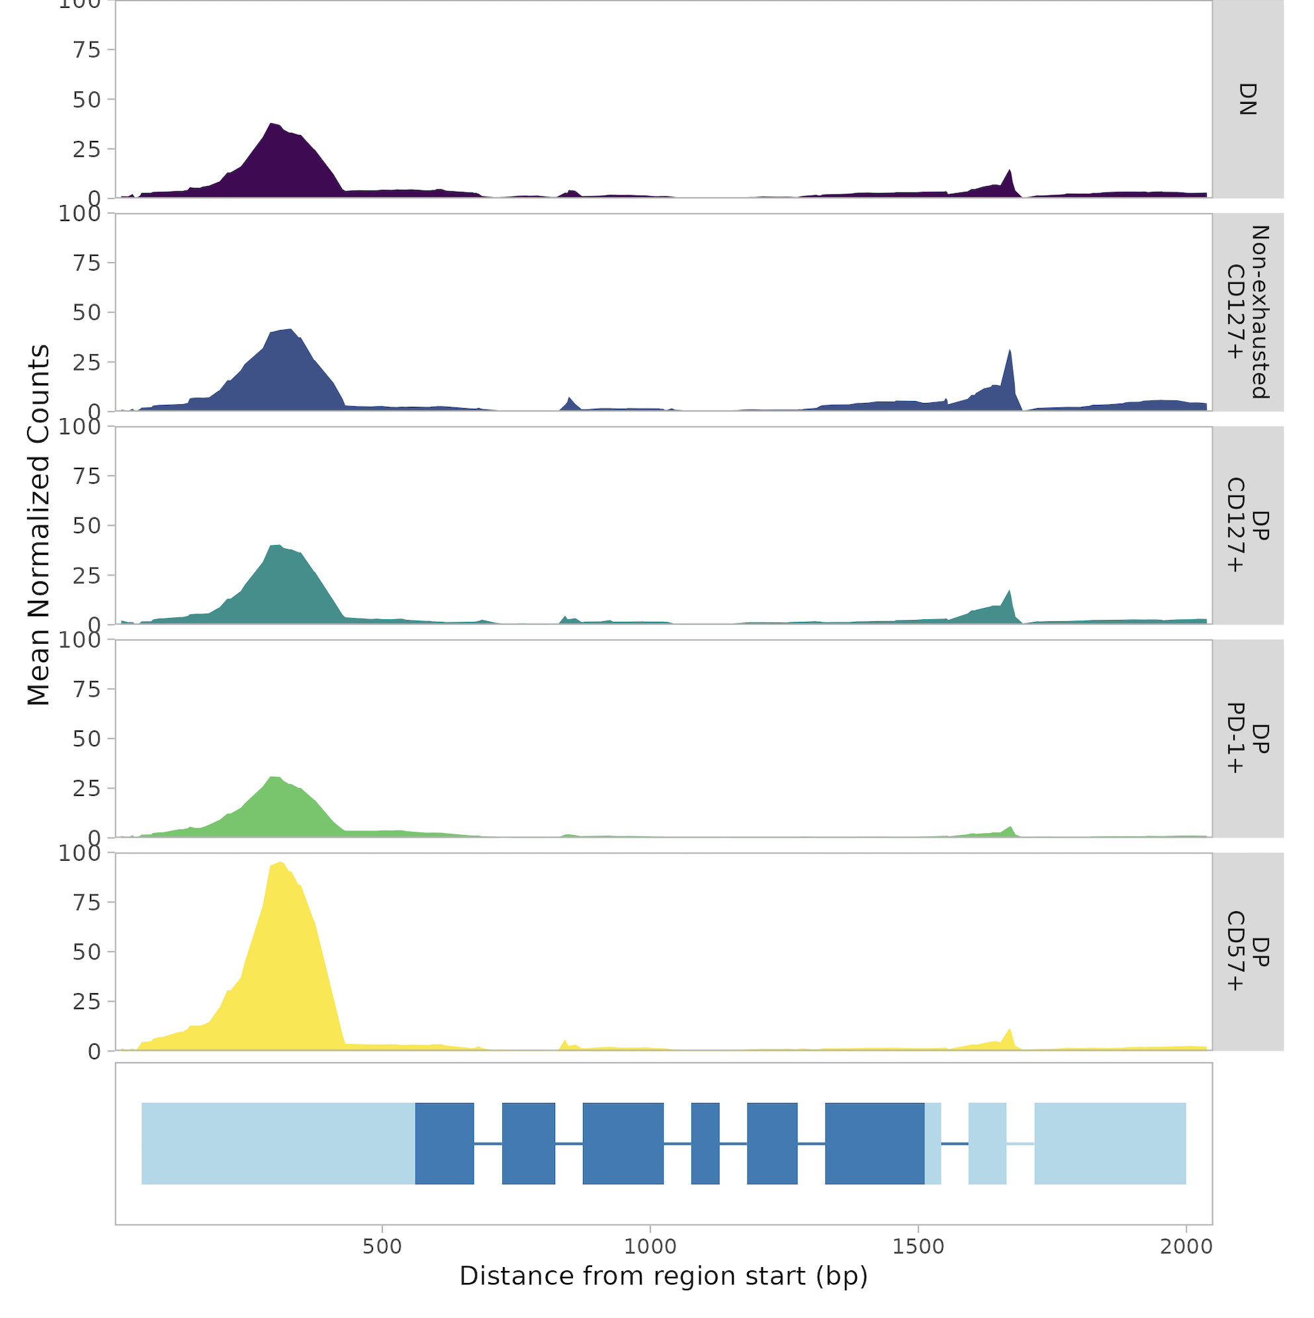
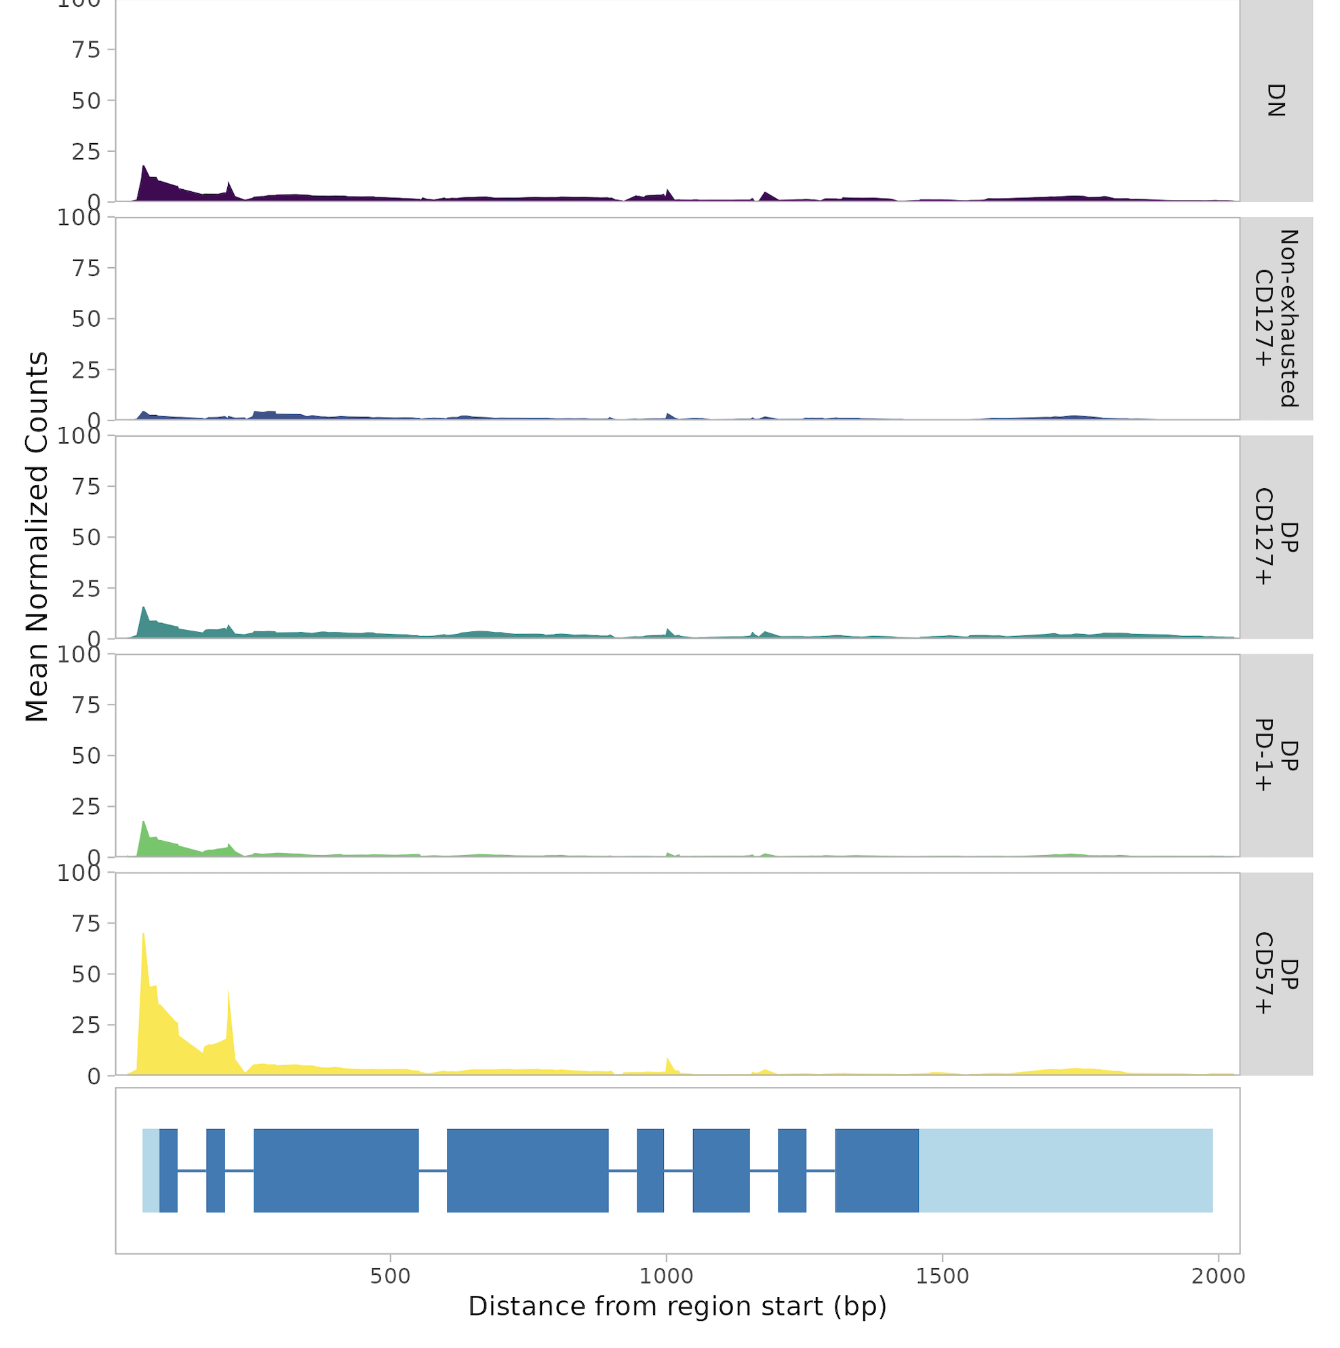
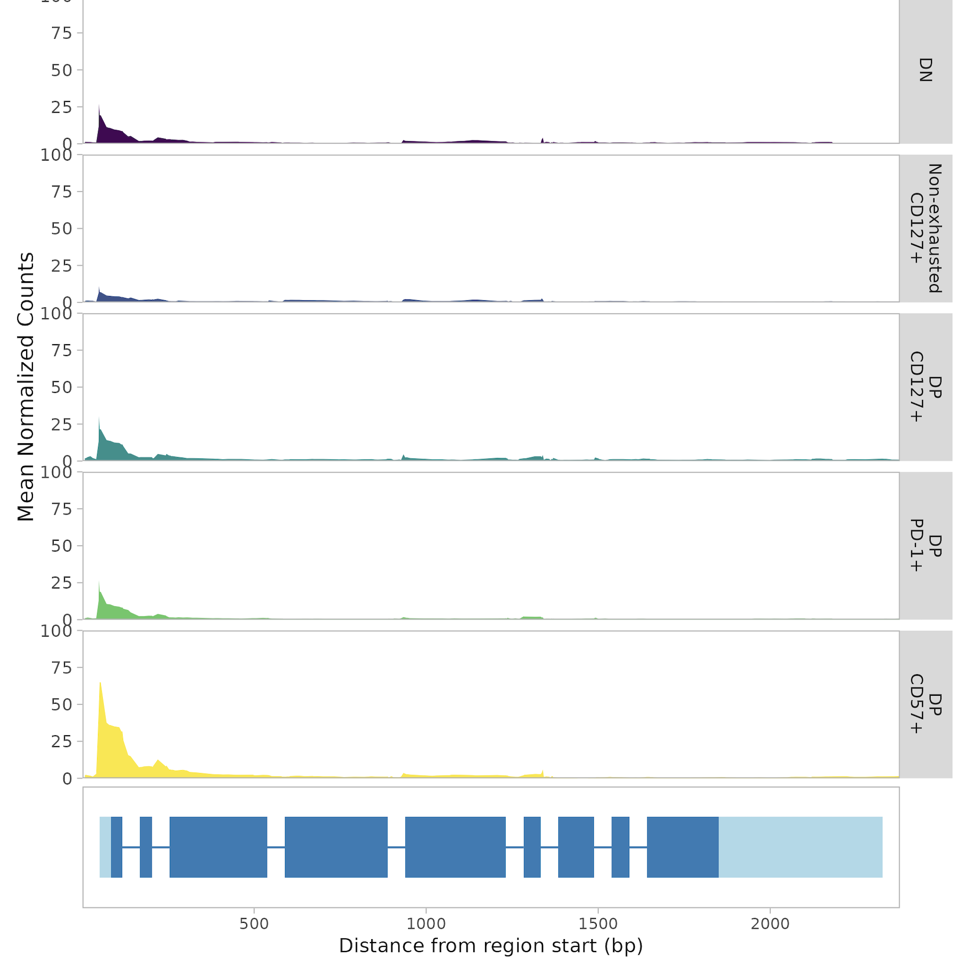
Mean gene coverage plots supporting DP CD57⁺ CD8s as T_{ex}^{eff}
KLRF1
KLRC1
NCR1
KIR2DL3
KIR3DL2

Slide 32
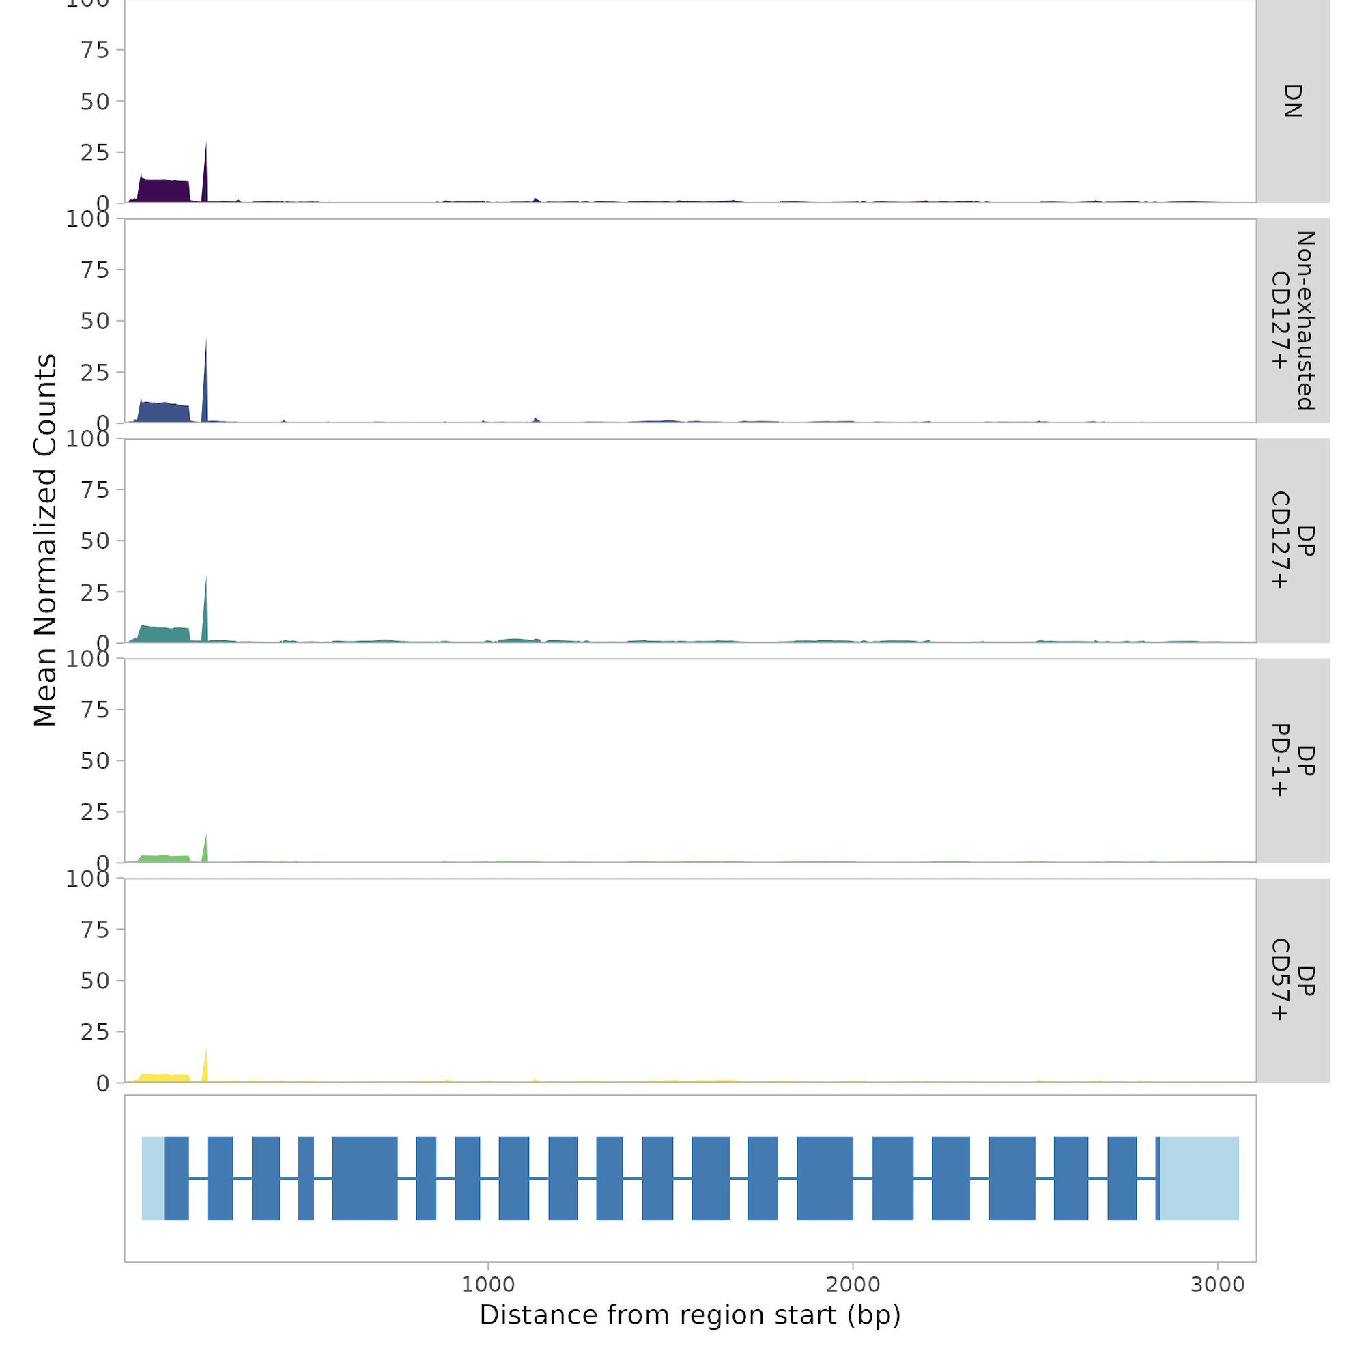
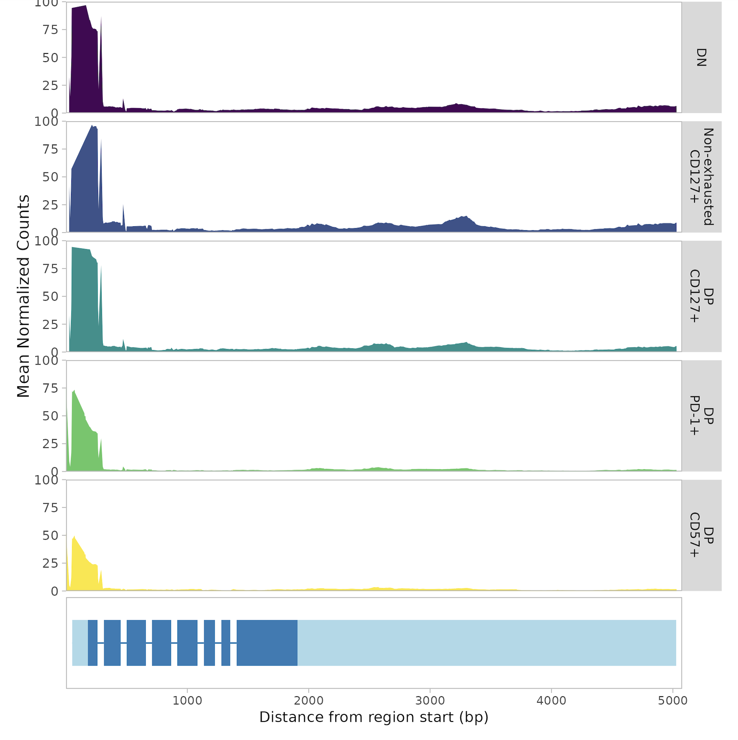
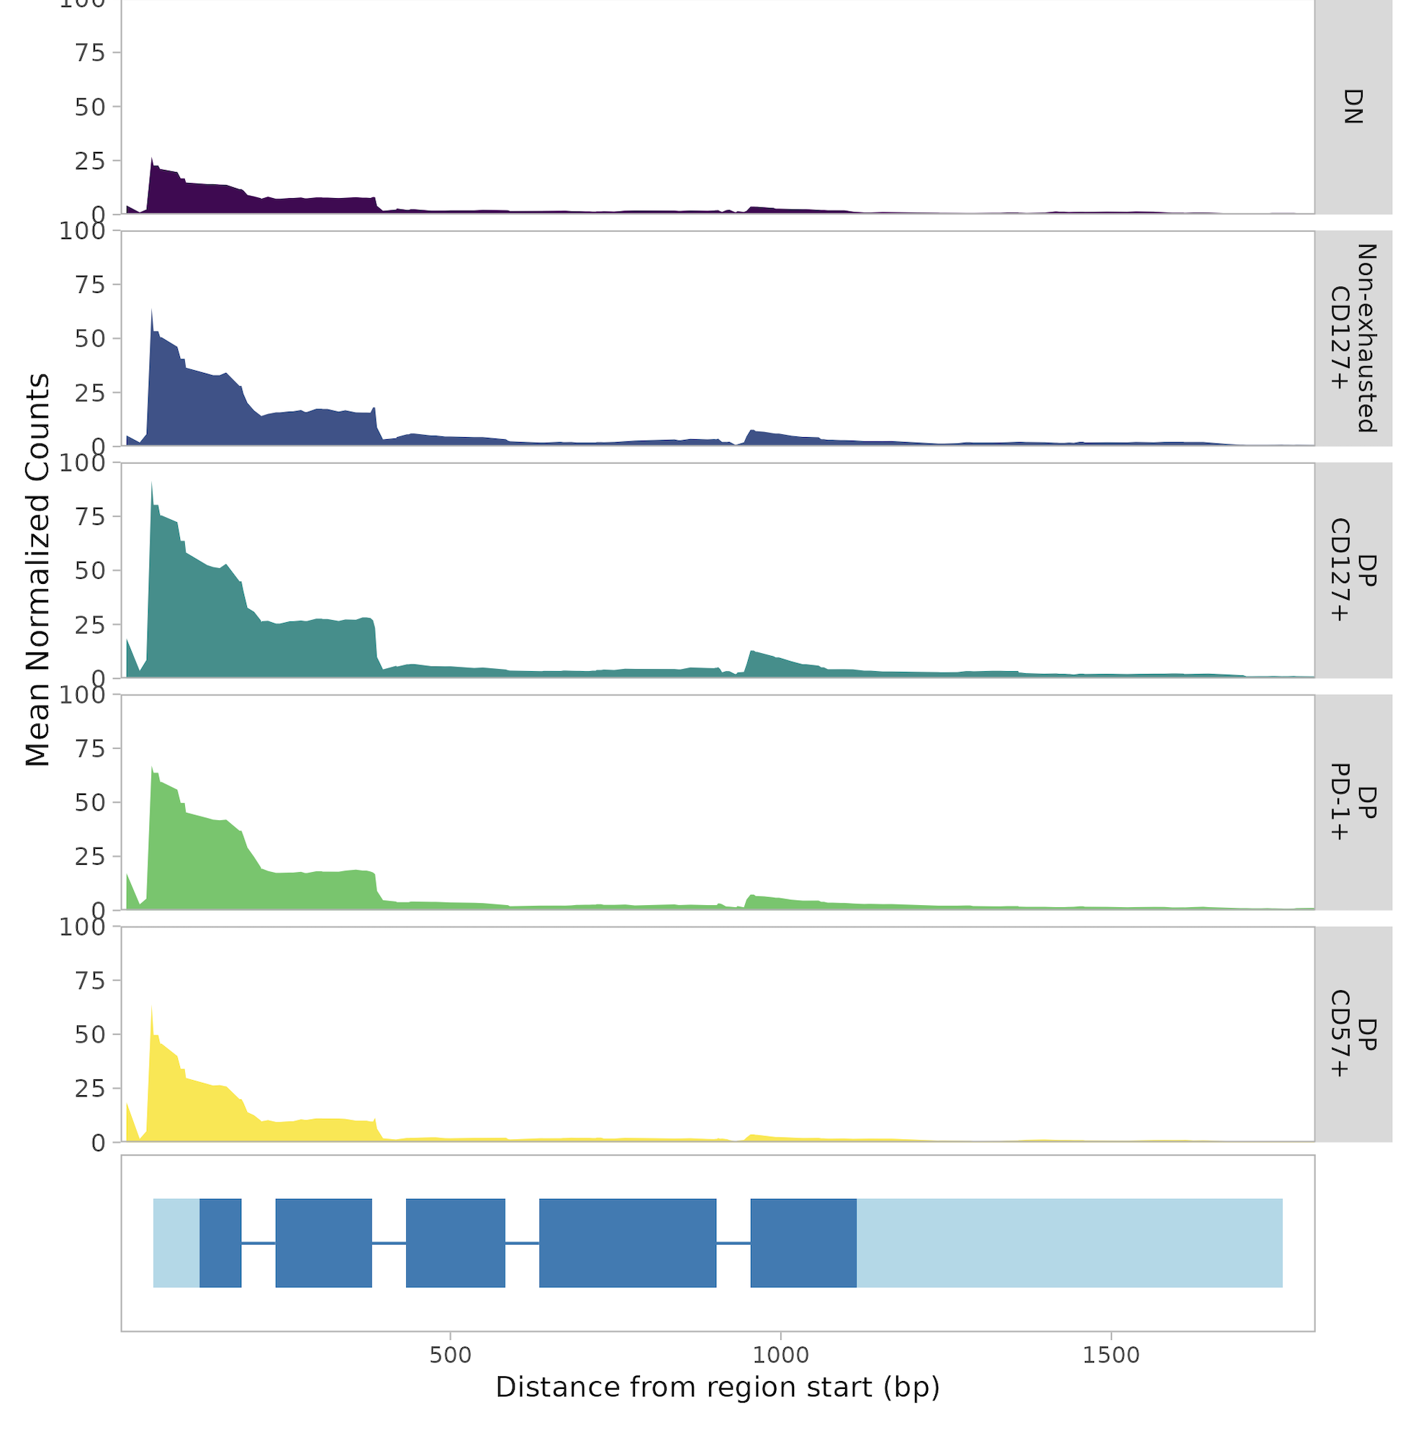
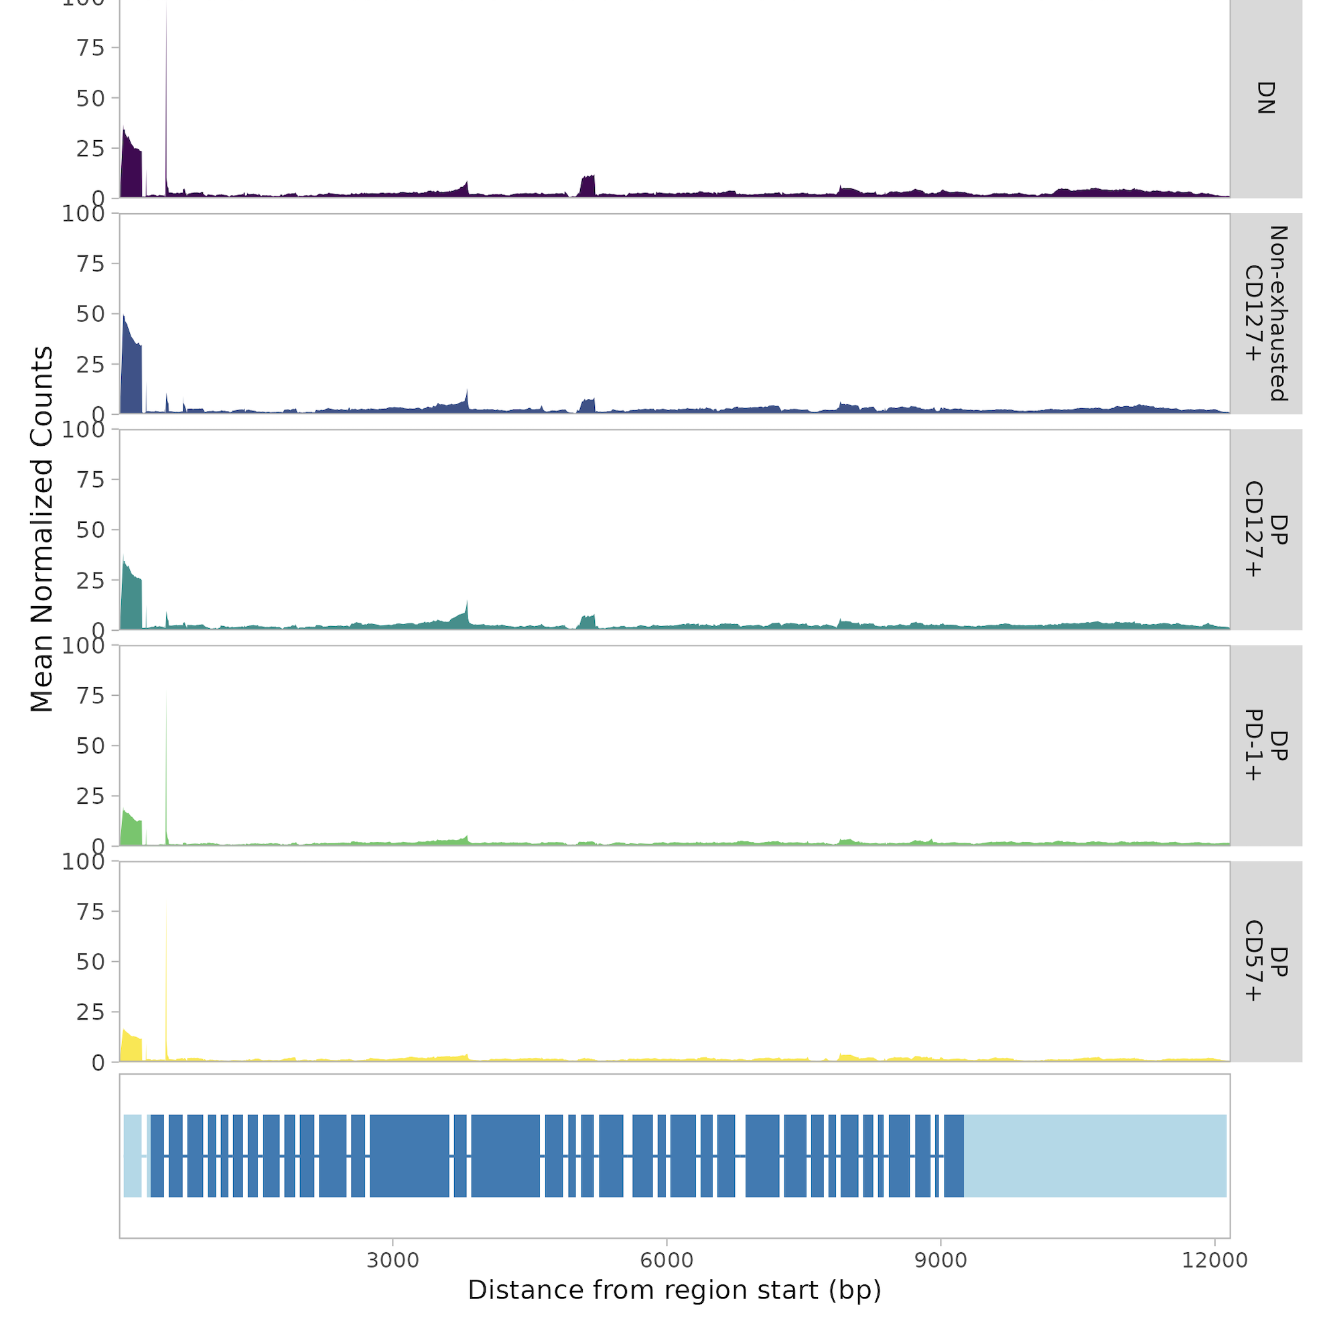
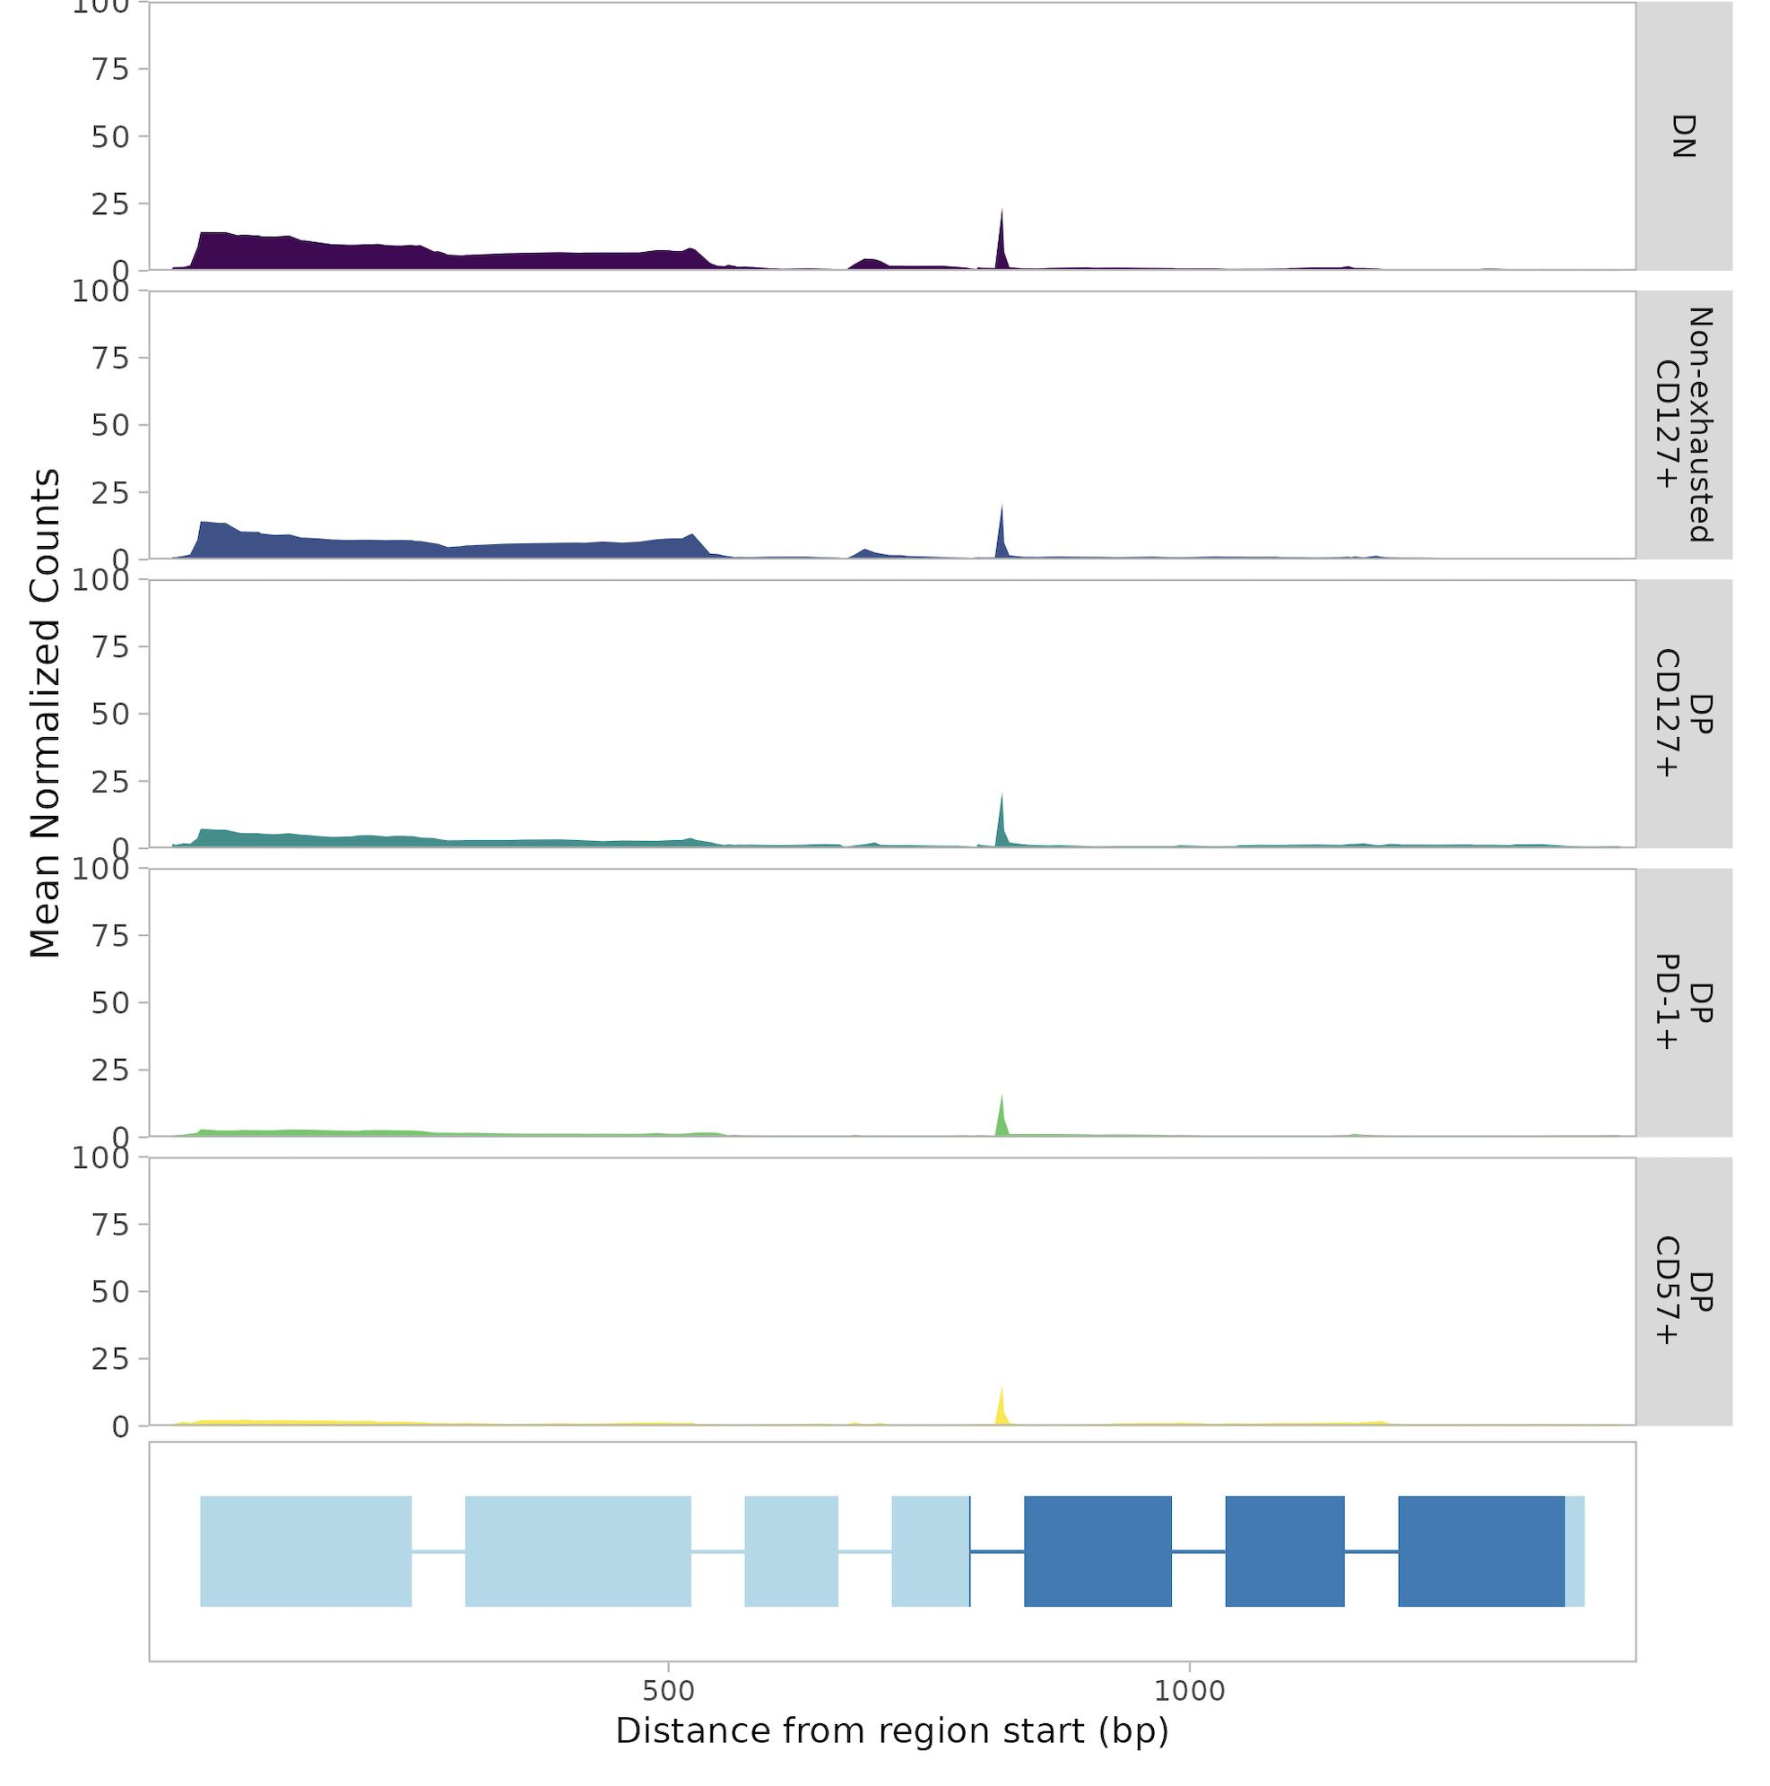
Genes with higher coverage in DP CD127⁺ or lower coverage in DP CD127⁻
PDE9A (purine)
IL7R
GZMK
SPTBN1 (TGFβ)
MDS2 (purine)

Slide 33
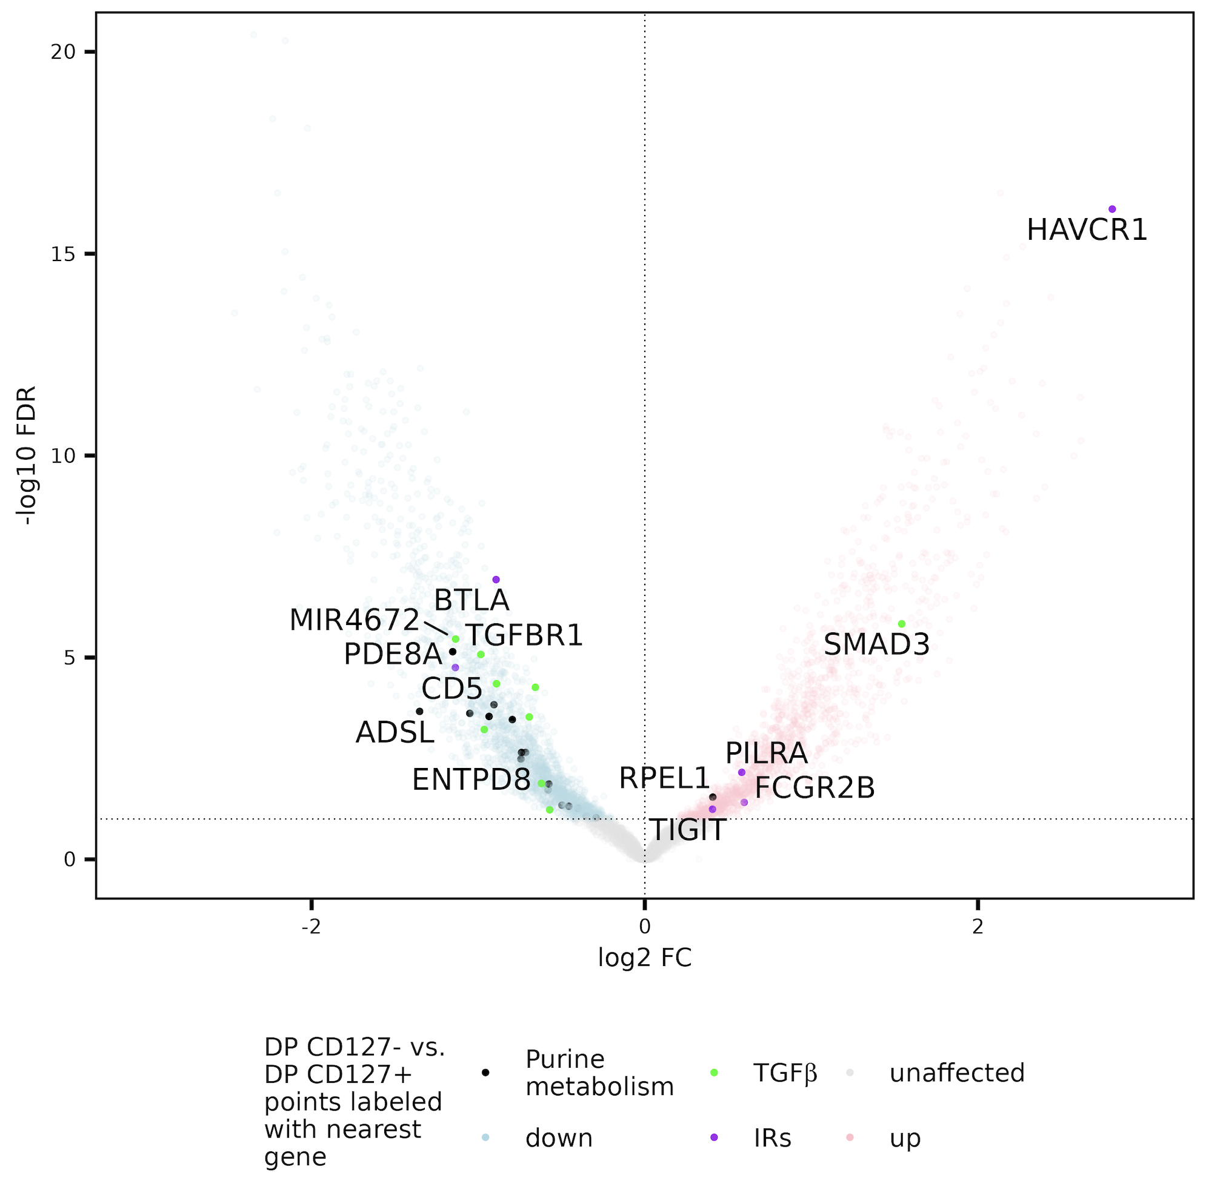
Purine metabolism set peaks more accessible in DP CD127⁺ than DP CD127⁻ CD8s
Up in DP CD127⁺
Up in DP CD127⁻
Counts of peaks with nearest gene/promoter in set | DP CD127⁺ | DP CD127⁻
In purine metabolism gene set | 16 | 1
Not in set | 2021 | 1464
**
**; p < 0.01
Notes:
Not sure if TIM-1 (HAVCR1) is confirmed IR, TIM-3 is IR, so same family of TIMs, they do share at least 1 ligand (phosphatidyl serine) TIM-3 marks terminal Tex, so that would be interesting/consistent with hypothesis (DP CD127- associating with better response), Slamf6 marks progenitor Tex and a peak near Slamf6 is also up in DP CD127- though…
Apparently, TGF-β signaling promotes IL-7Rα expression and CD8 differentiation, so this is consistent with that
Purine:
Fisher's Exact Test for Count Data data: contingency_table p-value = 0.002052 alternative hypothesis: true odds ratio is not equal to 1 95 percent confidence interval: 1.795848 485.359038 sample estimates: odds ratio 11.58634
Same deal with normalized peak counts pval = 1
Pearson's Chi-squared test with Yates' continuity correction data: contingency_table X-squared = 7.6498, df = 1, p-value = 0.005678
Connecting purine to TCR: “ADA catalyzes the conversion of adenosine to inosine intracellularly, as part of the purine metabolism pathways, and extracellularly, where ADA can co-stimulate T-cell activation through its interaction with CD26 and enhance both IFN-gamma and TNF-alpha production”
MAYBE purine metabolism links to DP CD127+s being more activated! And this being up in DN/non-exhausted is consistent too then I believe
“purine/thymidine enables rapid T cell expansion,”

Slide 34
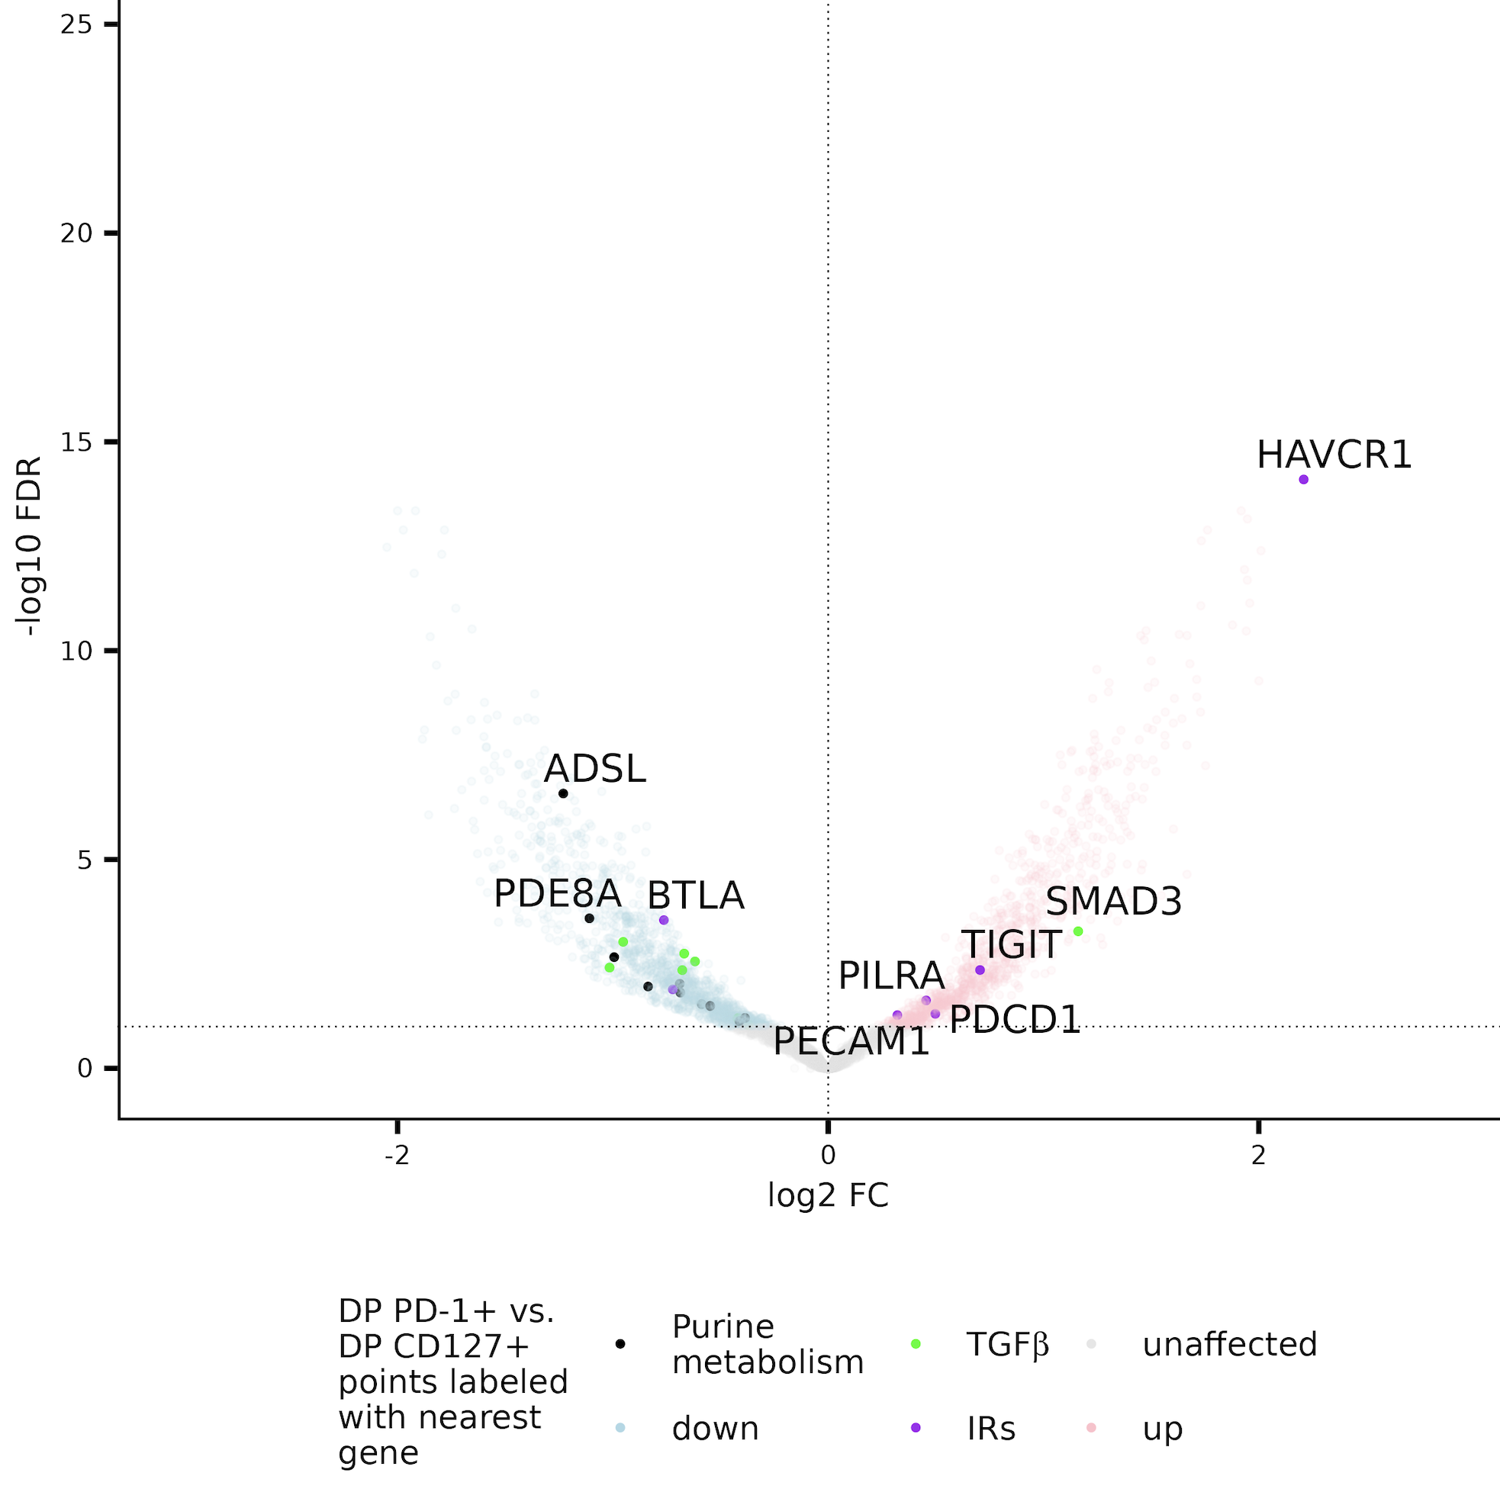
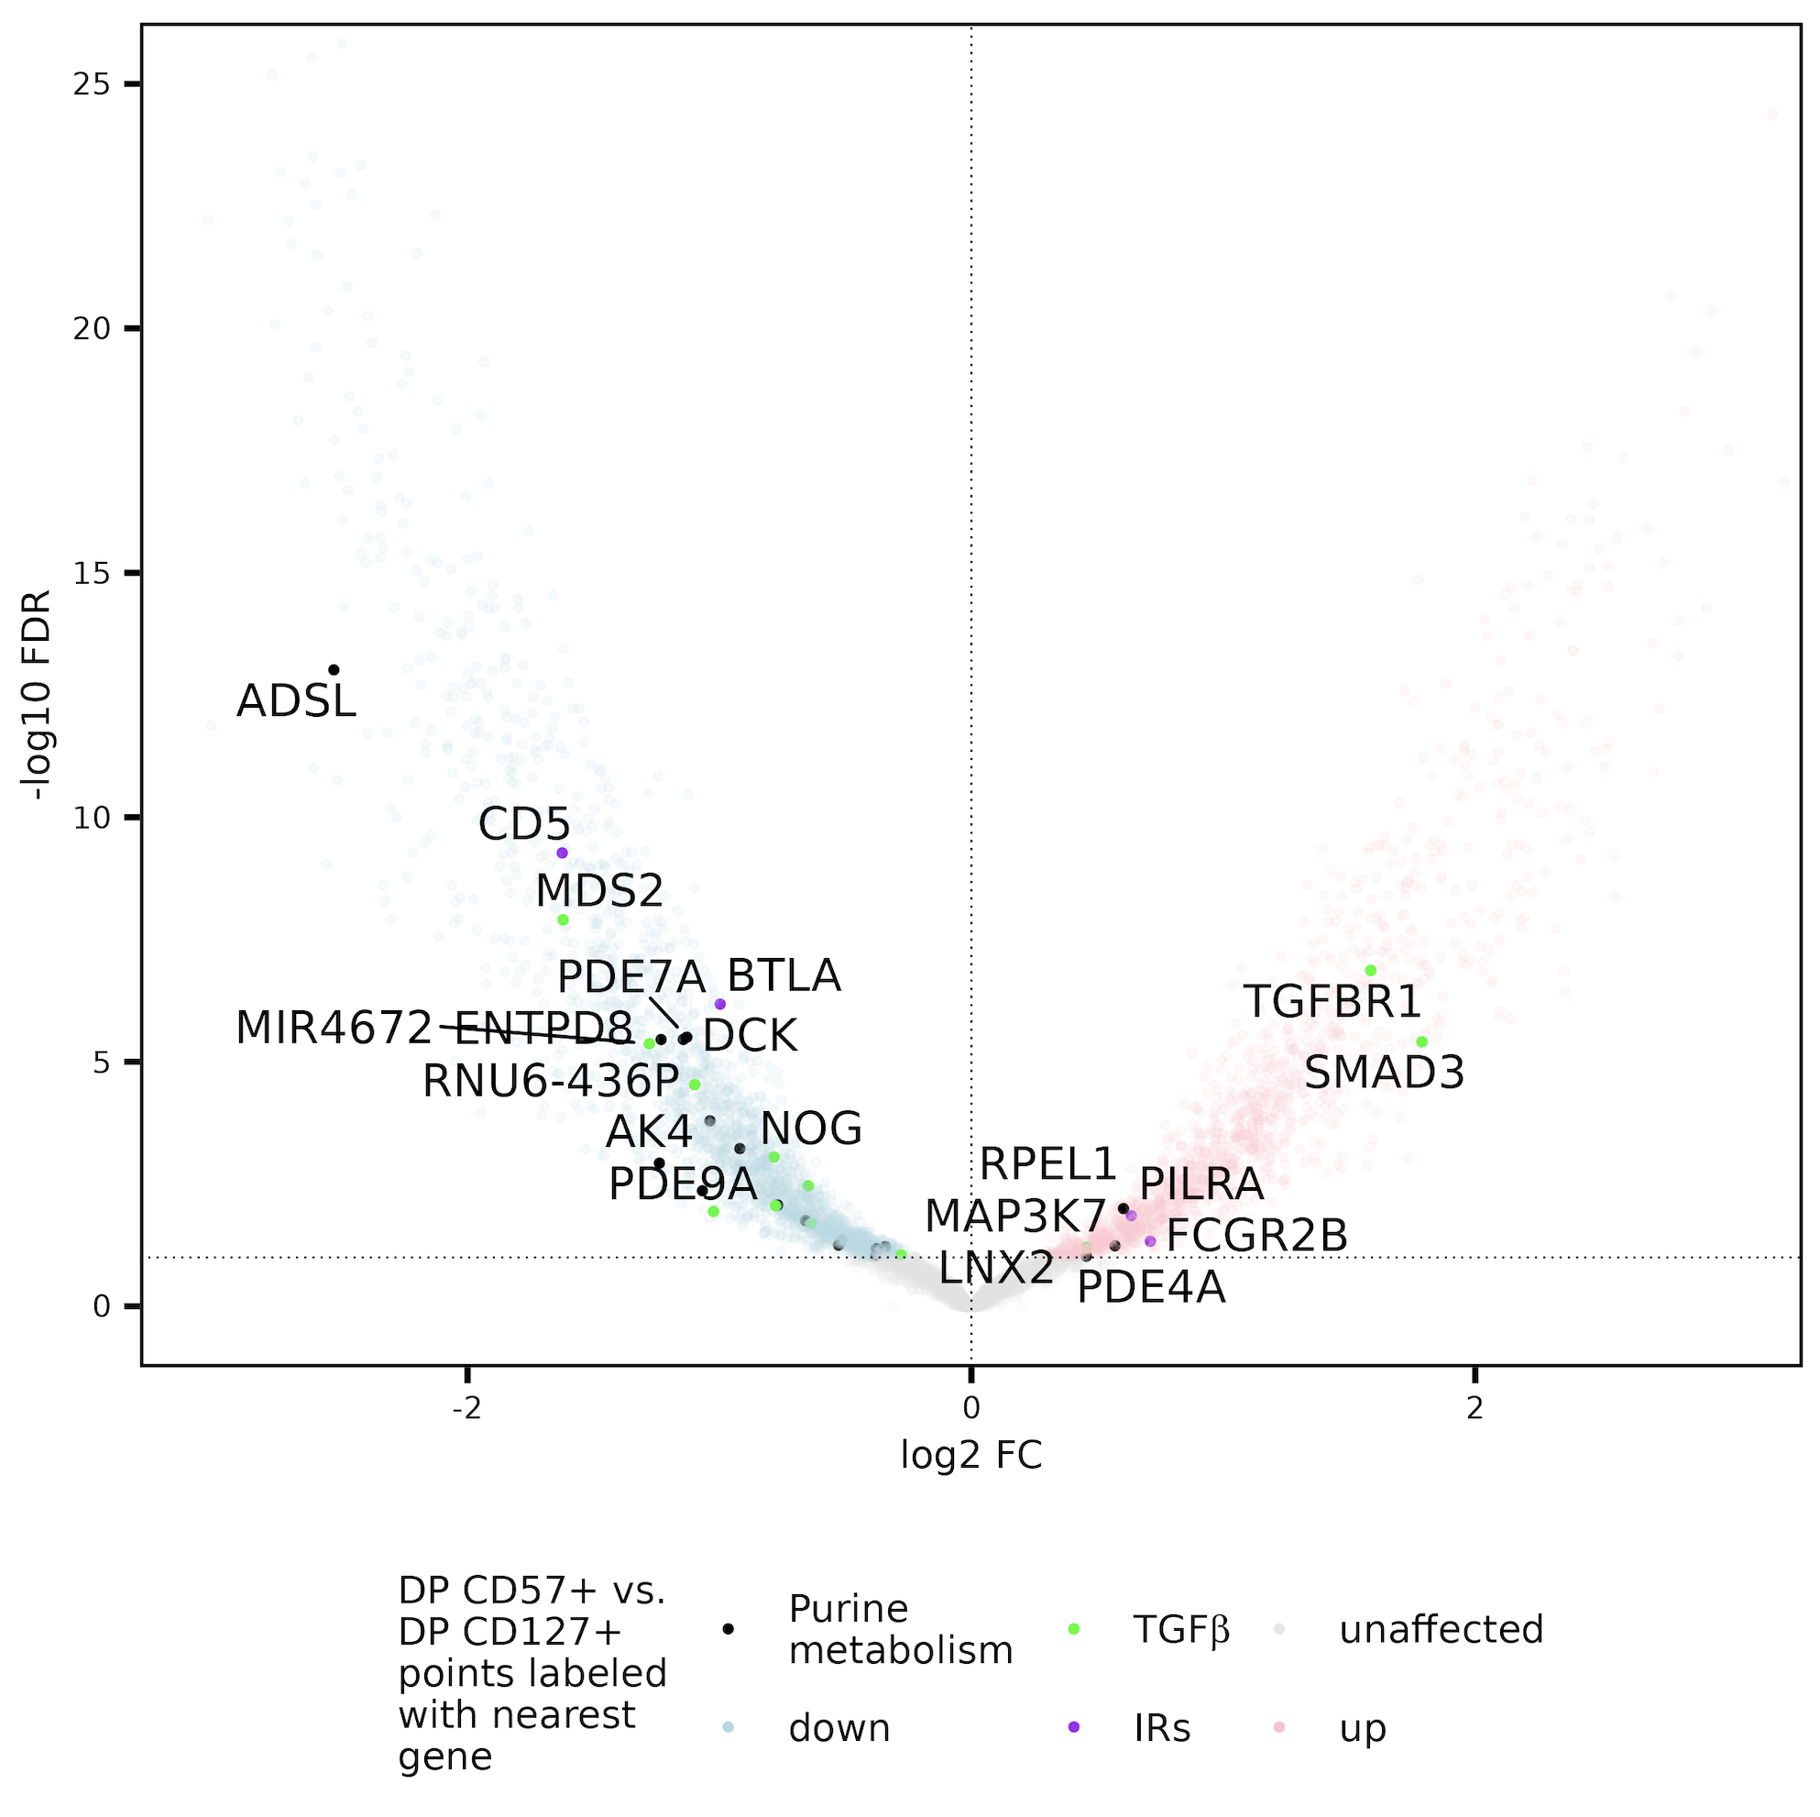
Purine metabolism peaks more accessible in DP CD127⁺ than both DP CD127⁻ CD8 sorts

Slide 35
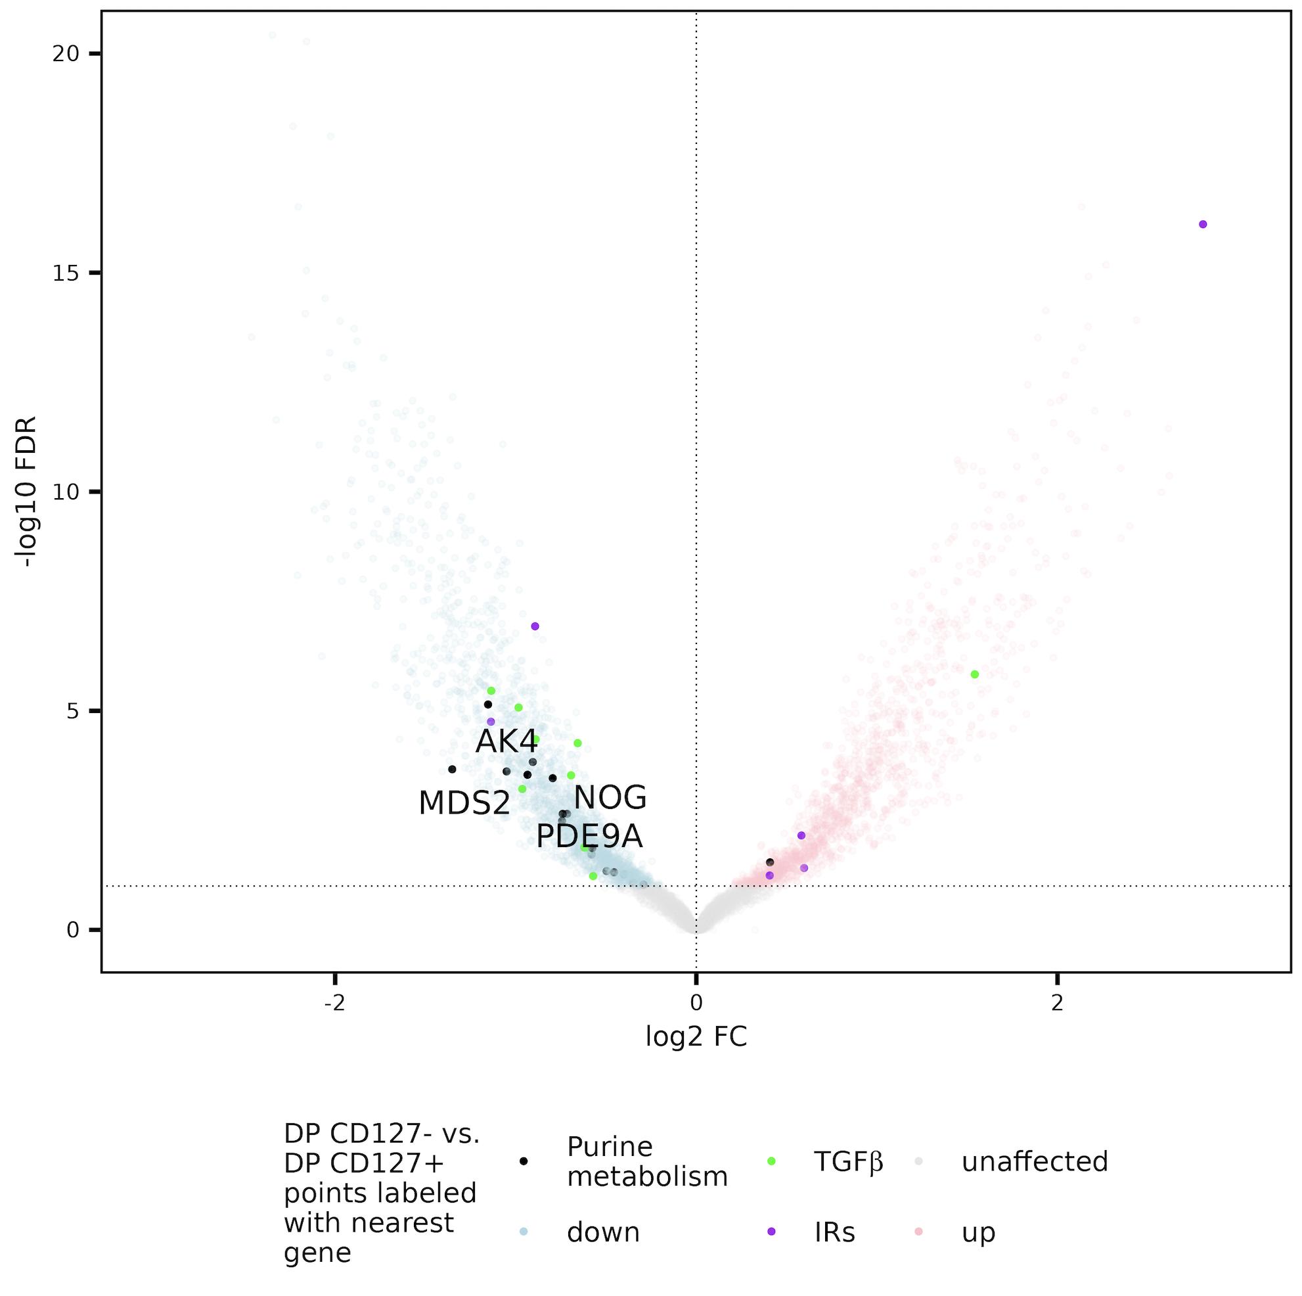
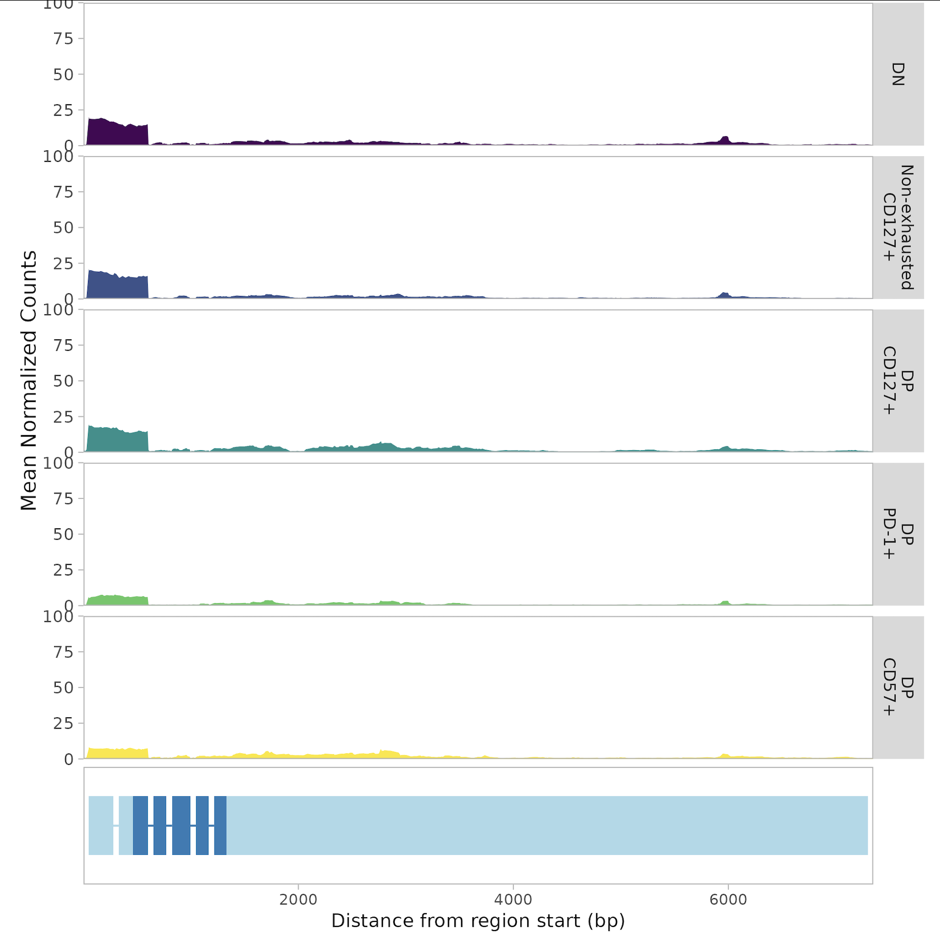
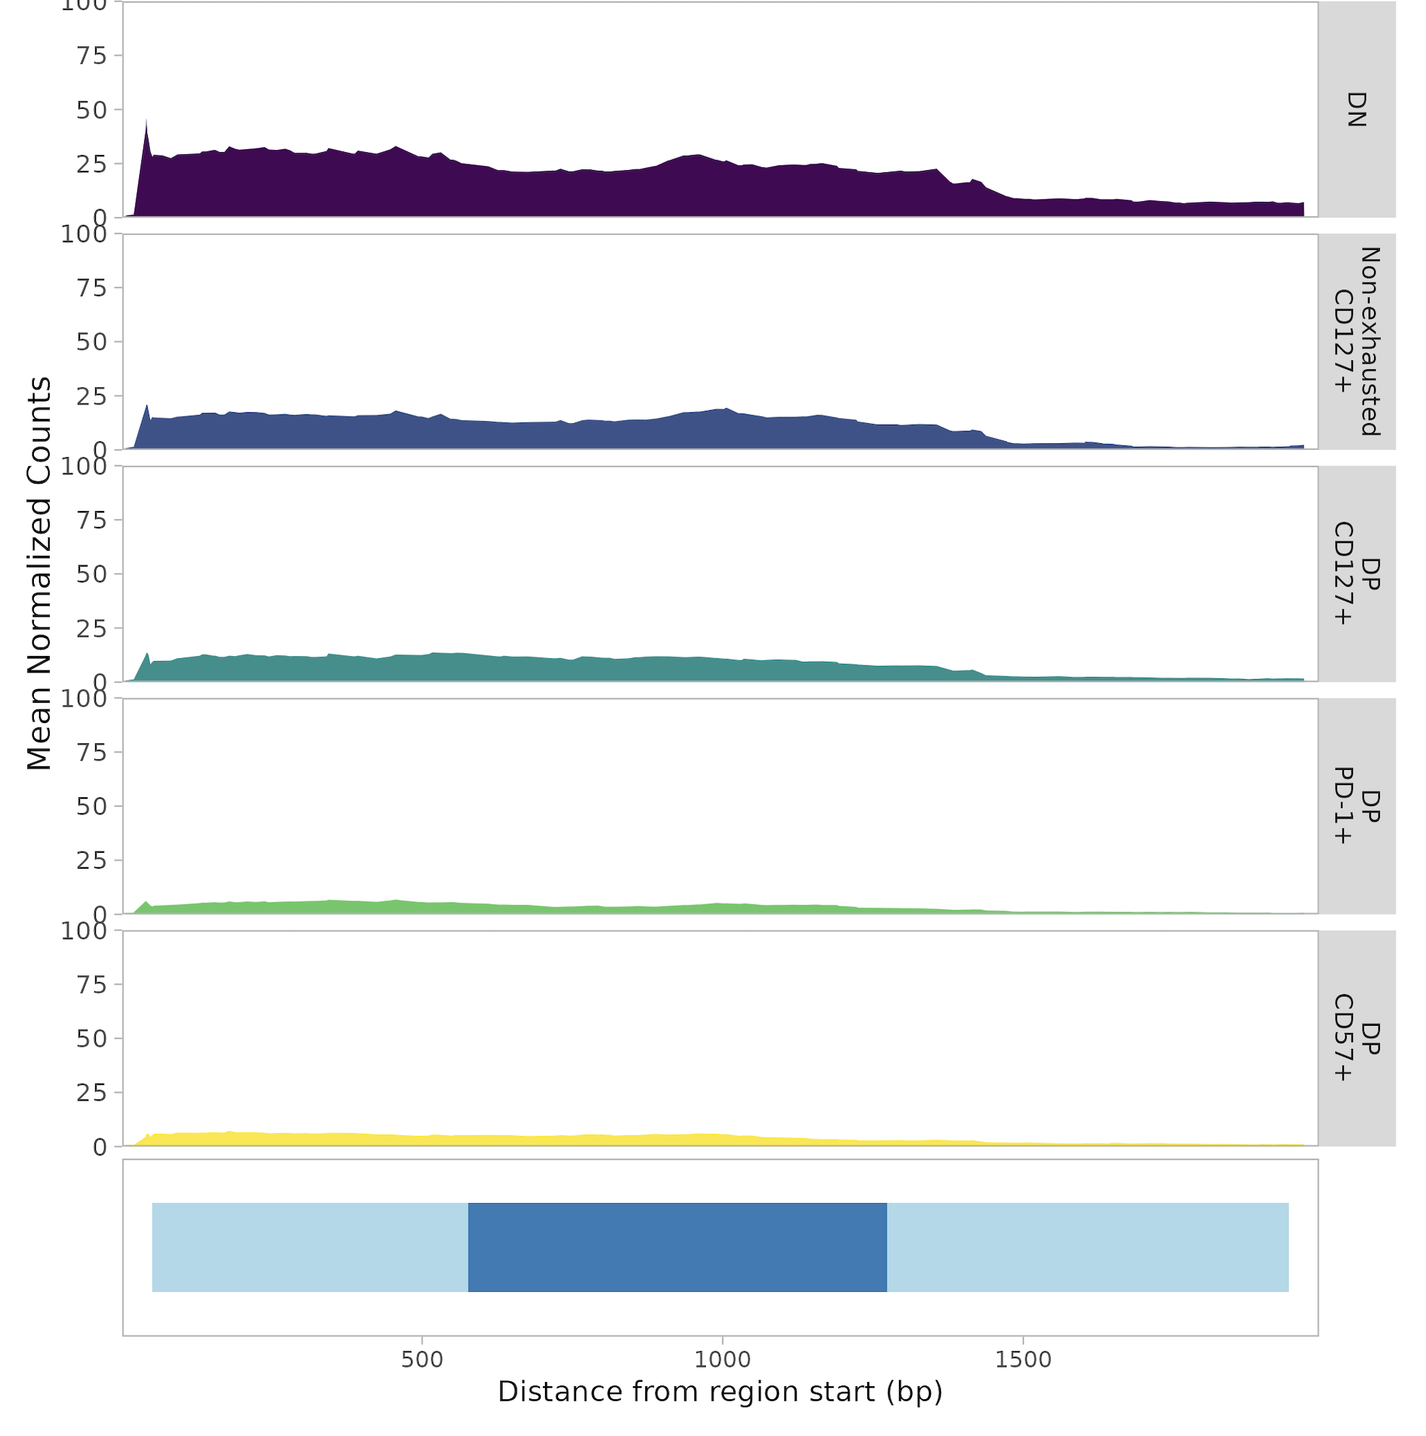
Some purine metabolism genes more accessible in DP CD127⁺ than DP CD127⁻ CD8s
AK4 gene
NOG gene
Up in DP CD127⁺
Up in DP CD127⁻
Notes:
Also (less dramatically): PDE9A, MDS2
PDE7A shows opposite trend (high in DP CD127-)

Slide 36
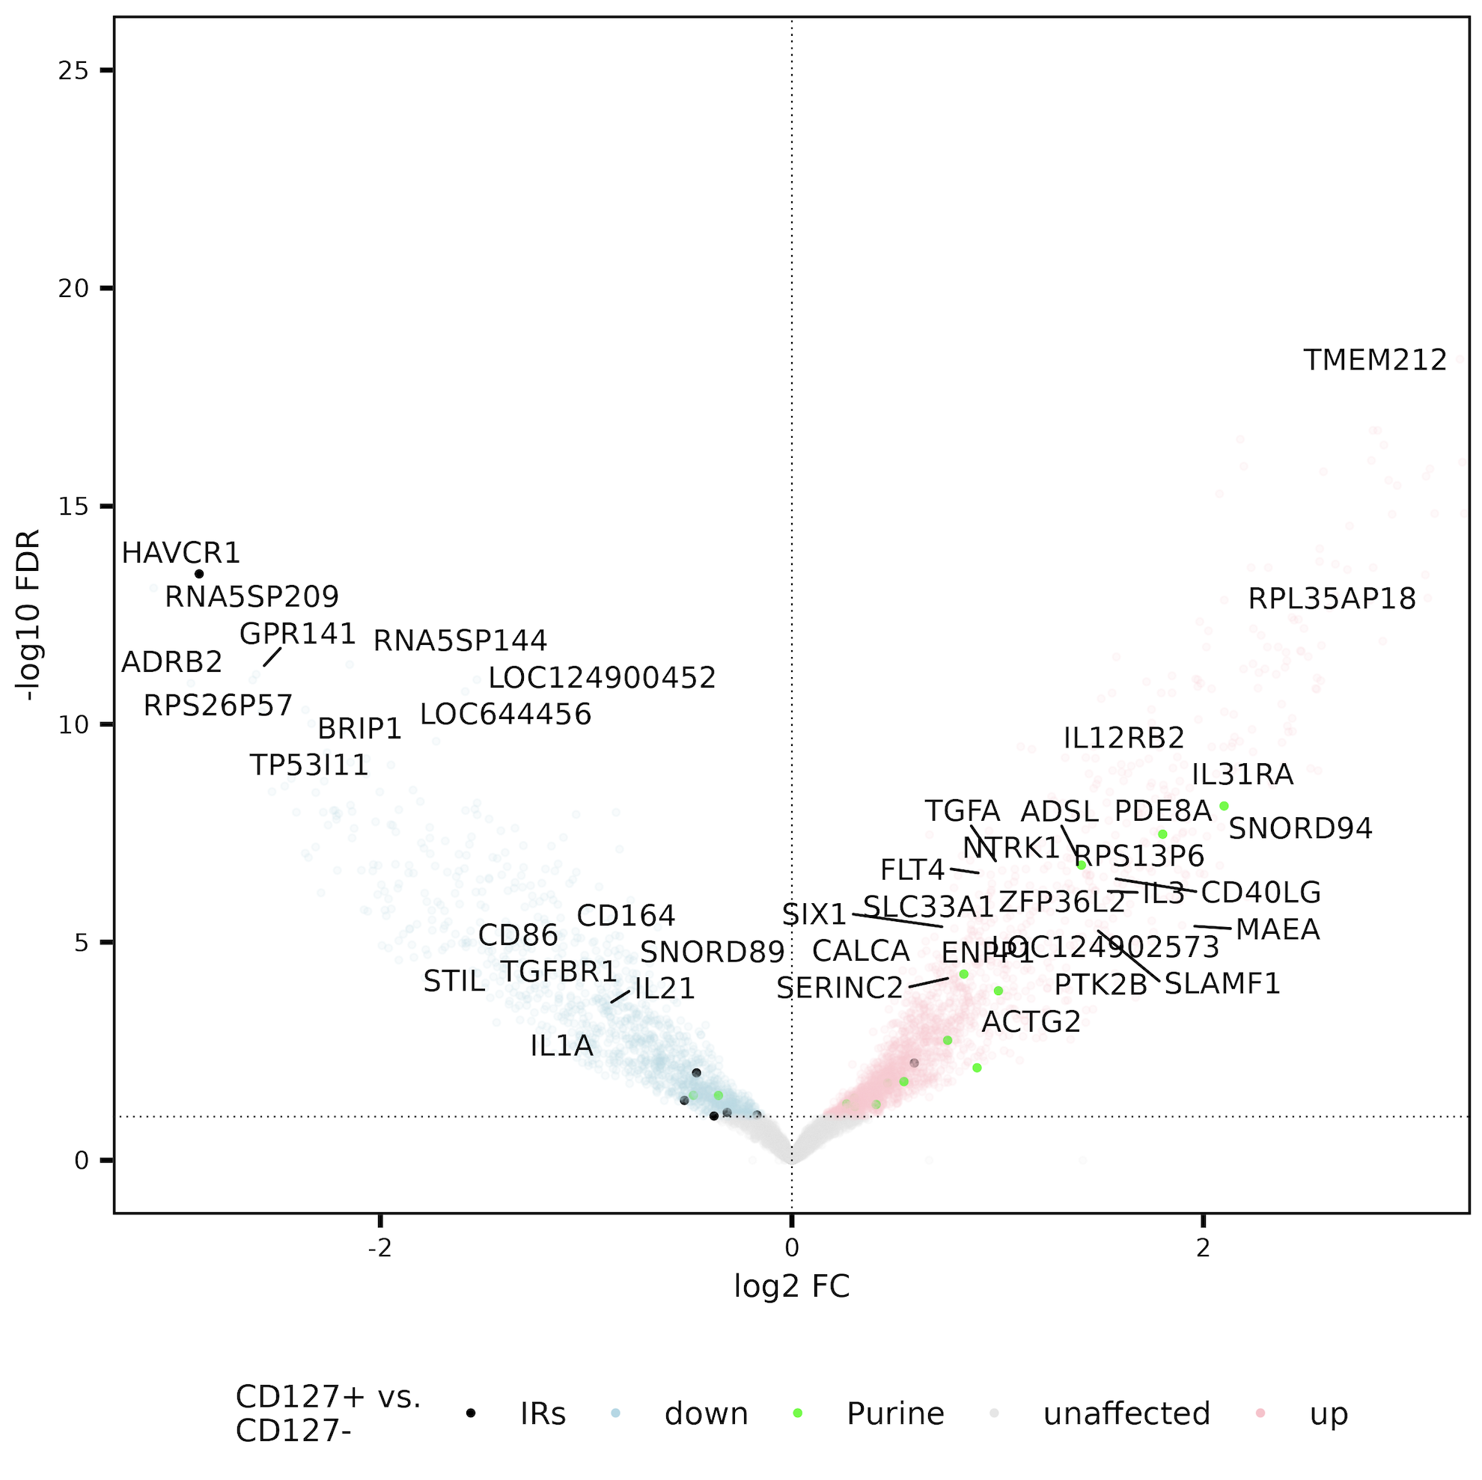
Purine metabolism gene set also up in CD127⁺ vs. CD127⁻

Slide 37
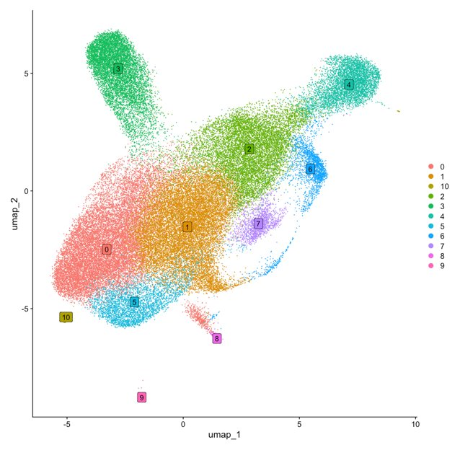
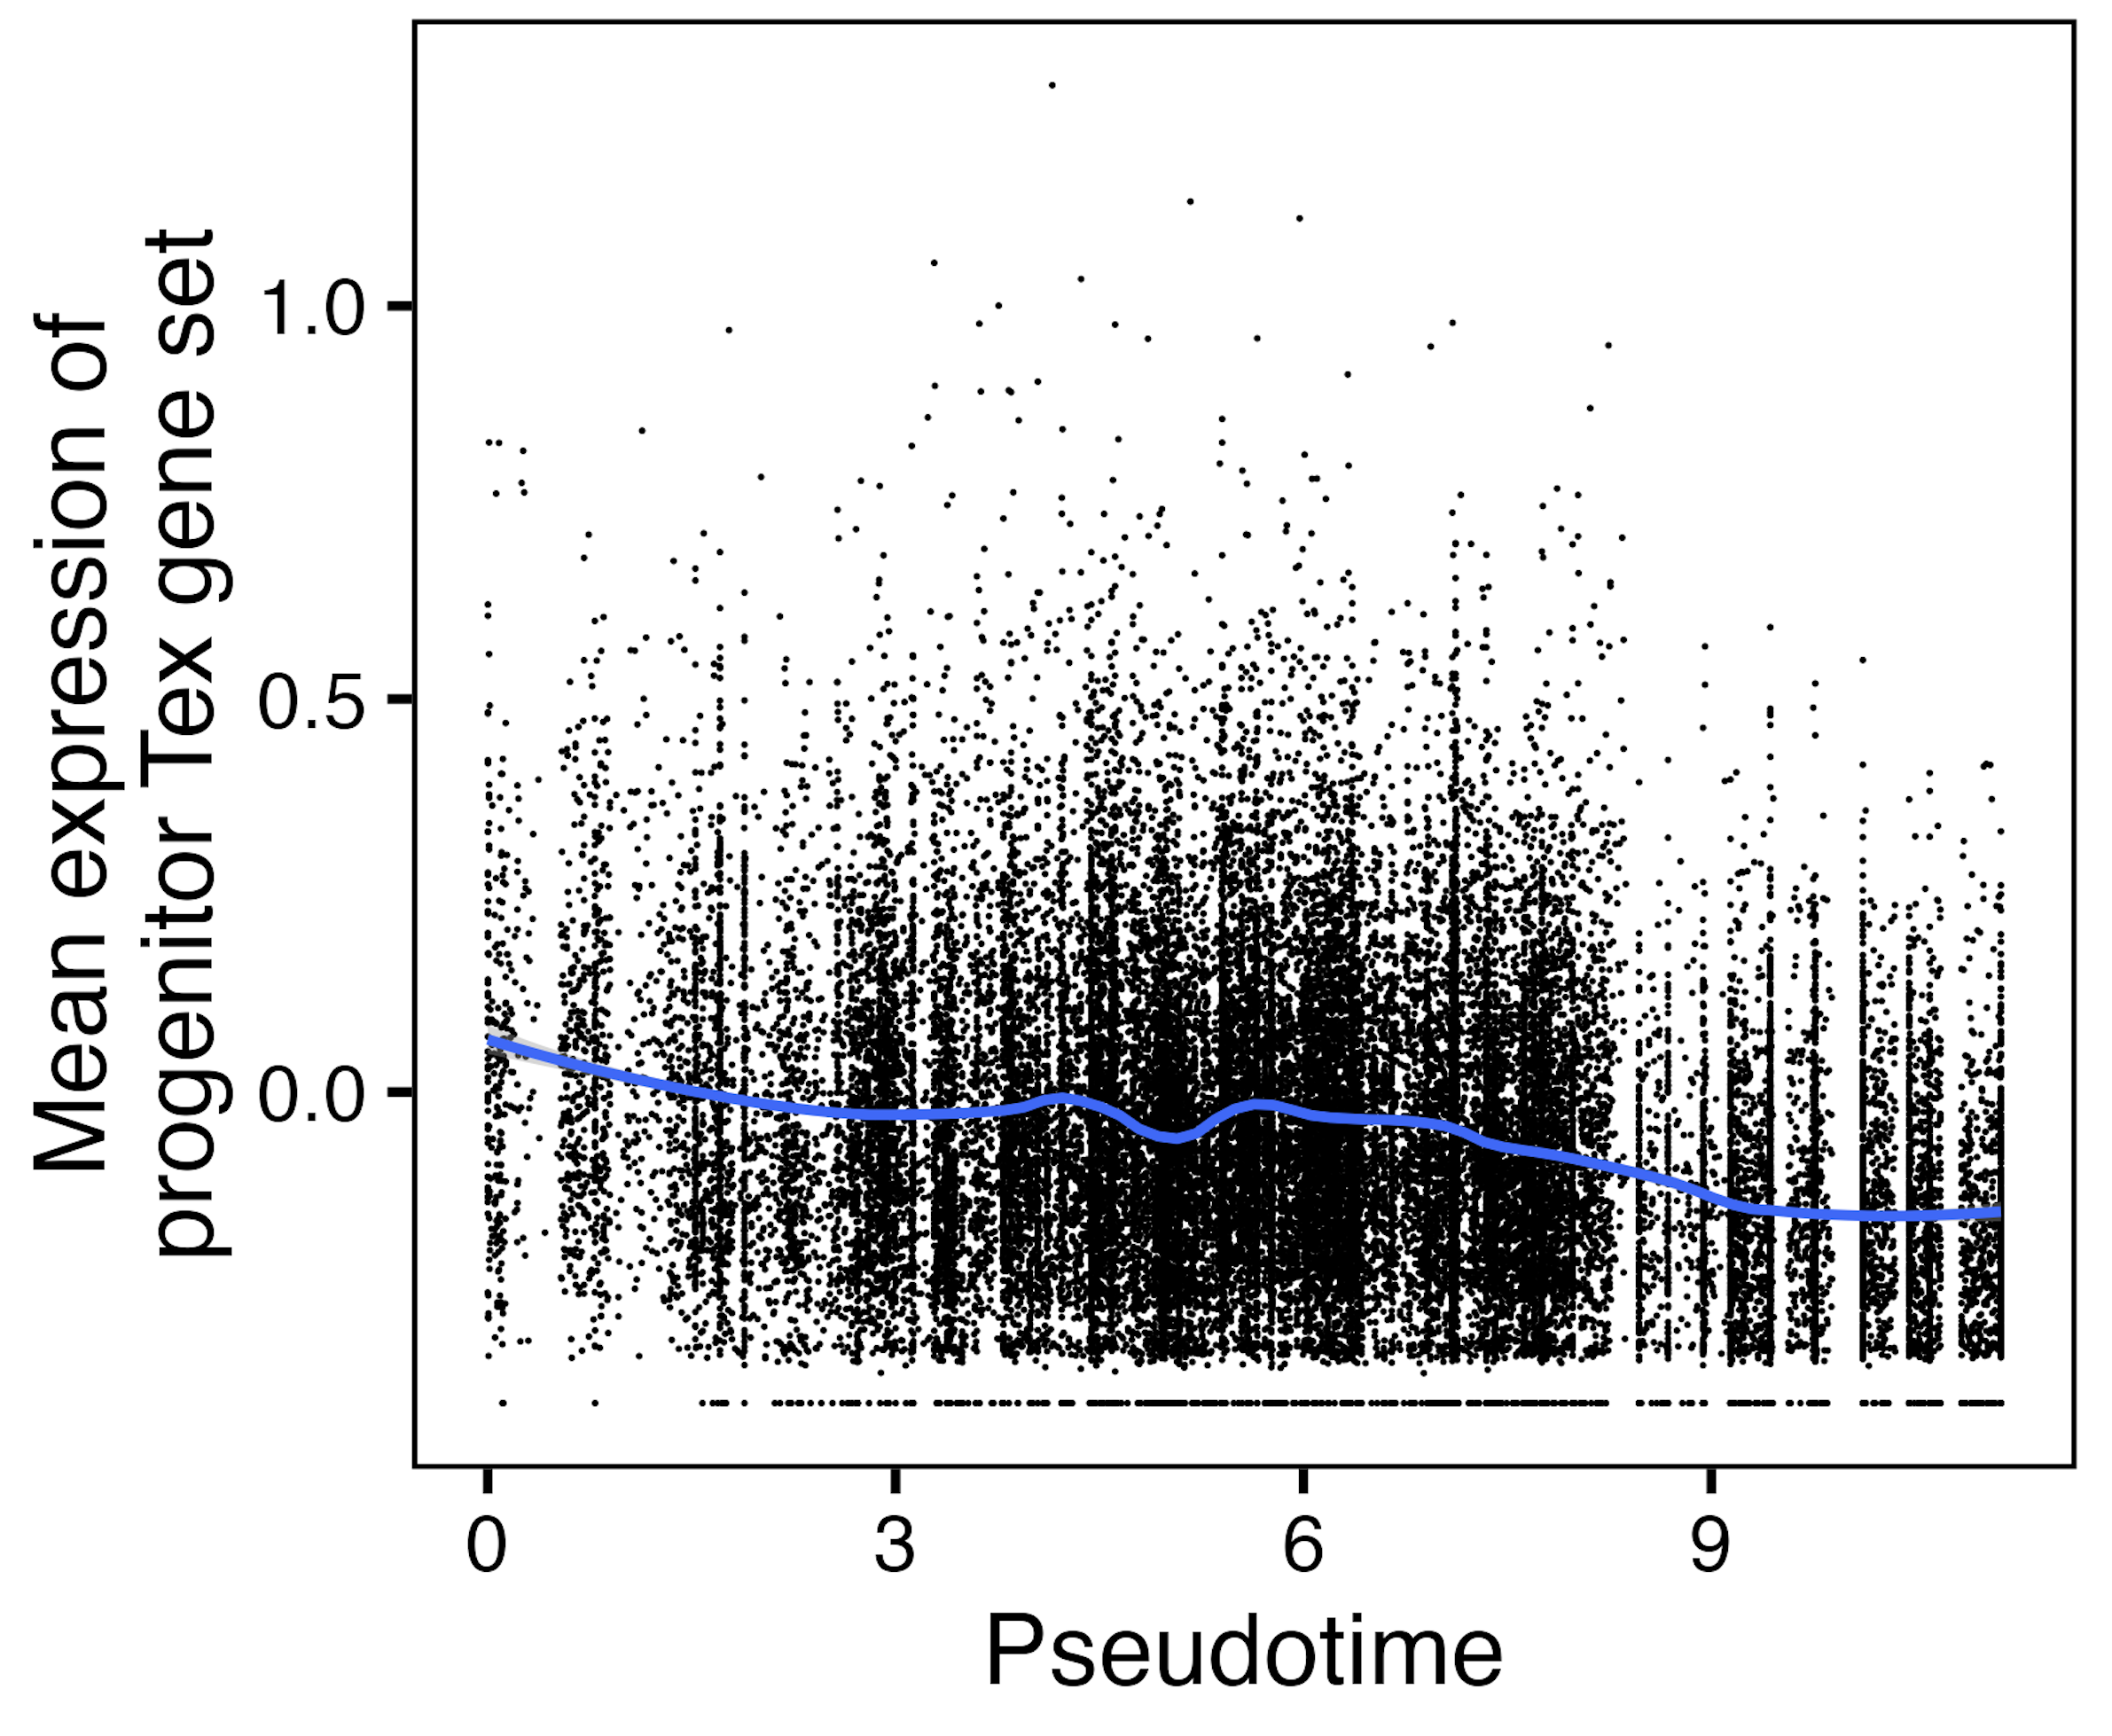
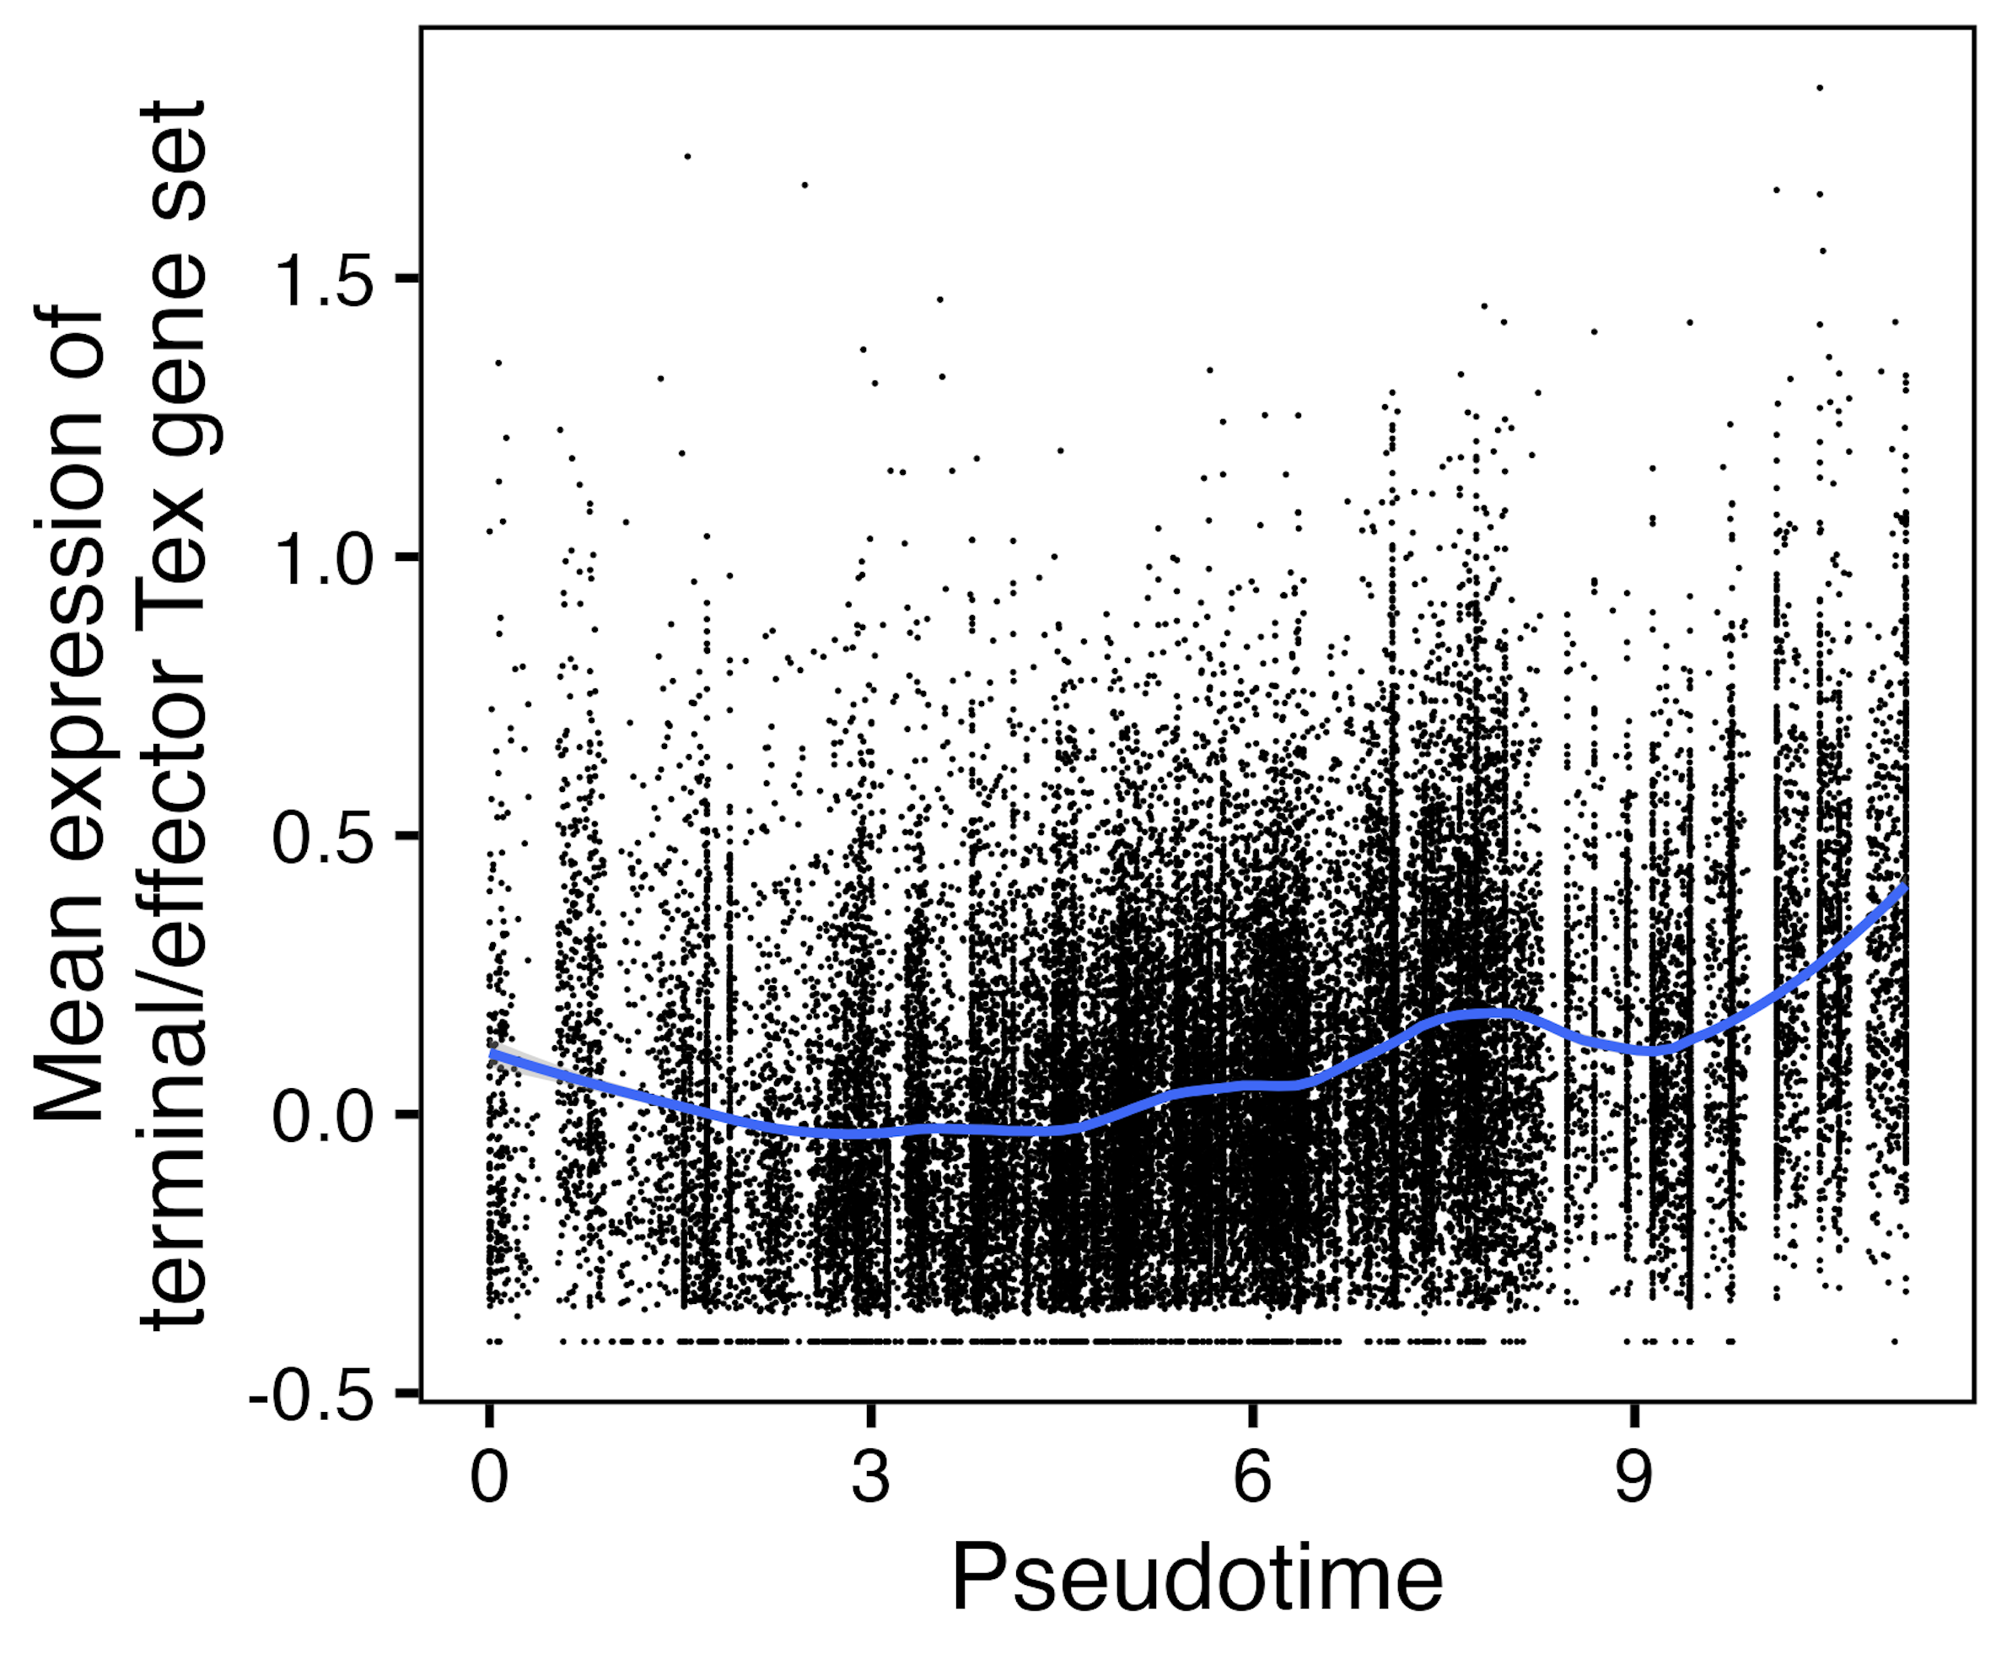
TN10 (clusters 0, 1, 5-7): over pseudotime, progenitor T_{ex} gene set expression decreases & terminal/effector T_{ex} gene set expression increases
Notes:
RNA expression
Z-score transformation (mean = 0, SD = 1) is applied to each gene's expression across all cells to get this scaled.data that I used for yvals here
Better ylab is Mean z score of genes in …?

Slide 38
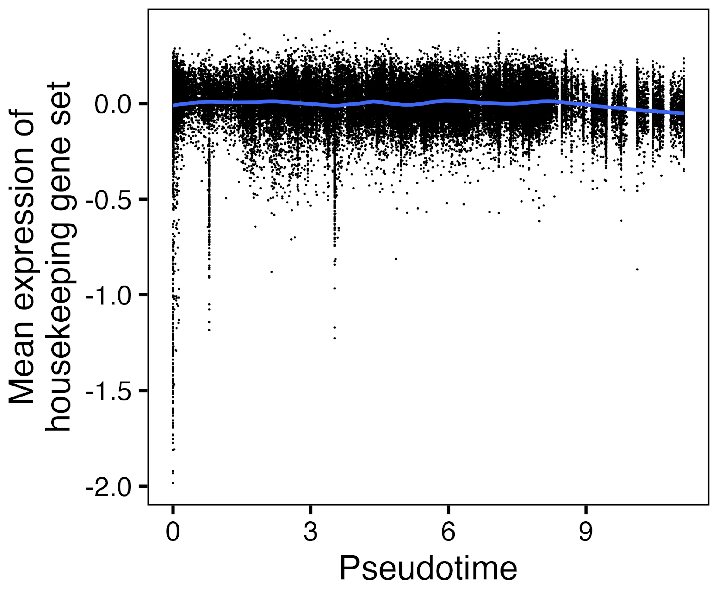
TN10 (all non-naive CD8s): comparison of housekeeping gene set, no change in mean expression over pseudotime
Notes:
RNA expression
Z-score transformation (mean = 0, SD = 1) is applied to each gene's expression across all cells to get this scaled.data that I used for yvals here
Better ylab is Mean z score of genes in …?

Slide 39
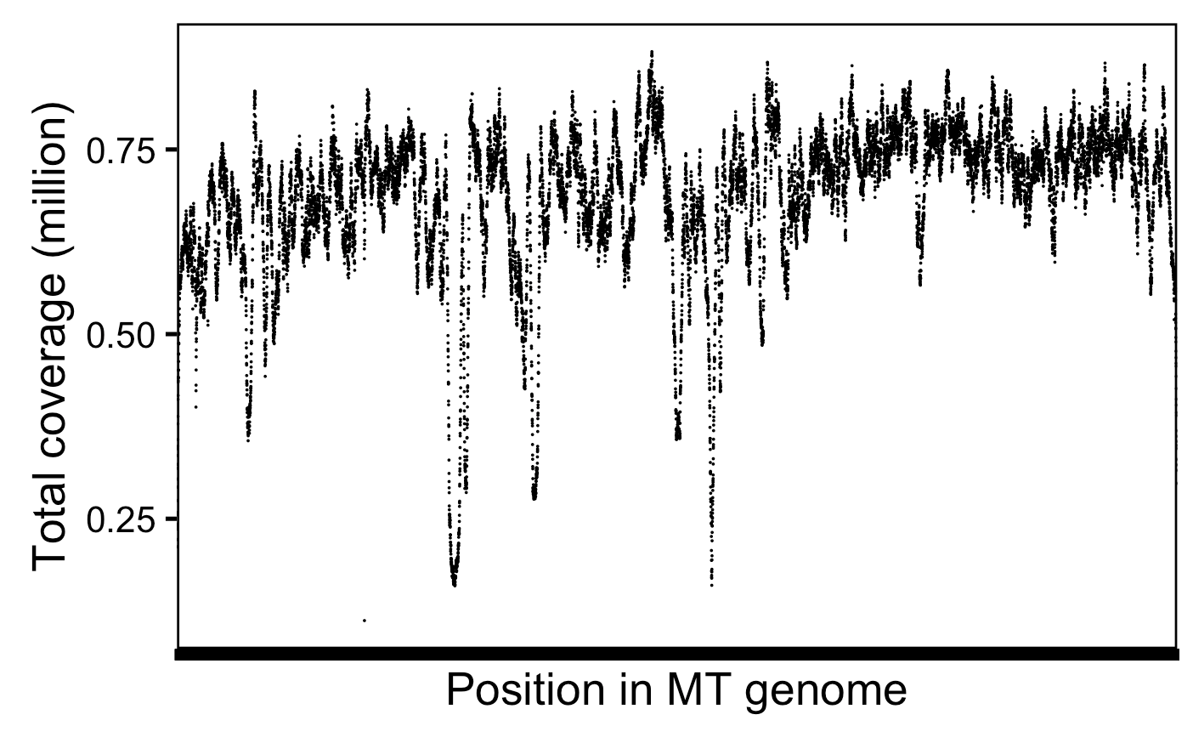
With reseq, cover MT genome to ~685k X depth
Notes:
# mean across positions and libs is 13,697 reads covering a specific position per lib, so that's 50*13,697 = ~685k X depth or coverage
Got the same # doing sum(combined_coverage_data$coverage) / 16569 (MT genome size)

